Slide 1
Resonance
Frequency
Damping
Response

Slide 2
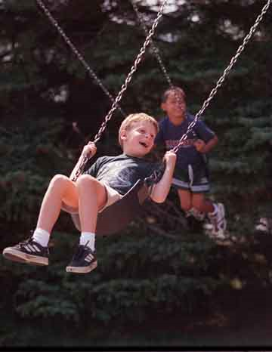

Slide 3
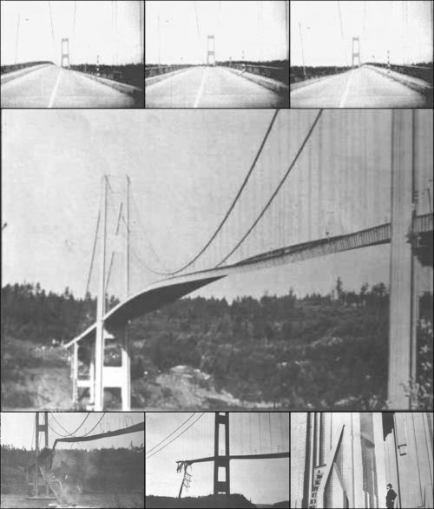
Tacoma Narrows Bridge (1940)
Nov 7, 1940
http://www.youtube.com/watch?v=3mclp9QmCGs

Slide 4
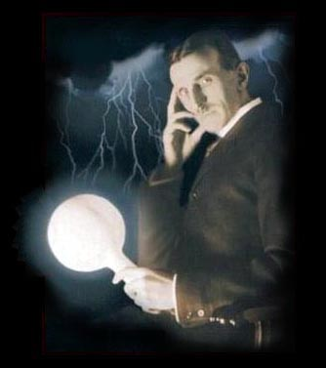
Tesla

Slide 5
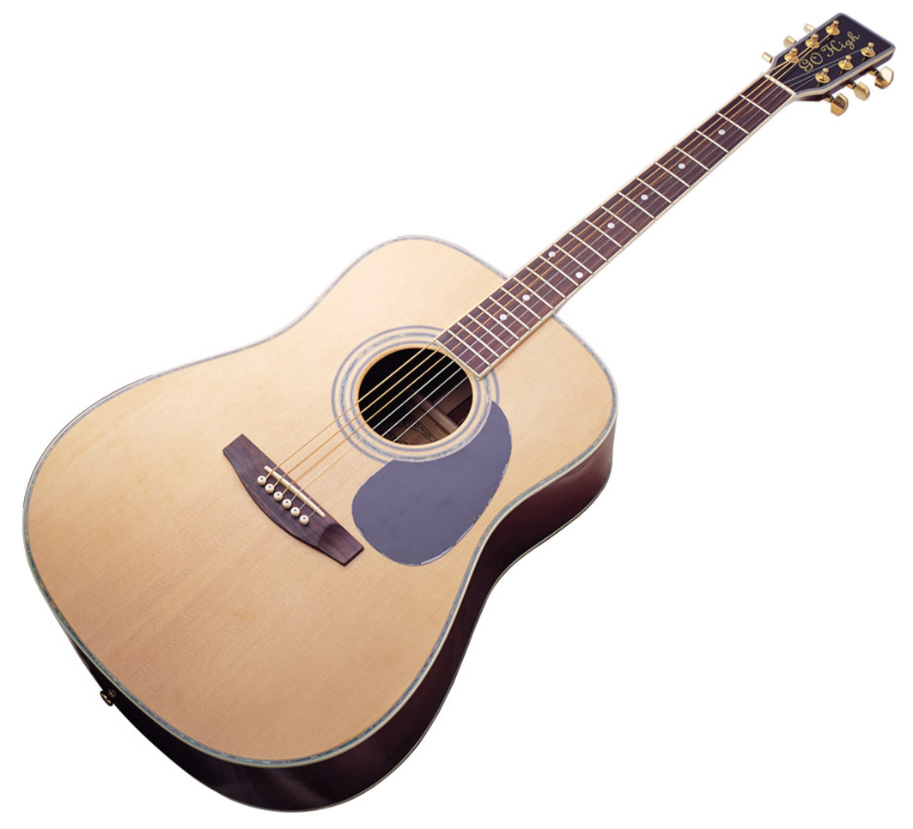
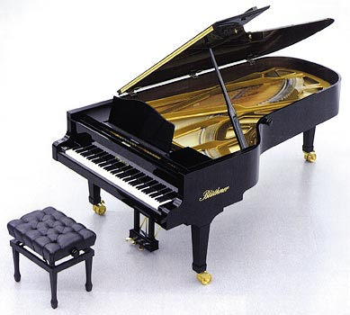

Slide 6
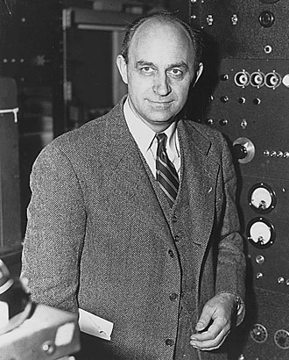
Enrico Fermi

