Slide 1
EECS 70A: Network Analysis
Announcements:
PSpice is installed in ECT 123 and EH 1131. (Not required but you may use for HWs if you like.)
Next quiz (#4) will be due Monday night
HW4 will be posted soon
Lecture 10

Slide 2
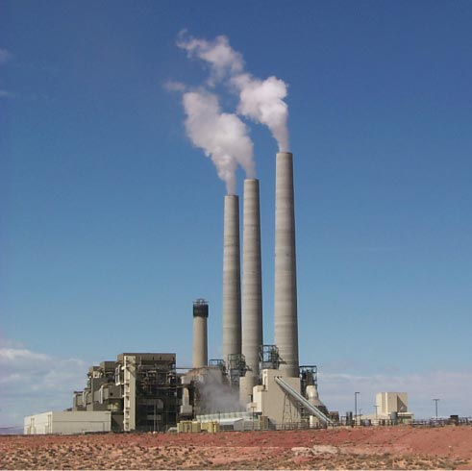
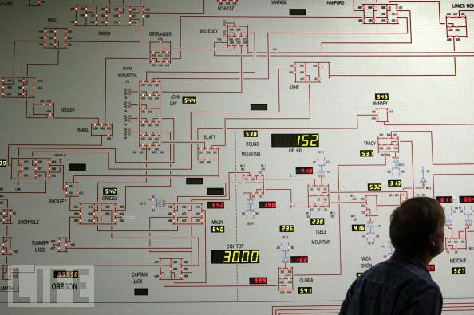
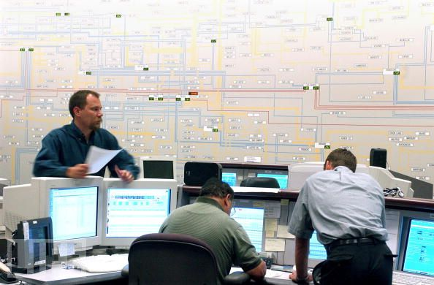
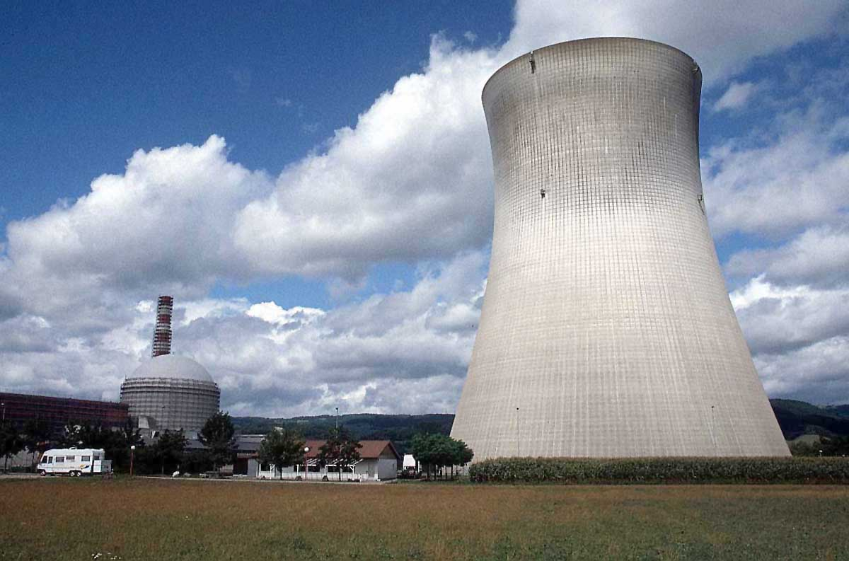
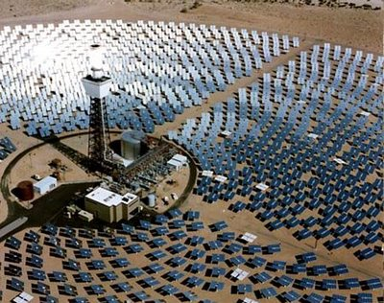

Slide 3
Capacitors
+q
-q
A=area
d=plate separation
Farads[F] = Coulombs/Volt [C]/[V]
+
-
V
C
Dielectric constant:
i
SiO₂
+
-
HfO₂
V

Slide 4
“High-K Dielectric”
http://www.intel.com/technology/45nm/hafnium.htm?iid=tech_45nm+body_animation_hafnium

Slide 5
Time dependence
q, V, i can depend on time !
Implicit:
Will not always write (t), but it is assumed from now on.

Slide 6
Example Capacitor Problem
Find V(t), q(t)
+
C
V
-

Slide 7
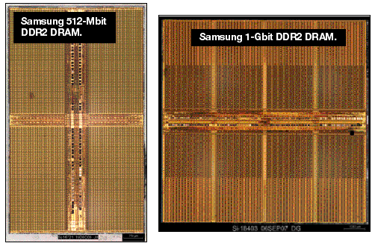
One-bit memory
Typical dimensions:
0.1 micron x 0.1 micron area
10 nm thickness.
What is C?
http://i.cmpnet.com/eet/news/07/11/DC1502_UTH_samsung.gif

Slide 8
1 Bit Read/Write
+
C
V
-

Slide 9
Example Problem #2
V
(Students): Find i(t), q(t)
t
+
C
V
-

Slide 10
RC circuit
Find V(t), q(t), i(t)
R
+
C
V
-

Slide 11
DRAM vs. SRAM

Slide 12
Example Capacitor Problem #2
Find V(t), q(t)
I(t)=I₀cos(ωt)
+
C
V
-

Slide 13
Parallel Capacitors
?
i₁
i₂
i₃
i_{N}
=
i
C₁
C₂
C₃
C_{N}
i
C_{equivalent}

Slide 14
Series Capacitors
C₁
C₂
C₃
C_{N}
?
+
-
+
-
+
-
+
-
=
V₁
V₂
V₃
V_{N}
+
V
+
V
C_{equivalent}
-
-

Slide 15
Example problem #4
(Students) Find V(t), given that V(t=0) = 5 Volts
1 kΩ
+
1 μF
2 μF
V
4 kΩ
3 μF
-

Slide 16
Inductors
L
i
A=area
l=wire length
N = # of turns
μ = 4 π 10⁻⁶ H/m
+
-
V
Henry[H]
V

Slide 17
Series Inductors
L₁
L₂
L₃
?
+
-
+
-
+
-
=
V₁
V₂
V₃
+
V
+
V
L_{equivalent}
-
-

Slide 18
Parallel Inductors
?
i₁
i₂
i₃
i_{N}
=
+
L₁
L₂
L₃
L_{N}
+
V
V
L_{equivalent}
-
-

Slide 19
Example Inductor Problem
(Students): Find V(t).
L₁
+
V
-

Slide 20
Example Inductor Problem #2
V
(Students): Find i(t)
t
L₁
+
V
-

Slide 21
Example Inductor Problem #3
Find V(t)
L
+
I(t)=I₀cos(ωt)
V
-

Slide 22
LR circuit
Find V(t), i(t)
R
L₁
+
V
-

Slide 23
Example LR problem
(Students) Find V(t), given that V(t=0) = 5 Volts
+
1 kΩ
4 kΩ
1 μH
2 μH
V
3 μH
-

Slide 24
Power
I
I x V_{ab} = power
a
Watts [W] = Volt Amp [V-A]
Note: MKSA unit system: Meters Kilogram Second Amp
b
Resistor:
Energy lost to heat…
Inductor or capacitor:
Energy STORED and can be recovered…

Slide 25
Energy stored
I
I x V_{ab} = power
a
Energy:
b
Capacitor stored energy:
Inductor stored energy:

Slide 26
Symbol library
I_{ab}
I=5 A
a
+
+
a
+
a
-
b
b
-
-
b

Slide 27
Symbol library
+
+
2
-
-
+
C
-
i
+
-
V
i₇
i₇
i₇
2 Ω
3 V
3 A
3 i₁
2 i₁
+
+
-
-

