Slide 1
EECS 70A: Network Analysis
Announcements:
Final HW due Friday of 10th week
Professor Burke’s office hours this week: Tu 9:30-11:30 (EH 2230) Th 9:30-11 (EG 2232) Th 2-3:30 (EH 2230)
Exam will cover all of Ch. 9 (not delta-Y), and part of Ch. 14 (14.1 14.2 14.3 14.5 14.6 14.7)
Lecture 15

Slide 2
Conversion procedures
i(t)
I
I =
v(t)
V
V =
I
i(t)
I
V
v(t)
V
For the exam, you should know how to carry out these procedures.

Slide 3
Conversion procedures
Given i(t) find v(t):
i(t)
i(t)
I
V = I Z_{eq}
v(t)
+
Z_{eq}
v(t)
Given v(t) find i(t):
-
v(t)
V
I = V/ Z_{eq}
i(t)
For the exam, you should know how to carry out these procedures.

Slide 4
Complex numbers
Euler’s relationship:
Memorize
Need to be able to manipulate complex numbers, e.g. given:
(A,B,C,D all real)
Find Re(u), Im(u)
Express u as x+jy, re^{iφ}
Find Re(u re^{jωt})
Did some of this in office hours..

Slide 5
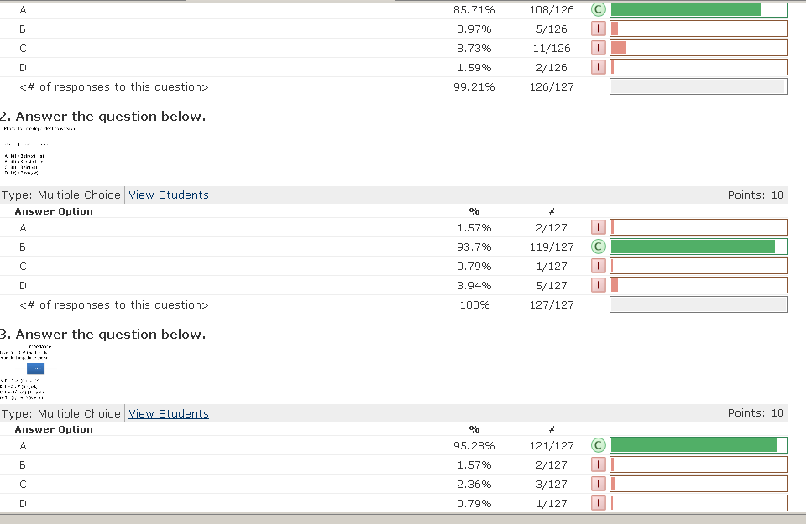
Quiz #6 Results

Slide 6
“Transfer Function”
Linear network
Input
Output

Slide 7
Significance of H(ω)

Slide 8
RC transfer function
R
INPUT:
V(t)=V₀ cos(ωt)
a
+
OUTPUT:
V_{ab}(t)
C
-
b

Slide 9
Magnitude of H

Slide 10
Example problem
Find H(ω) for this circuit, then sketch the magnitude of H(ω) vs ω: (students)
+
R
V_{in}
+
L
V_{out}
-
-

Slide 11
Band pass filter (RLC)
+
C
V₁
-
INPUT:
V(t)=V₀ cos(ωt)
a
+
+
OUTPUT:
V_{ab}(t)
V₂
R
-
-
b

Slide 14
http://www.peachparts.com/shopforum/showthread.php?t=256624

Slide 15
Resonance

Slide 17
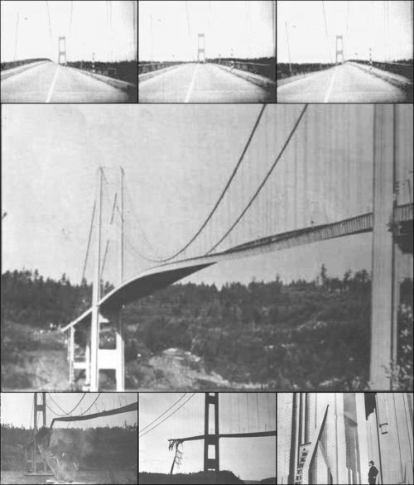
Tacoma Narrows Bridge (1940)
Nov 7, 1940
http://www.youtube.com/watch?v=3mclp9QmCGs

Slide 18
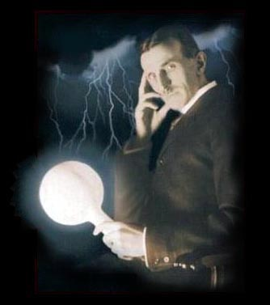
Tesla

