Slide 1
EECS 70A: Network Analysis
Announcements:
Next quiz will be due on Monday next week
Next HW will be due on Wednesday next week
Graded midterms are being scanned today; available for pickup Wednesday from TAs
Lecture 7

Slide 2
Today’s Agenda
TLTC Midterm Student Feedback Survey
Midterm 1 results
Review of Nodal Analysis
Review of Mesh Analysis
Example problems using both techniques
Thevinin/Norton theorem

Slide 3
TLTC Midterm Feedback Survey
The good:
Recorded lectures
online notes/tablet pc
To improve:
Need more complex examples in class
To drop:
Demos

Slide 4
Midterm results
Detailed solutions posted online. Please make sure you understand them!

Slide 5
Nodal analysis summary
Define reference node
Label remaining nodes (e.g. V₁, V₂, V₃, …)
Apply KCL + Ohm’s law
Solve for nodal voltages (e.g. using Kramer’s rule)
Solve for currents

Slide 6
Nodal analysis example
Define a reference node.
Label remaining nodes.
Apply KCL + ohm.
i₁
i₂
R₁
R₂
i₃
i₄
i₅
R₃
R₄
R₅
i₆
i₇
3 A
R₆
R₇
i₈
i₉
i₁₀
R₈
R₉
R₁₀
R₁₁
R₁₂
i₁₁
i₁₂
Typical notation:
i₁ is current through R₁. (Same as before)
V₁ is voltage of node 1 relative to
reference node. (Different from before)
We will do this entire problem in class…
Using these techniques, you can attempt the “monster problem” as extra credit on HW3…

Slide 12
Mesh analysis summary
Assign mesh currents i₁, i₂, … i_{n}
Apply KVL to each mesh
Solve for mesh currents (e.g. using Kramer’s rule)
Then solve for voltages

Slide 13
Assigning mesh currents
R₁
R₂
V₁
+
R₃
+
V₂
-
-

Slide 14
Nodal vs. mesh analysis?
i₁
i₂
i₃
i₄
2 A
7 Ω
2 Ω
5 Ω
5 A
3 Ω

Slide 15
Nodal analysis example
i₁
i₂
i₃
i₄
2 A
7 Ω
2 Ω
5 Ω
5 A
3 Ω

Slide 16
Nodal vs. Mesh Analysis
2 Ω
5 Ω
6 V
3 Ω
4 V
+
+
-
-
4 Ω
1 Ω
1 Ω
1 Ω
+
+
-
-
2 V
3 V

Slide 17
Nodal vs. Mesh Analysis
2 Ω
5 Ω
6 V
3 Ω
4 V
+
+
-
-
4 Ω
1 Ω
1 Ω
1 Ω
+
+
-
-
2 V
3 V

Slide 18
3 V
(Monster HW problem)
+
3 A
7 Ω
7 Ω
7 Ω
-
i₁
2 Ω
3 i₁
3 A
2 i₁
7 Ω
7 Ω
+
-
3 V
3 V
3 V
3 Ω
5 Ω
+
+
+
-
-
-
2 Ω
5 Ω
7 Ω
7 Ω
3 A
3 A
3 Ω
3 A
3 V
7 Ω
7 Ω
+
-
2 Ω
5 Ω
7 Ω
7 Ω
7 Ω
7 Ω
3 i₁
3 A
7 Ω
7 Ω
7 Ω
+
-
2 Ω
5 Ω
7 Ω
7 Ω
7 Ω
7 Ω
7 Ω
3 A
3 A
7 Ω
7 Ω

Slide 19
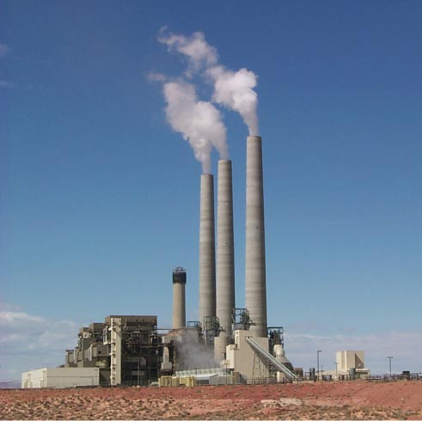
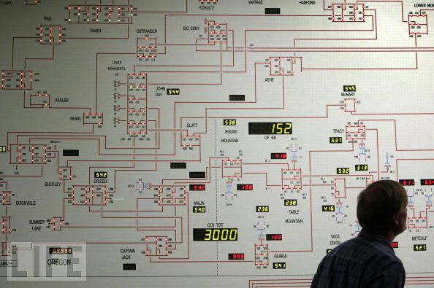
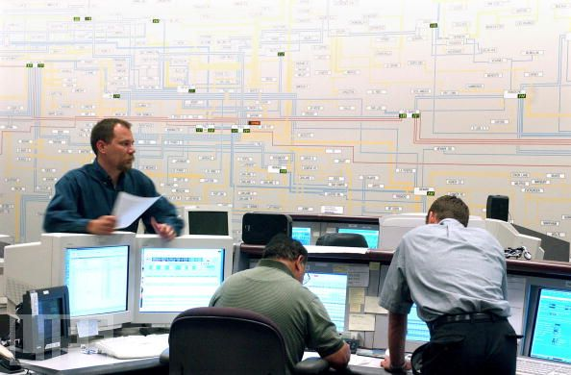
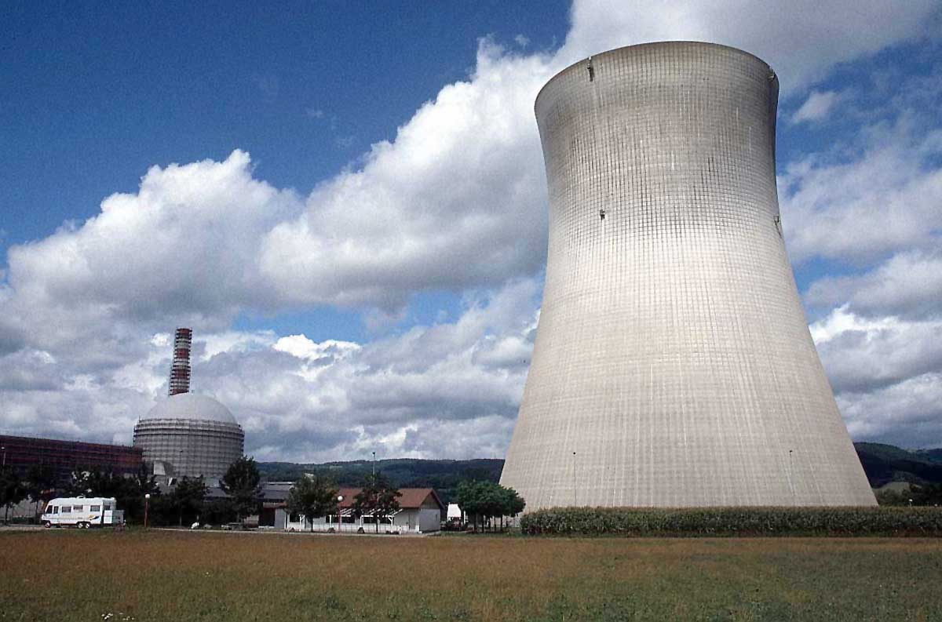
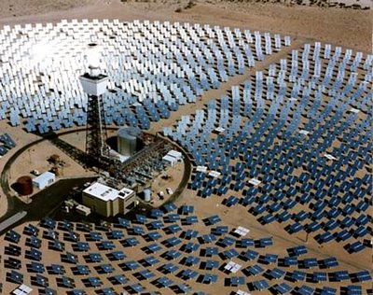

Slide 20
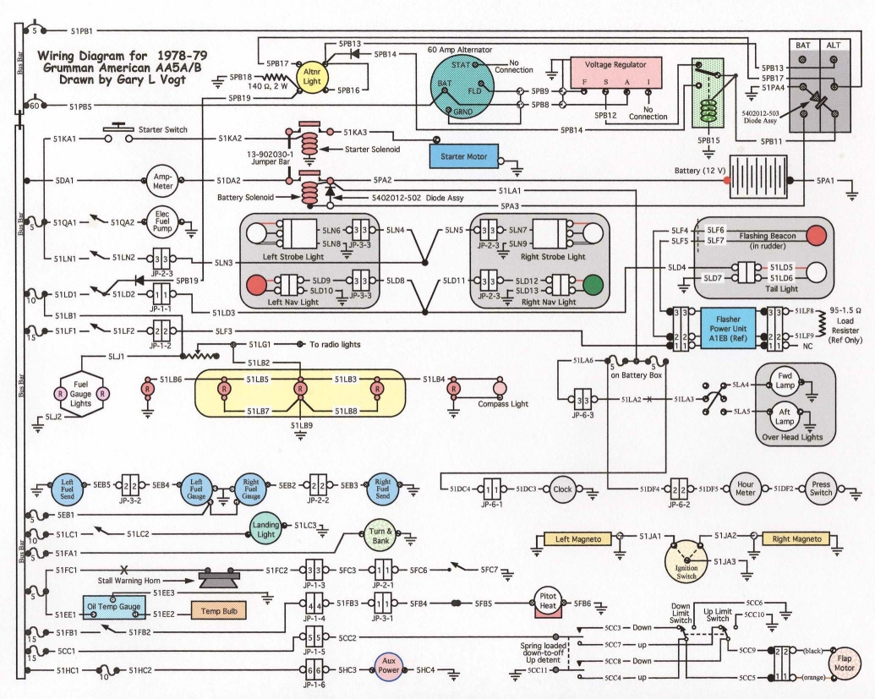

Slide 21
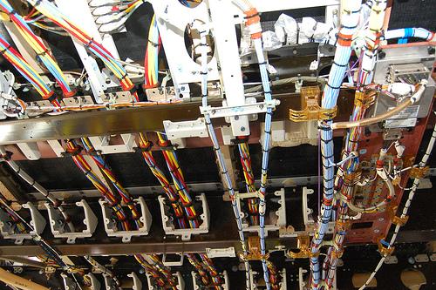

Slide 22
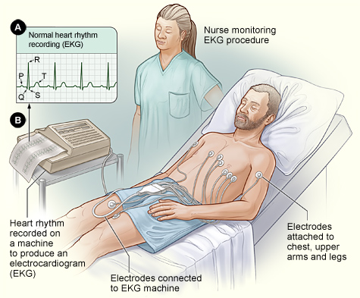
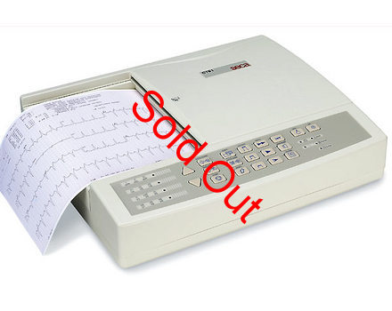

Slide 23
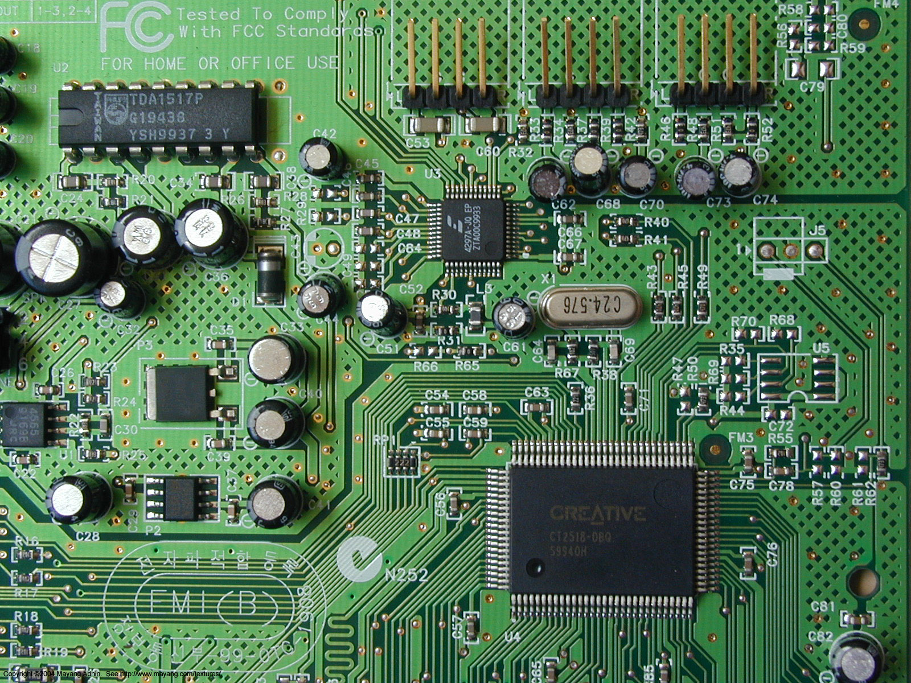
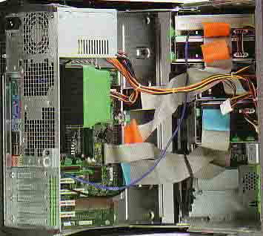
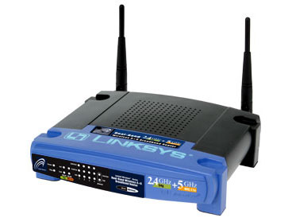

Slide 24
Compartmentalization: Need for simplicity
Power brick image.
And ask class to show their own…
Demo: Computer?

Slide 25
Thevenin’s Theorem
I
Linear two-terminal circuit
Load
a
+
-
b
Equivalent to:
R_{th}
Load
a
V_{th}
+
+
-
-
b

Slide 26
Finding V_{th}, R_{th}
Linear two-terminal circuit
a
+
-
b
Equivalent to:
R_{th}
a
V_{th}
+
+
-
-
b

Slide 27
Source/load
R_{source}
V_{source}
+
R_{load}
-
Derivation:
Case 1:
Thevenin Thm:
Any circuit can be
represented by this
equivalent circuit.
Case 2:
We say R_{load} “loads down” the source.

Slide 28
Source/load
R_{source}
V_{source}
+
R_{load}
-
Derivation:
Case 1:
Thevenin Thm:
Any circuit can be
represented by this
equivalent circuit.
Case 2:
We say R_{load} “loads down” the source.

Slide 29
Example
Find Thevenin equivalent circuit:
R₁
V₁
+
-
R₂

Slide 30
Norton’s Theorem
I
Linear two-terminal circuit
Load
a
+
-
b
Equivalent to:
Load
a
I_{N}
R_{N}
+
-
b

Slide 31
Finding V_{th}, R_{th}
Linear two-terminal circuit
a
+
-
b
Equivalent to:
Equivalent to:
R_{th}
a
a
V_{th}
+
+
+
I_{N}
R_{N}
-
-
-
b
b

Slide 32
Example
Find the Thevenin & Norton equivalent circuit of the circuit below with respect to terminals a and b:
12 Ω
a
+
+
30 V
60 Ω
2 V_{x}
+
V_{x}
-
-
-
b

Slide 33
3 V
(Monster HW problem: Part 2):Find the Thevenin & Norton equivalent circuit of the circuit below with respect to terminals a and b:
+
3 A
7 Ω
7 Ω
7 Ω
-
a
i₁
+
2 Ω
3 i₁
3 A
2 i₁
7 Ω
7 Ω
+
-
3 V
3 V
3 V
3 Ω
5 Ω
+
+
+
-
-
-
-
b
2 Ω
5 Ω
7 Ω
7 Ω
3 A
3 A
3 Ω
3 A
3 V
7 Ω
7 Ω
+
-
2 Ω
5 Ω
7 Ω
7 Ω
7 Ω
7 Ω
3 i₁
3 A
7 Ω
7 Ω
7 Ω
+
-
2 Ω
5 Ω
7 Ω
7 Ω
7 Ω
7 Ω
7 Ω
3 A
3 A
7 Ω
7 Ω

Slide 34
Power
R_{th}
a
Arrow means R_{L} variable (e.g. by a knob)
V_{th}
+
+
R_{L}
-
-
Power delivered to load = ?

Slide 35
Questions?

Slide 36
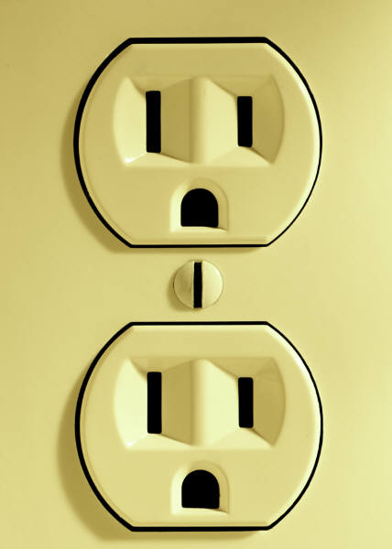
Ground?
?
Ground
Reference
Earth

Slide 37
Symbol library
I_{ab}
I=5 A
a
+
+
a
+
a
-
b
b
-
-
b

Slide 38
Symbol library
+
+
2
-
-
+
-
i₇
i₇
i₇
2 Ω
3 V
3 A
3 i₁
2 i₁
+
+
-
-

Slide 39
Symbol & circuit library

