Slide 1
EECS 70A: Network Analysis
Announcements:
Announcement #1
Lecture 11

Slide 2
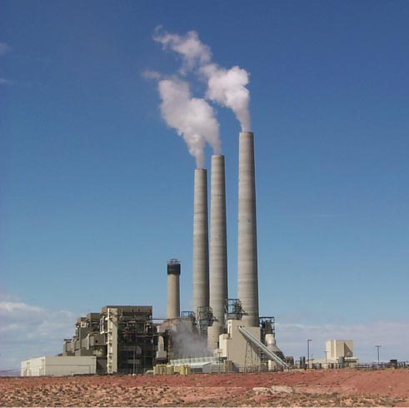
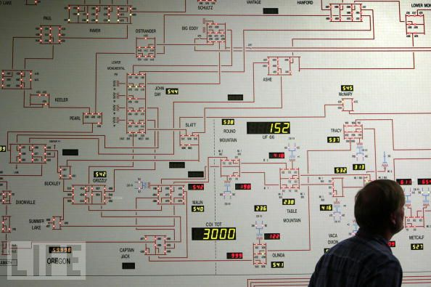
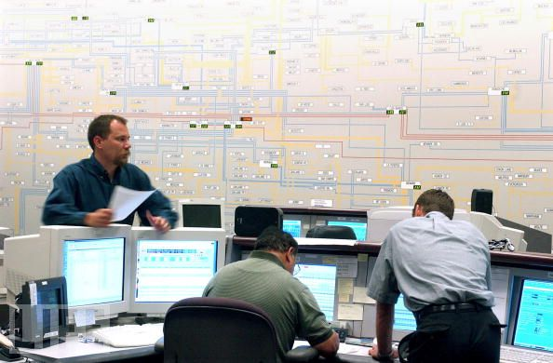
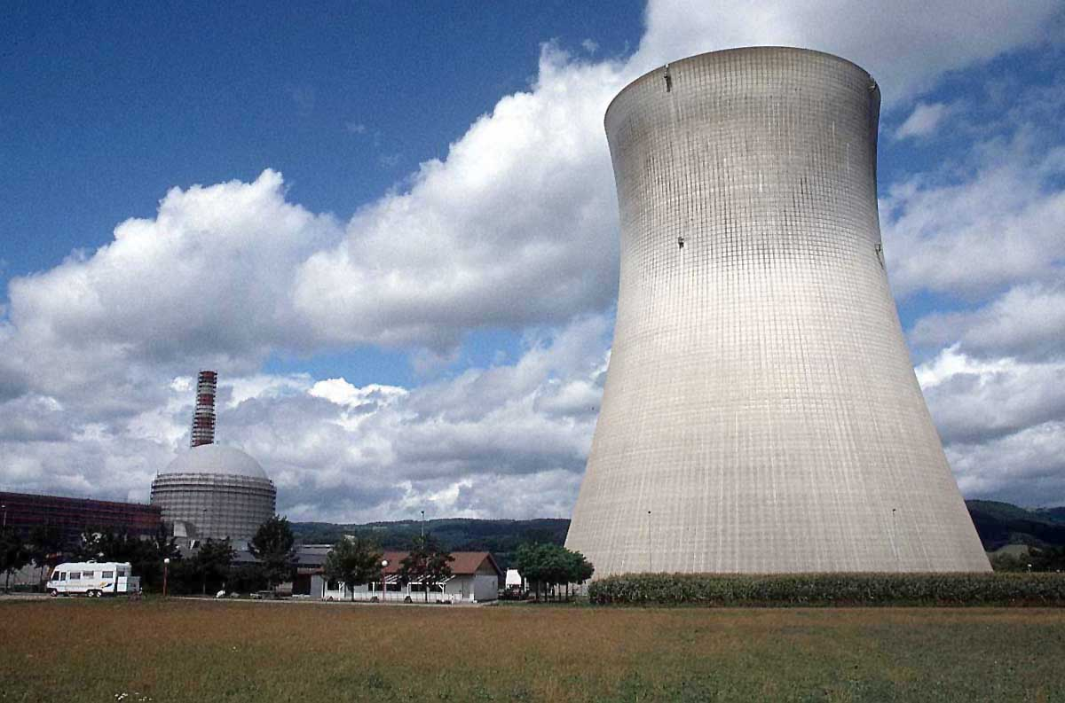
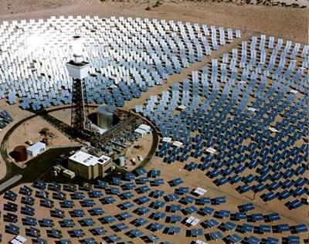

Slide 3
Sine waves

Slide 4
Phase

Slide 5
Complex numbers
Imag
y
x
Real

Slide 6
Complex algebra
Addition:
Subtraction:
Multiplication:
Division:
Inversion:
Square root:
Complex conjugate:

Slide 7
Euler relationship
Phasors:
“Phasor”
V
(Complex #)

Slide 8
Circuits
V = I R
+
V=I/jωC
L
+
V=jωL I
R
C
V
V
-
-
“Impedance”
Z = R
Z=1/jωC
Z = jωL
KCL, KVL hold for relationship between V, I.

Slide 9
Series/Parallel Impedances
=
Z₁
Z₂
Z₃
Z_{eq}
Z _{eq}= Z ₁ +Z ₂ +Z ₃
Z₃
=
Z₁
Z_{eq}
Z₂
Z _{eq}⁻¹ = Z ₁⁻¹ +Z ₂⁻¹ +Z ₃⁻¹

Slide 10
Example problem #1
Find Z_{eq} for this circuit: (instructor)
R₂
R₁
L

Slide 11
Example problem #2
Find Z_{eq} for this circuit: (students)
C
R₁
R₂

Slide 12
Example problem #3
Find i(t), V₁(t), V₂(t) for this circuit: (instructor)
+
C
V₁
-
V(t)=V₀ cos(ωt)
+
V₂
R
-

Slide 13
Example problem #4
Find i(t), V₁(t), V₂(t) for this circuit: (students)
+
V₁
R
-
I(t)=I₀ cos(ωt)
L
+
V₂
-

Slide 14
Low pass filter
R
INPUT:
V(t)=V₀ cos(ωt)
a
+
OUTPUT:
V_{ab}(t)
C
-
b

Slide 15
High pass filter
+
C
V₁
-
INPUT:
V(t)=V₀ cos(ωt)
a
+
+
OUTPUT:
V_{ab}(t)
V₂
R
-
-
b

Slide 16
Band pass filter (RLC)
+
C
V₁
-
INPUT:
V(t)=V₀ cos(ωt)
a
+
+
OUTPUT:
V_{ab}(t)
V₂
R
-
-
b

Slide 17
Symbol library
I_{ab}
I=5 A
a
+
+
a
+
a
-
b
b
-
-
b

Slide 18
Symbol library
+
+
2
-
-
+
C
-
i
+
-
V
i₇
i₇
i₇
2 Ω
3 V
3 A
3 i₁
2 i₁
+
+
-
-

