Slide 1
EECS 70A: Network Analysis
Announcements:
Announcement
Lecture 13

Slide 2




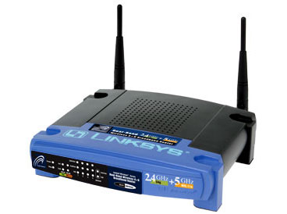
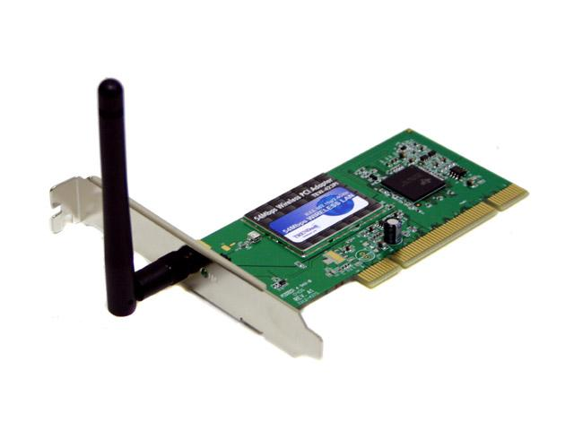
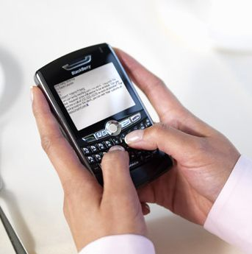
Wireless Communications
Broadcast Radio:
Telecom:
All use sine waves (phasors) as way to describe signals and circuits.
Internet:
3G data:

Slide 3
Frequency Allocations
http://www.ntia.doc.gov/osmhome/allochrt.PDF

Slide 4
Phasors
“Voltage Phasor”
V
(Complex #)
“Current Phasor”
I

Slide 5
Circuits
V = I R
+
V=I/jωC
L
+
V=jωL I
R
C
V
V
-
-
“Impedance”
Z = R
Z=1/jωC
Z = jωL
Can think of this as a “generalized Ohm’s law for ac circuits”
KCL, KVL hold for relationship between V, I.

Slide 6
Phasor to voltage conversion
Find V(t), q(t)
Problem gives us:
I(t)=I₀cos(ωt)
Compare to definition of current phasor:
I(t)=I₀cos(ωt)
+
C
V
-
Find voltage phasor using generalized Ohm’s law:
V=I/jωC
Find v(t) from voltage phasor:

Slide 7
Phase vs. impedance (Z)
In general:
Z real i.e. Z = x + jy
=> i(t), v(t) “in phase”
In general:
Z imag i.e. Z = x + jy
=> i(t), v(t) “out of phase by 90 degrees”
i(t)
v(t)
HW problem: Find relationship between phase shift and impedance (Z).

Slide 8
Example phasor problem
Find i(t) (students)
Problem gives us:
v(t)=3 cos(10 t + 30º) Volts
Compare to definition of voltage phasor:
+
C
V
v(t)=3 cos(10 t + 30º) Volts
-
Find current phasor using generalized Ohm’s law:
I=jωC V = …
Find i(t) from current phasor:

Slide 9
Example problem #3
Find i(t), V₁(t), V₂(t) for this circuit: (instructor)
+
C
V₁
-
V(t)=V₀ cos(ωt)
+
V₂
R
-

Slide 10
High pass filter
+
C
V₁
-
INPUT:
V(t)=V₀ cos(ωt)
a
+
+
OUTPUT:
V_{ab}(t)
V₂
R
-
-
b

Slide 11
Low pass filter
R
INPUT:
V(t)=V₀ cos(ωt)
a
+
OUTPUT:
V_{ab}(t)
C
-
b

Slide 12
“Transfer function”
Linear network
H(ω)
X(ω)
Y(ω)
Input
Output
demo

Slide 13
RC transfer function
R
INPUT:
V(t)=V₀ cos(ωt)
a
+
OUTPUT:
V_{ab}(t)
C
-
b

Slide 14
Example problem #4
Find i(t), V₁(t), V₂(t) for this circuit: (students)
+
V₁
R
-
I(t)=I₀ cos(ωt)
L
+
V₂
-

Slide 15
Band pass filter (RLC)
+
C
V₁
-
INPUT:
V(t)=V₀ cos(ωt)
a
+
+
OUTPUT:
V_{ab}(t)
V₂
R
-
-
b

Slide 16
Symbol library
I_{ab}
I=5 A
a
+
+
a
+
a
-
b
b
-
-
b

Slide 17
Symbol library
+
+
2
-
-
+
C
-
i
+
-
V
i₇
i₇
i₇
2 Ω
3 V
3 A
3 i₁
2 i₁
+
+
-
-

