Slide 1
EECS 70A: Network Analysis
June 5, 2014
Comprehensive review

Slide 2
Topics covered
KCL, KVL
Nodal analysis
Mesh analysis
Thevenin/Norton theorem
RL, RC circuits (time dependence)
R,L,C circuits
  Phasors
  Impedances
  Transfer function/Bode
  Power

Slide 3
Nodal Analysis(Review)
Based on KCL, use node voltages as circuits variables.
Define a reference node.
Label remaining nodes. (n-1 nodes)
Apply KCL + ohm to all nodes and supernodes (e.g. V₁, V₂, V₃, …)
    Express all i’s in terms of v’s
Apply KVL to the voltage source
  If one end of voltage source connected to ground, don’t need to
Solve the n-1 simultaneous equations, to find V’s
Use Ohm’s law to find the currents.

Slide 4
Mesh analysis summary
Based on KVL, use mesh currents as circuit variables.
Assign mesh currents i₁, i₂, … i_{n}
Apply KVL + Ohm’s law to each mesh
Supermesh (if there is a current source present):
CASE 1: current source only in one mesh.
  Already have the current for that mesh => no need to write KVL for that mesh
CASE 2: current source exits between two meshes. => create a supermesh
  Apply KVL to the supermesh
  Apply KCL to a node in the branch where two meshes intersect
Solve the equations for i₁ ,i₂ ,…i_{n}
(e.g. using Kramer’s rule)
Then solve for voltages using Ohm’s law

Slide 5
Thevenin, Norton Theorems:
Linear two-terminal circuit
Thevenin:
Calculating V_{th}:
Connect nothing to a-b. Calculate voltage. This is V_{th}.
Calculating R_{th}:
  Method 1:
  Connect terminal a to b (short).
  Calculate the current from a to b. This is call I_{short circuit}.
  R_{th}=V_{th}/I_{short circuit}.
  Method 2:
  Find the input resistance looking into terminals a-b after all the independent sources have been turned off. (Voltage sources become shorts, current sources become opens.)
  Trick (if dependent sources present):
  Apply a 1 A current source to terminals a-b, find V_{ab}
  R_{th} = V_{ab}/1A.
a
+
-
b
Equivalent to:
R_{th}
a
V_{th}
+
+
-
-
b
Equivalent to:
a
+
Norton:
Calculating R_{N}:
R_{N}=R_{th}
Calculating I_{N}:
  I_{N}=V_{th}/R_{th}
I_{N}
R_{N}
-
b

Slide 6
Conversion procedures
i(t)
I
I =
v(t)
V
V =
I
i(t)
I
V
v(t)
V
For the exam, you should know how to carry out these procedures.

Slide 7
Circuits
V = I R
+
V=I/jωC
L
+
V=jωL I
R
C
V
V
-
-
“Impedance”
Z = R
Z=1/jωC
Z = jωL
KCL, KVL hold for relationship between V, I.

Slide 8
Series/Parallel Impedances
=
Z₁
Z₂
Z₃
Z_{eq}
Z _{eq}= Z ₁ +Z ₂ +Z ₃
Z₃
=
Z₁
Z_{eq}
Z₂
Z _{eq}⁻¹ = Z ₁⁻¹ +Z ₂⁻¹ +Z ₃⁻¹

Slide 9
Conversion procedures
Given i(t) find v(t):
i(t)
i(t)
I
V = I Z_{eq}
v(t)
+
Z_{eq}
v(t)
Given v(t) find i(t):
-
v(t)
V
I = V/ Z_{eq}
i(t)
For the exam, you should know how to carry out these procedures.

Slide 10
“Transfer Function”
Linear network
Input
Output
H(ω) = V_{out}/V_{in}

Slide 11
Example Transfer function
+
R₁
L₁
V_{in}
+
L₂
R₂
V_{out}
-
-
Calculate H(ω) for this circuit. Sketch the magnitude of H(ω) vs. ω.

Slide 12
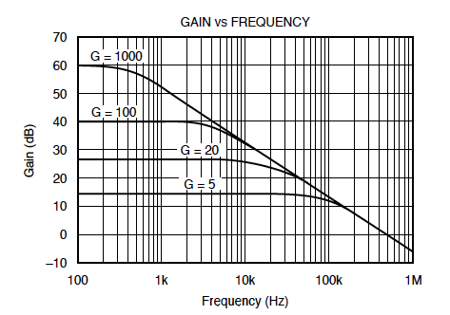
Bode example
Find Vout(t) given:
Vin(t)= 1 mV cos ( 2*pi*1kHz*t)

Slide 13
Comprehensive Example
1 kΩ
3 kΩ
Solve all currents, voltages using Nodal. Do again using mesh.
2 mF
+
3 cos(ω t+30deg)
25 μH
-

Slide 14
Comprehensive Example
1 kΩ
3 kΩ
Solve all currents, voltages using Nodal. Do again using mesh.
2 mF
+
3 cos(ω t+30deg)
25 μH
-

Slide 16
Phasor Example 2
3 Ω
1 μH
Find Thev Eq Circ + max pwr txfr load impedance.
+
4cos(ω t+45deg)
V_{out}
5Ω
1 Ω
-

Slide 17
Phasor Example 1
Find v(t).
1 kΩ
3 cos(ω t+30deg)
10 kΩ
25 μH
2 mF
+
V
-

Slide 18
Symbol library
+
+
2
-
-
+
C
-
i
+
-
V
i₇
i₇
i₇
2 Ω
3 V
3 A
3 i₁
2 i₁
+
+
-
-

Slide 19
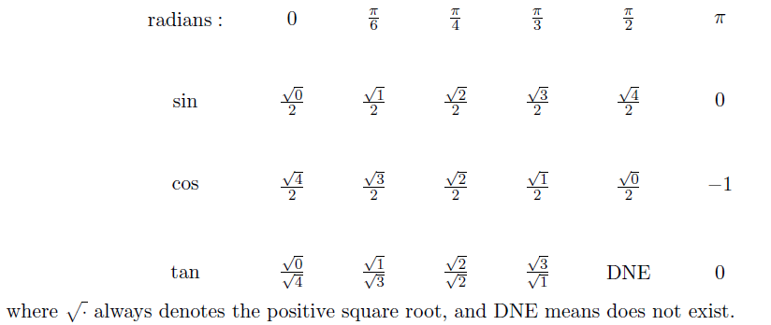
Exam cheat sheet
This will be provided with the exam.

