Slide 1
EECS 70A: Network Analysis
Announcements:
Announcement
Lecture 13

Slide 2




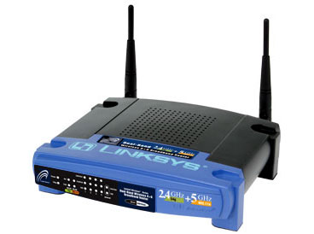
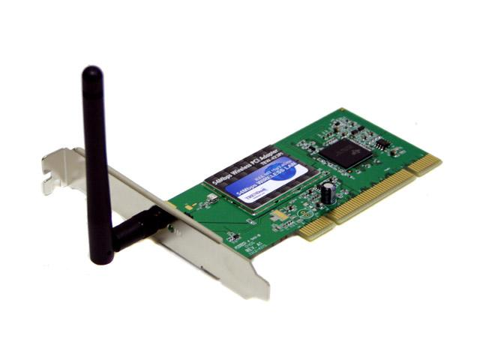

Wireless Communications
Broadcast Radio:
Telecom:
All use sine waves (phasors) as way to describe signals and circuits.
Internet:
3G data:

Slide 3
Frequency Allocations
http://www.ntia.doc.gov/osmhome/allochrt.PDF

Slide 4
“Transfer function”
Linear network
H(ω)
X(ω)
Y(ω)
Input
Output

Slide 5
Significance of Transfer Function H(ω)

Slide 6
During lecture computer crashed so a few of these pages are scans of my written notes that were presented in lecture.

Slide 7
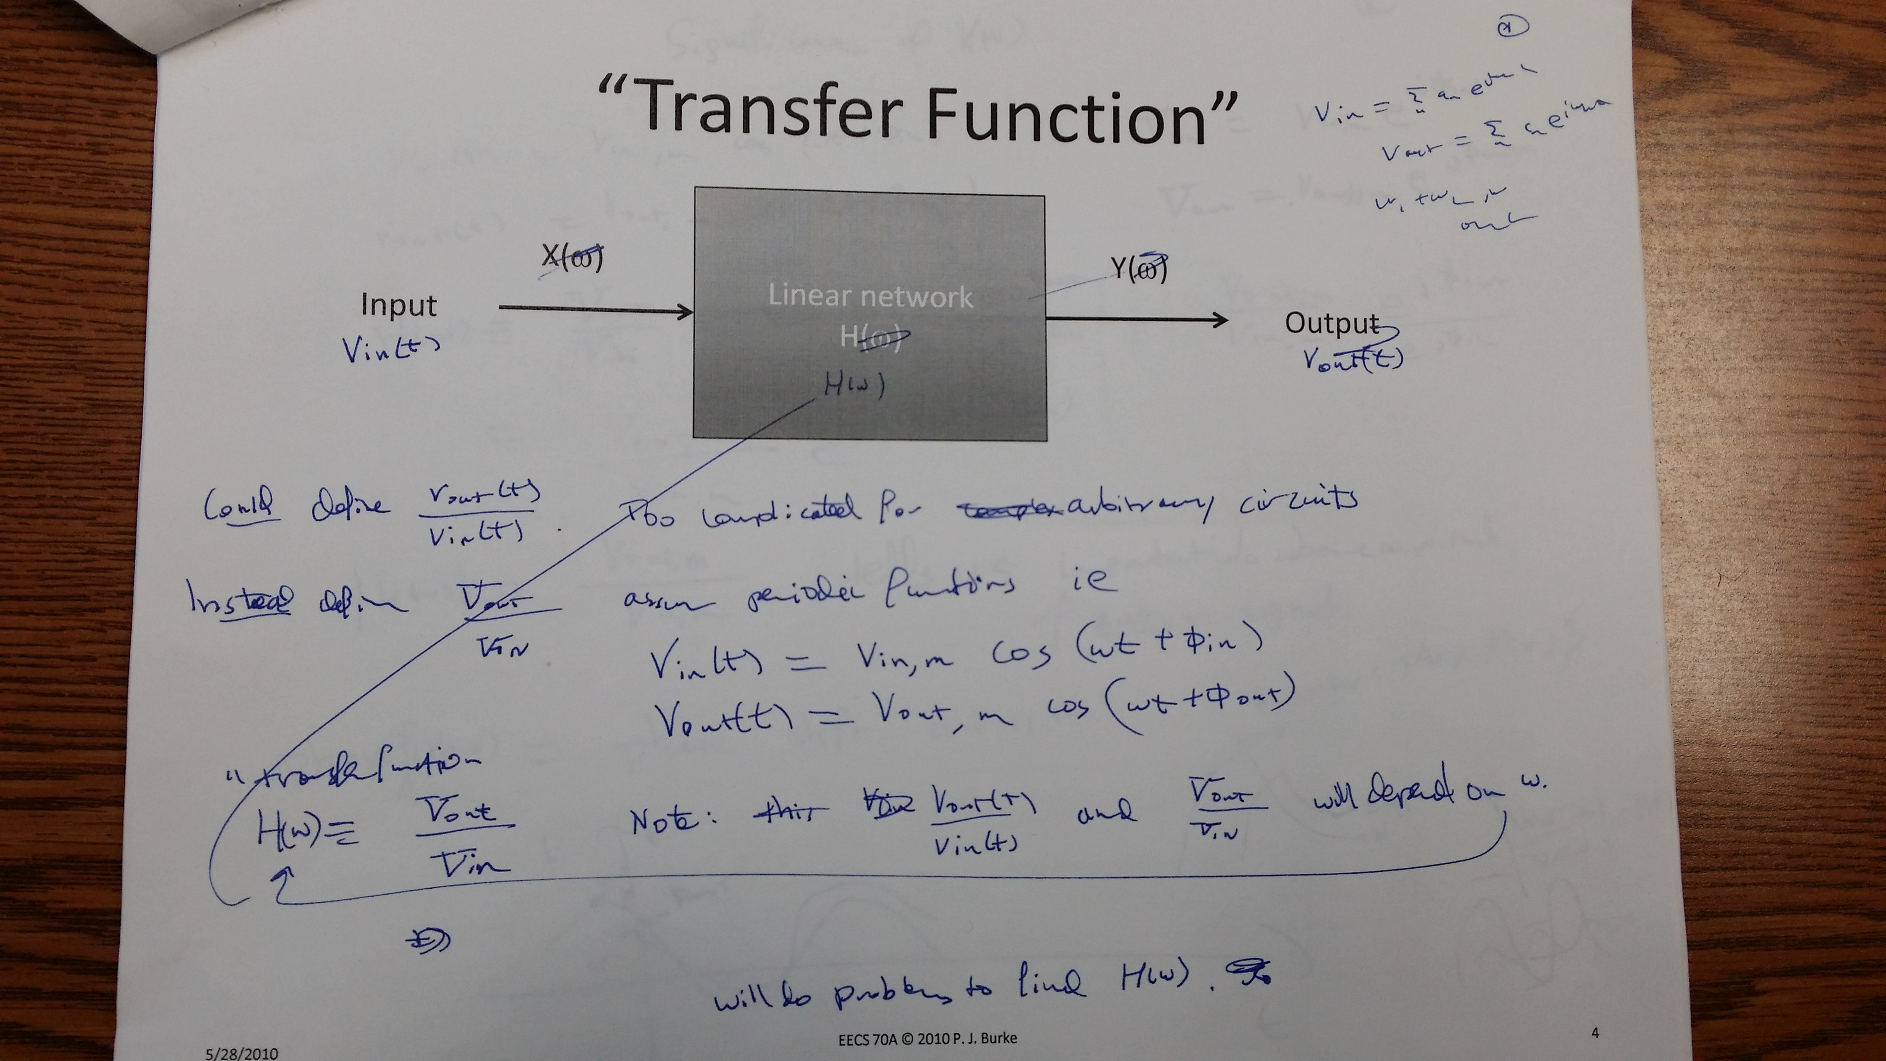

Slide 8
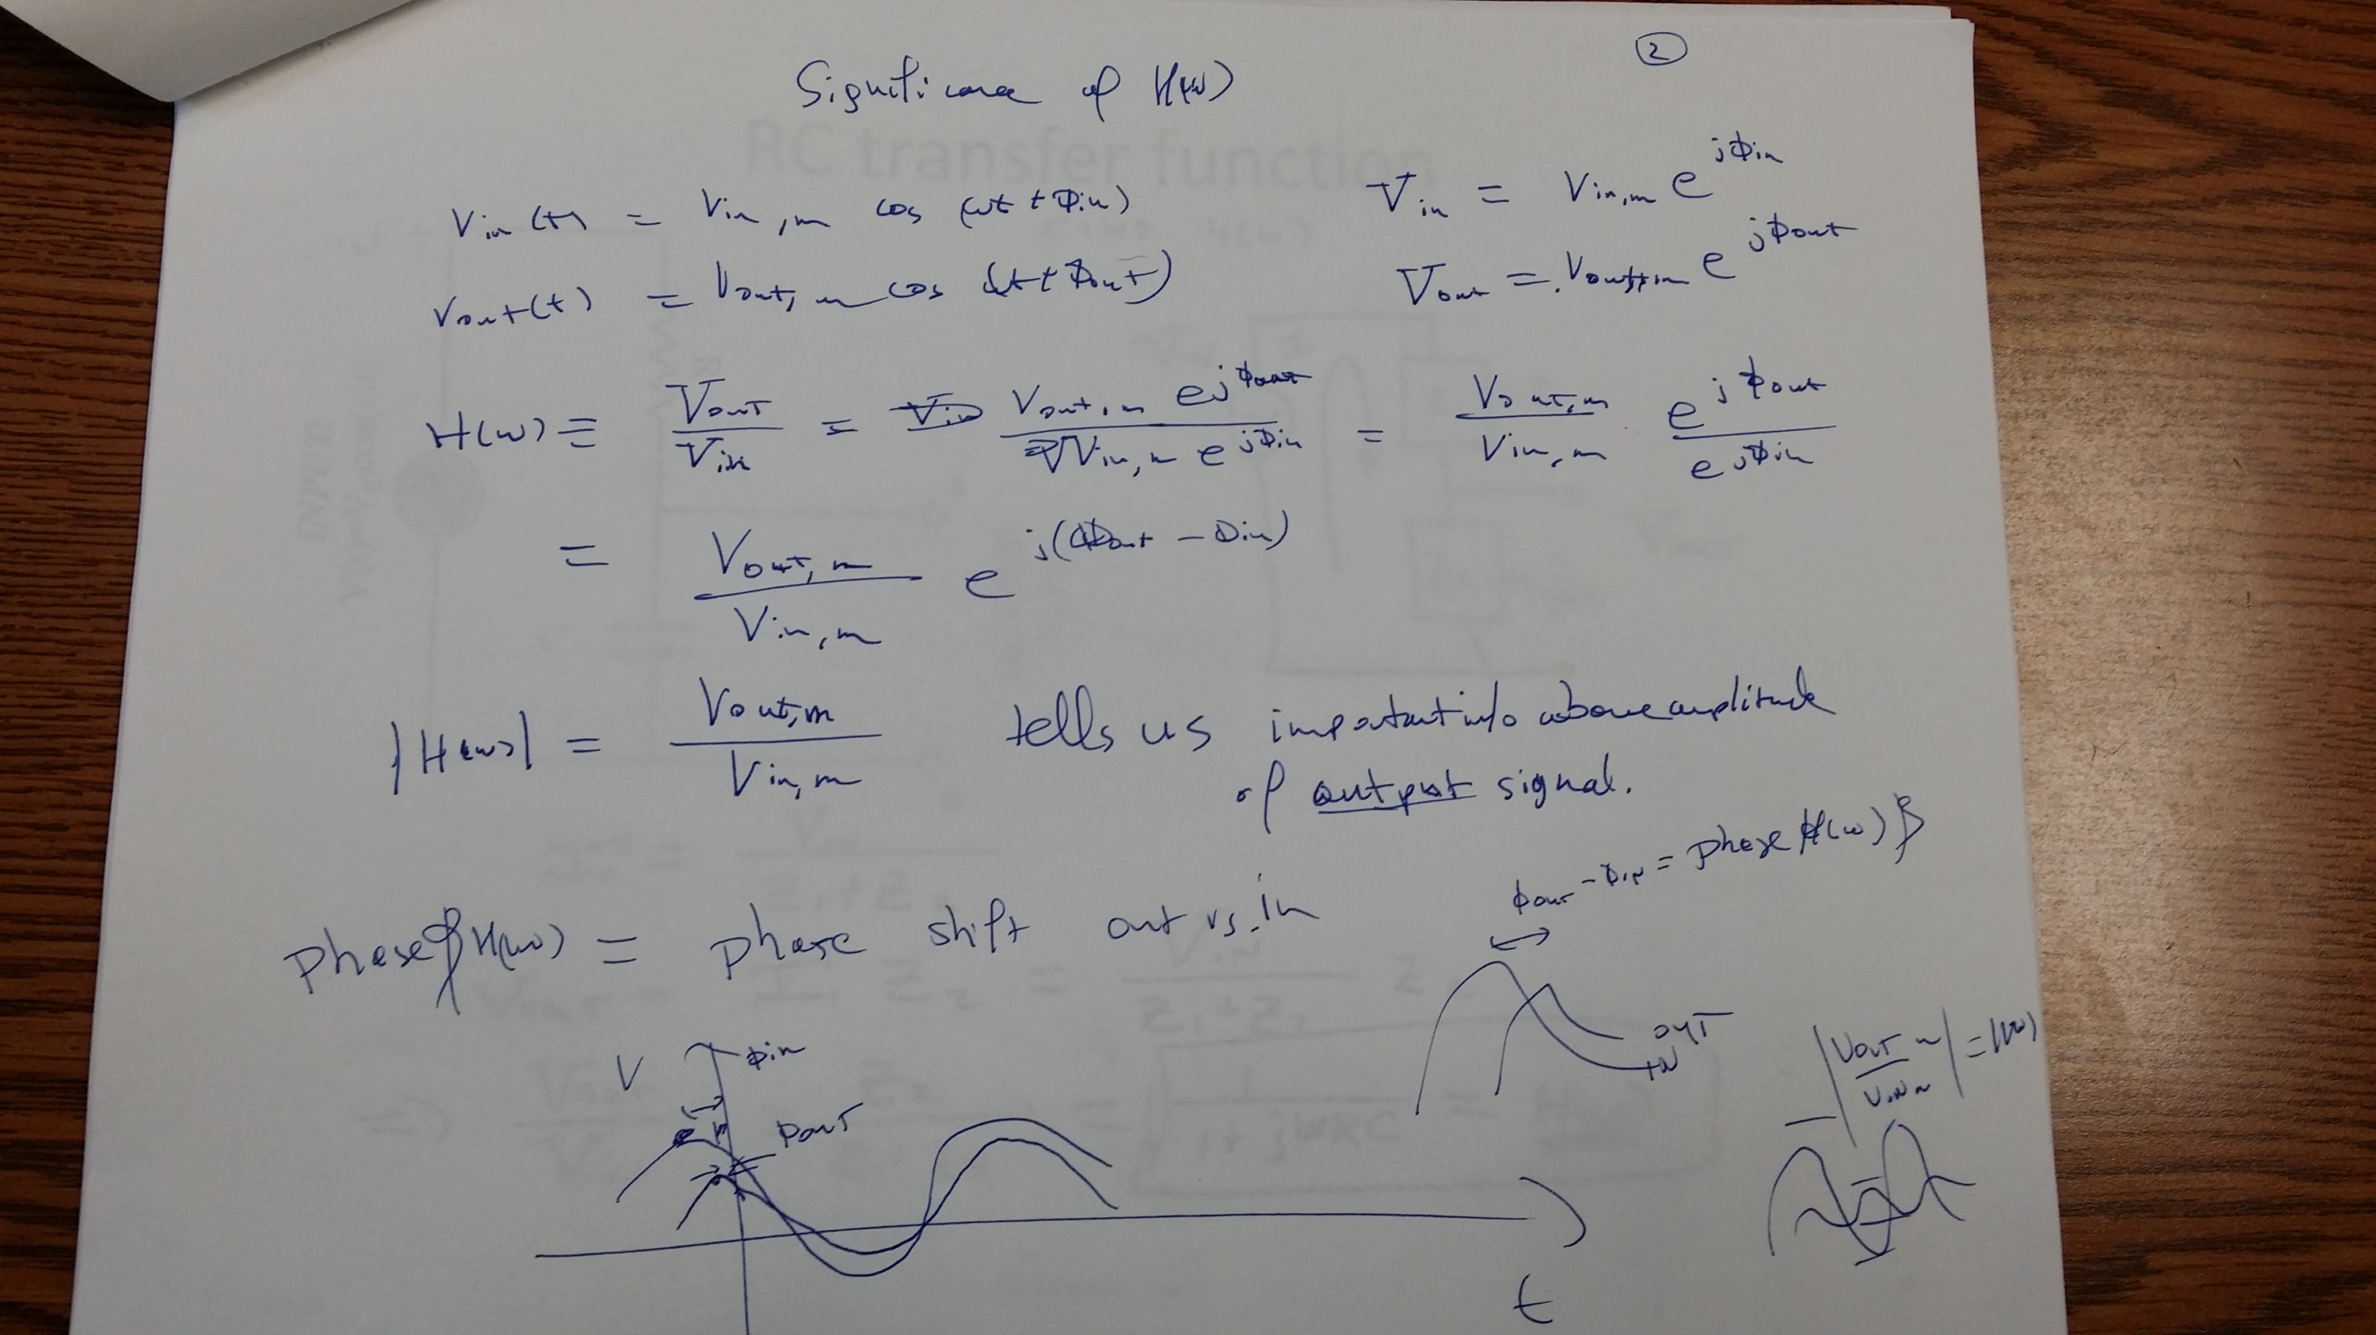

Slide 9
RC transfer function (Low pass filter)
Find H(ω)
R
INPUT:
V(t)=V₀ cos(ωt)
a
+
OUTPUT:
V_{ab}(t)
C
-
b

Slide 10
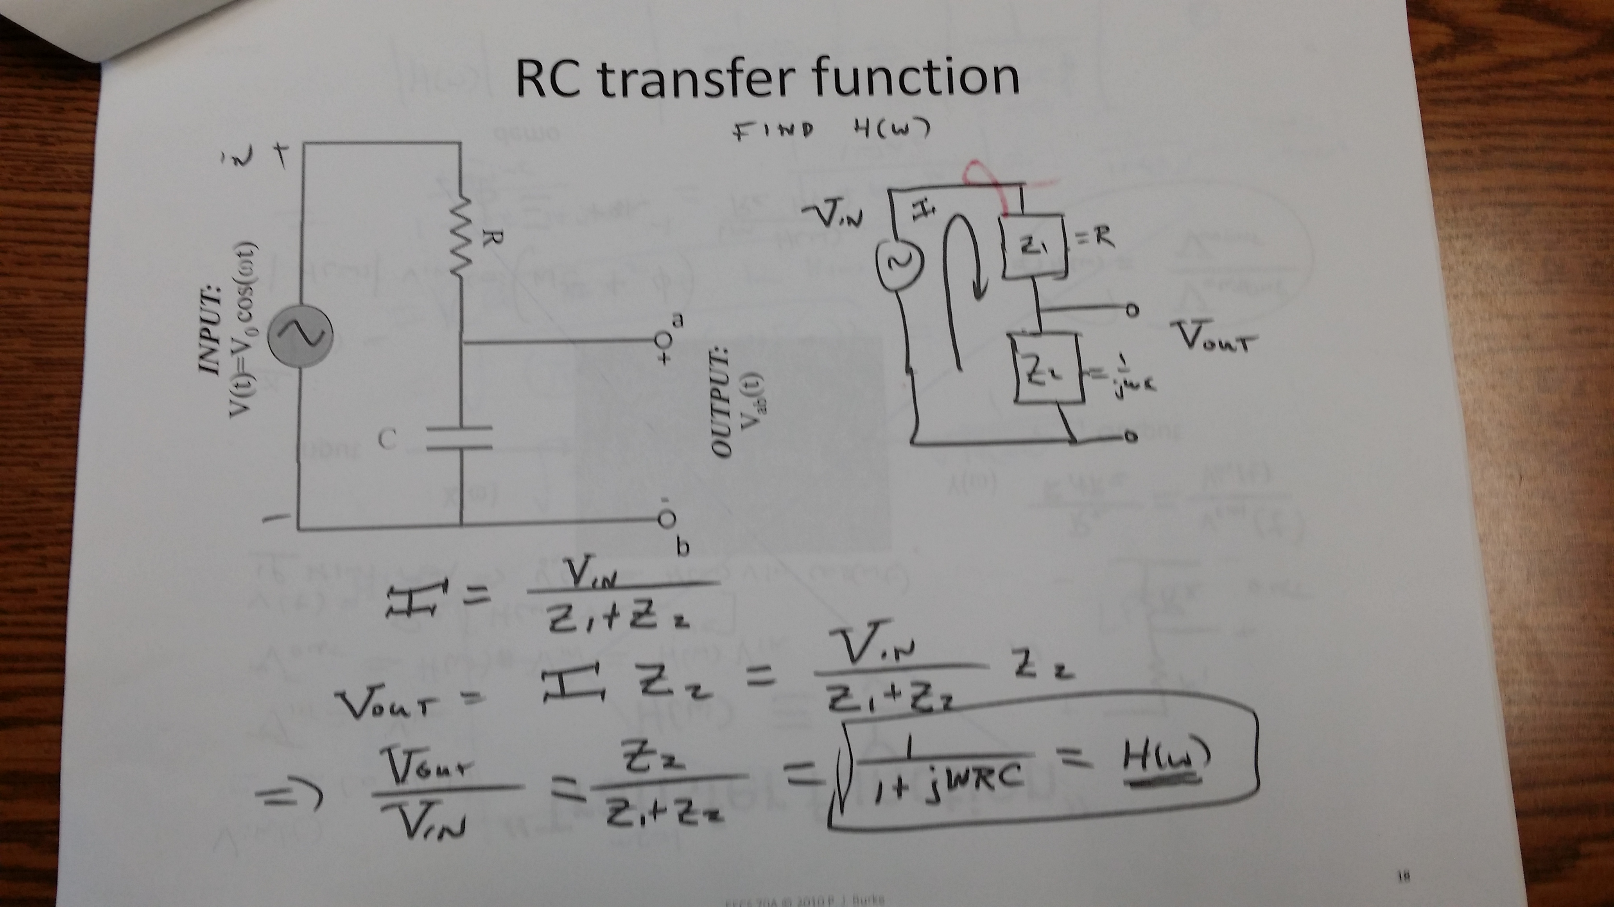

Slide 11
Magnitude RC Transfer Function H(ω)

Slide 12
Phase of RC Transfer Function H(ω)

Slide 13
Decibels

Slide 14
Bode Plots

Slide 15
RC transfer function (High pass filter)
Find H(ω)
+
C
V₁
-
INPUT:
V(t)=V₀ cos(ωt)
a
+
+
OUTPUT:
V_{ab}(t)
V₂
R
-
-
b

Slide 16
Example problem
Find H(ω) for this circuit, then sketch the magnitude of H(ω) vs ω: (students)
+
R
V_{in}
+
L
V_{out}
-
-

Slide 17
Band pass filter (RLC)
+
C
V₁
-
INPUT:
V(t)=V₀ cos(ωt)
a
+
+
OUTPUT:
V_{ab}(t)
V₂
R
-
-
b

Slide 18
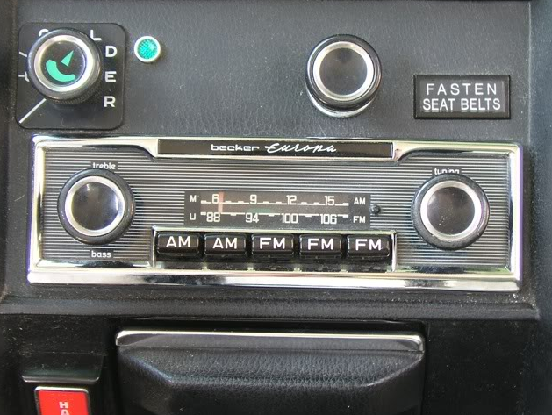
http://www.peachparts.com/shopforum/showthread.php?t=256624

Slide 19
Resonance

Slide 20


Slide 21
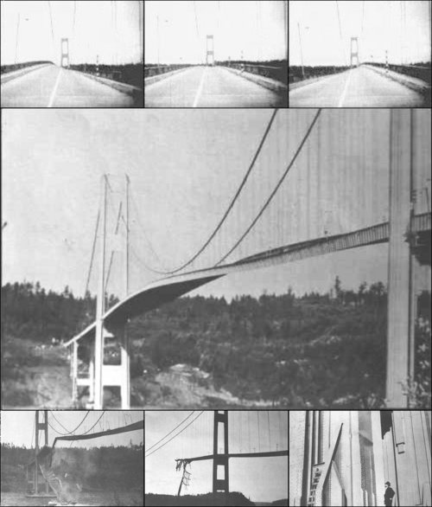
Tacoma Narrows Bridge (1940)
Nov 7, 1940
http://www.youtube.com/watch?v=3mclp9QmCGs

Slide 22


