Slide 1
EECS 70A: Network Analysis
Announcements:
Announcement
29 May 2014

Slide 2
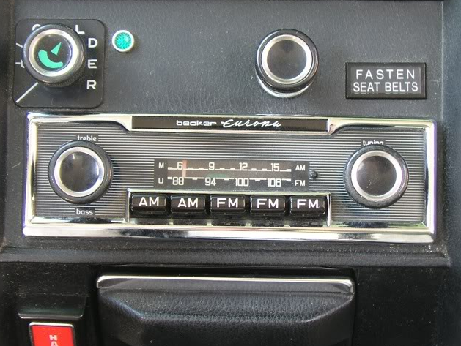
http://www.peachparts.com/shopforum/showthread.php?t=256624

Slide 3
“Transfer function”
Linear network
H(ω)
X(ω)
Y(ω)
Input
Output

Slide 4
Band pass filter (RLC)
+
C
V₁
-
INPUT:
V(t)=V₀ cos(ωt)
a
+
+
OUTPUT:
V_{ab}(t)
V₂
R
-
-
b

Slide 5
Bandwidth

Slide 6
Bode of RLC

Slide 8
Fourier

Slide 10
Modulation Schemes

Slide 11
Sidebands

Slide 12
Demo

