Slide 1
EECS 70A: Network Analysis
Announcements:
Announcements
Lecture 6

Slide 2
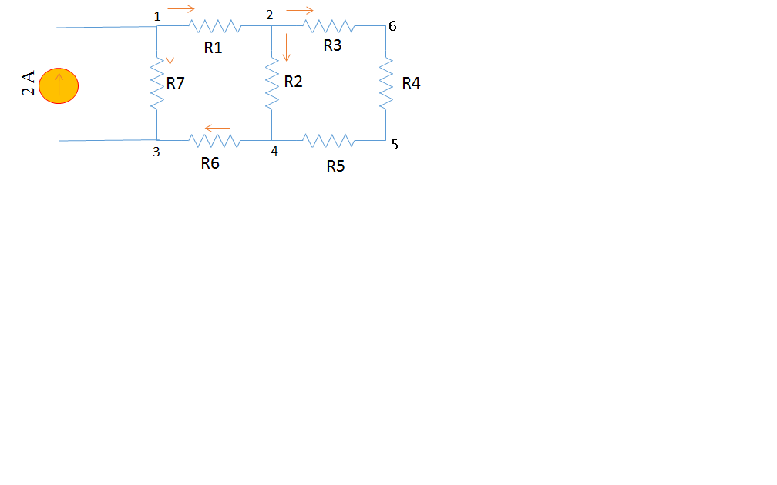

Slide 3
Today’s Agenda
Review of Nodal Analysis
Mesh Analysis
Introduction
What is a Mesh?
Mesh Current
Method
Mesh Analysis with Current Source

Slide 4
Node Voltage(review)
i
a
R₁
i
b
R₂
i
c
V_{ab} is the voltage drop across resistor 1

Slide 5
Nodal Analysis(Review)
Based on KCL, Use node voltages as circuits variables.
Define a reference node.
Label remaining nodes. (n-1 nodes)
Apply KCL + ohm to all nodes and supernodes
Express all I’s in terms of v’s
Apply KVL to loops with voltage source
Solve the n-1 simultaneous equations, to find V’s
Use Ohm’s law to find the currents.

Slide 6
Apply KCL + Ohm to All Nodes and Supernodes
R₁
R₂
R₃
R₄
R₅
3 A
R₆
R₇
R₈
R₉
R₁₀
R₁₁
R₁₂

Slide 7
Nodal Analysis-Example
0.2 Ω
i₁
+
-
1 Ω
0.5 Ω
i₁
+ V₀ -
5 V
+
0.5 Ω
2V₀
-
0.2 Ω
1 Ω

Slide 8
Mesh Analysis-Introduction What is a Mesh?
A loop is a closed path with no node passed more than once.
A mesh is a loop that does not contain any other loops within it.

Slide 9
Mesh Analysis-Introduction Mesh Current vs. Element Current
+
V₂
-
The current through a mesh is known as mesh current.
Direction of the mesh current is arbitrary-conventionally assumed to be clockwise.
The current through an element can be the same as mesh current or the subtraction of two mesh currents.
+
-
V₁
V₃
-
+
+
V₄
-

Slide 10
Mesh Analysis-Method
Assign mesh currents i₁ ,i₂ ,…i_{n}
Apply KVL+ Ohm’s law to each mesh
Solve the equations for i₁ ,i₂ ,…i_{n}
3 Ω
5 Ω
10 v
+
7 Ω
+
5 v
-
-
10 Ω
2 Ω

Slide 11
Apply KVL+ Ohm’s Law to Each Mesh
R1
R4
10 v
+
R3
+
5 v
-
-
R2
R5

Slide 12
Mesh Analysis - Example
7 Ω
2 Ω
i
4 Ω
1 Ω
+
2 i
+
-
-
5 v
3 Ω

Slide 13
Mesh Analysis with Current Sources
CASE 1: current source only in one mesh.
already have the current for that mesh => no need to write KVL for that mesh
3 Ω
5 Ω
10 v
+
7 Ω
5 A
-
10 Ω
2 Ω

Slide 14
Mesh Analysis with Current Sources
CASE 2: current source exits between two meshes. => create a supermesh
Apply KVL to the supermesh
Apply KCL to the supermesh
3 Ω
5 Ω
5 A
10 v
+
7 Ω
-
3 Ω
10 Ω
2 Ω

Slide 15
Mesh Analysis- Example
6 v
+
-
2 Ω
4 Ω
1 Ω
+
12 v
-
5 Ω
3 A

Slide 16
Mesh Analysis- Example
5 Ω
5 A
2 Ω
3 Ω
7 Ω
3 A

Slide 17
Nodal Versus Mesh Analysis
The method that results in fewer number of equations is more suitable.
Mesh analysis for networks with many series connected elements
Nodal Analysis for networks with many parallel connected elements
But also depends on the type of the sources.
i₁
i₂
i₃
i₄
5 A
2 A
7 Ω
2 Ω
5 Ω
5 A
3 Ω
10 V
2 Ω
+
R₁
R₂
-
R₃
R₄
R₅
3 Ω
3 A
R₆
R₇
R₈
R₉
R₁₀
R₁₁
R₁₂

Slide 18
i₁
i₂
i₃
i₄
2 A
7 Ω
2 Ω
5 Ω
5 A
3 Ω

Slide 19
i₁
i₂
i₃
i₄
2 A
7 Ω
2 Ω
5 Ω
5 A
3 Ω

Slide 20
Nodal Versus Mesh Analysis
The method that results in fewer number of equations is more suitable.
Mesh analysis for networks with many series connected elements
Nodal Analysis for networks with many parallel connected elements
But also depends on the type of the sources.
i₁
i₂
i₃
i₄
5 A
2 A
7 Ω
2 Ω
5 Ω
5 A
3 Ω
10 V
2 Ω
+
R₁
R₂
-
R₃
R₄
R₅
3 Ω
3 A
R₆
R₇
R₈
R₉
R₁₀
R₁₁
R₁₂

Slide 21
Nodal Versus Mesh Analysis
The method that results in fewer number of equations is more suitable.
Mesh analysis for networks with many series connected elements
Nodal Analysis for networks with many parallel connected elements
But also depends on the type of the sources.
i₁
i₂
i₃
i₄
5 A
2 A
7 Ω
2 Ω
5 Ω
5 A
3 Ω
10 V
2 Ω
+
R₁
R₂
-
R₃
R₄
R₅
3 Ω
3 A
R₆
R₇
R₈
R₉
R₁₀
R₁₁
R₁₂

Slide 22
Nodal Versus Mesh Analysis
The method that results in fewer number of equations is more suitable.
Mesh analysis for networks with many series connected elements
Nodal Analysis for networks with many parallel connected elements
But also depends on the type of the sources.
i₁
i₂
i₃
i₄
5 A
2 A
7 Ω
2 Ω
5 Ω
5 A
3 Ω
10 V
2 Ω
+
R₁
R₂
-
R₃
R₄
R₅
3 Ω
3 A
R₆
R₇
R₈
R₉
R₁₀
R₁₁
R₁₂

Slide 23
Symbol library
I_{ab}
I=5 A
a
+
+
a
+
a
-
b
b
-
-
b

Slide 24
Symbol library
+
+
2
-
-
+
-
i₇
i₇
i₇
2 Ω
3 V
3 A
3 i₁
2 i₁
+
+
-
-

Slide 25
Symbol & circuit library

