Slide 1
EECS 70A: Network Analysis
Announcements:
Etc etc etc
Lecture 10

Slide 2
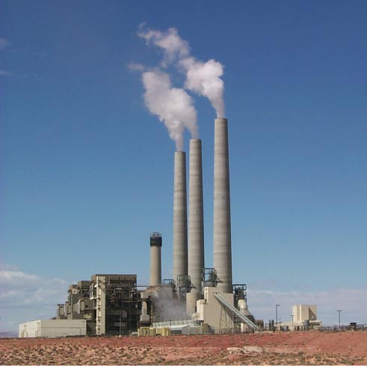
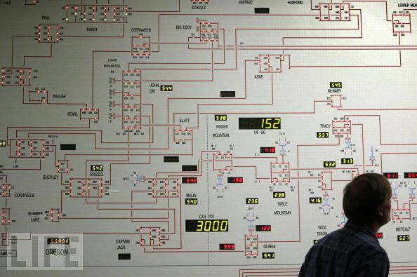
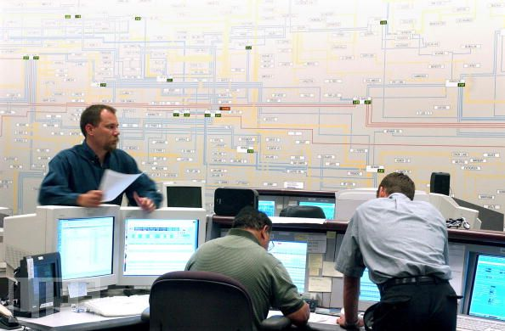
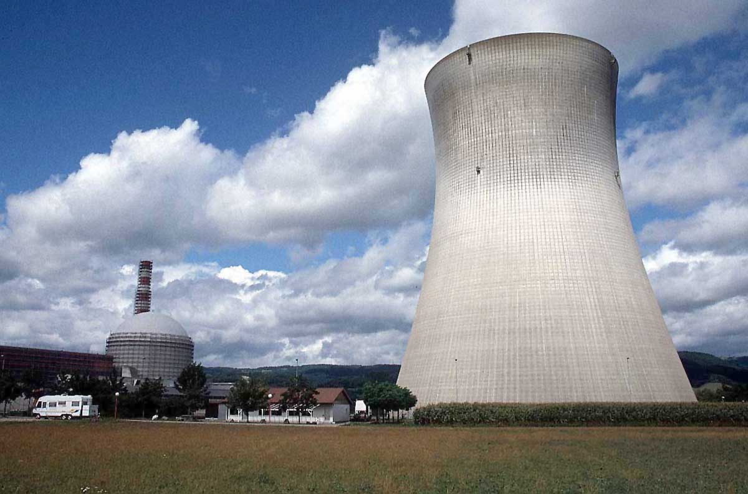
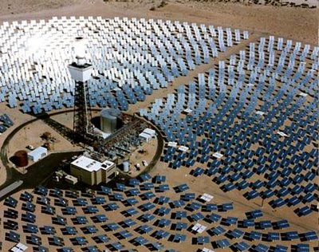

Slide 3
Capacitors
+q
-q
A=area
d=plate separation
Farads[F] = Coulombs/Volt [C]/[V]
+
-
V
C
Dielectric constant:
i
SiO₂
+
-
HfO₂
V

Slide 4
Time dependence
q, V, i can depend on time !
Implicit:
Will not always write (t), but it is assumed from now on.

Slide 5
Example Capacitor Problem
Find V(t), q(t)
+
C
V
-

Slide 6
Example Capacitor Problem
Find V(t), q(t)
+
C
V
-

Slide 7
“High-K Dielectric”
http://www.intel.com/technology/45nm/hafnium.htm?iid=tech_45nm+body_animation_hafnium

Slide 8
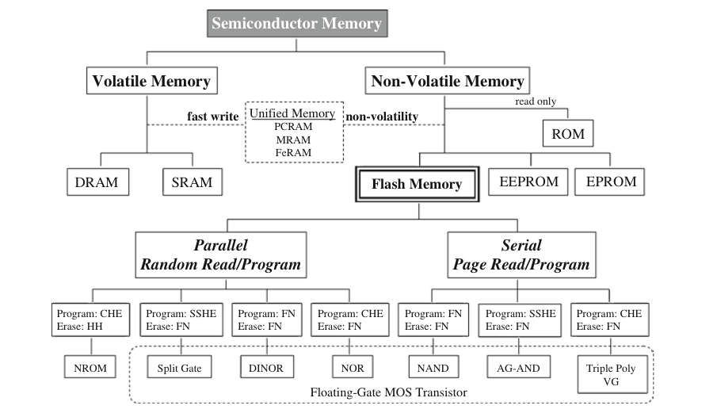
Semiconductor memory
1. Ogura, T. Flash Memory. CMOS Processors and Memories 2010, 197–232.

Slide 9
SRAM

Slide 10
DRAM

Slide 11
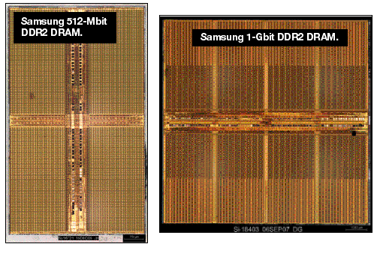
One-bit memory
Typical dimensions:
0.1 micron x 0.1 micron area
10 nm thickness.
What is C?
http://i.cmpnet.com/eet/news/07/11/DC1502_UTH_samsung.gif

Slide 12
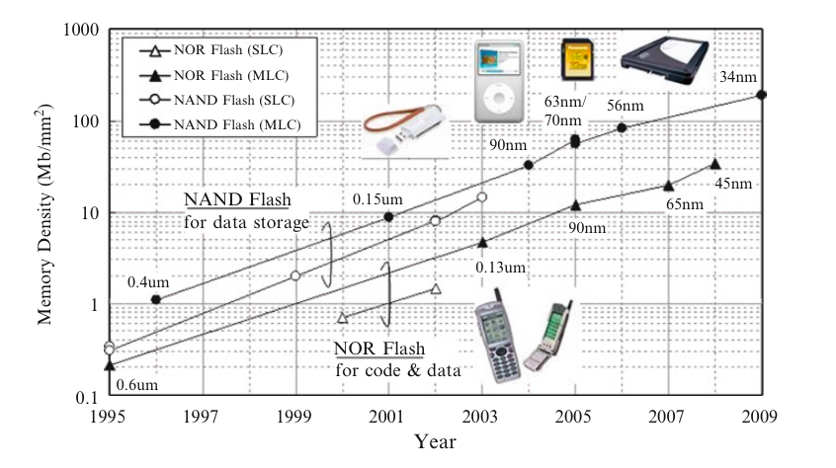
Flash Memory
1. Ogura, T. Flash Memory. CMOS Processors and Memories 2010, 197–232.

Slide 13
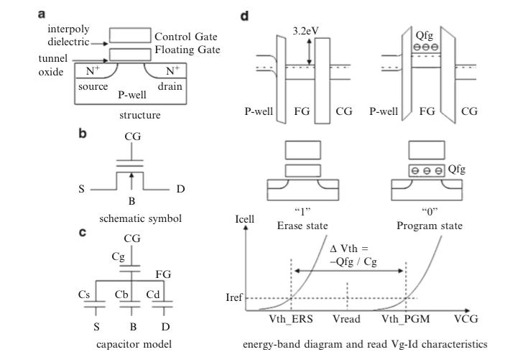
Flash memory
1. Ogura, T. Flash Memory. CMOS Processors and Memories 2010, 197–232.

Slide 14
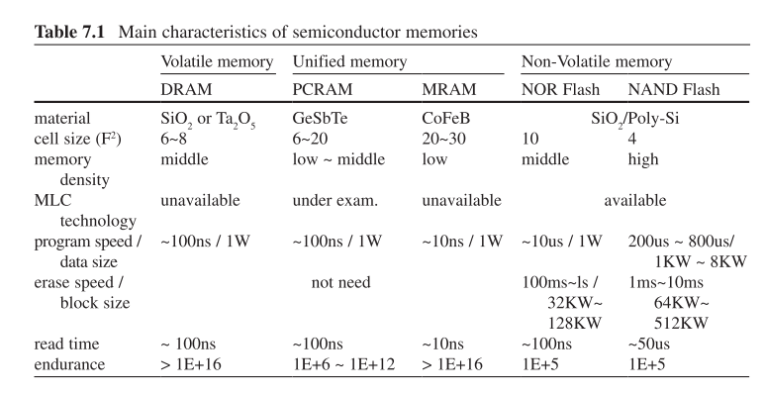
Flash memory
1. Ogura, T. Flash Memory. CMOS Processors and Memories 2010, 197–232.

Slide 15
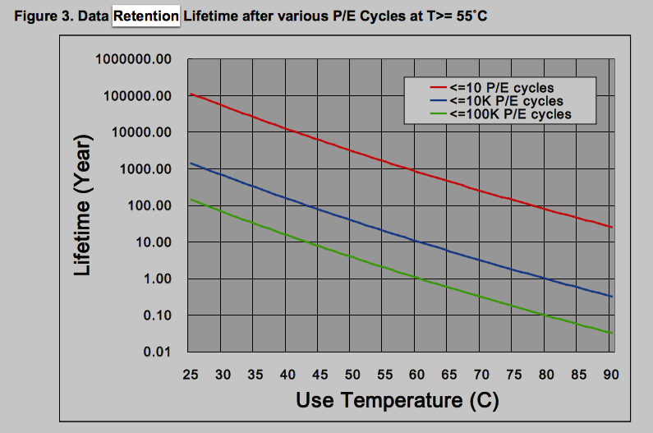
Data retention
http://www.macronix.com/Lists/ApplicationNote/Attachments/750/AN0291V2-ProgramErase%20Cycling%20Endurance%20and%20Data%20Retention%20in%20NOR%20Flash%20Memories.pdf

Slide 16
1 Bit Read/Write
+
C
V
-

Slide 17
Example Problem #2
V
(Students): Find i(t), q(t)
t
+
C
V
-

Slide 18
RC circuit
Find V(t), q(t), i(t)
R
+
C
V
-

Slide 20
Example Capacitor Problem #2
Find V(t), q(t)
I(t)=I₀cos(ωt)
+
C
V
-

Slide 22
Phasors

Slide 24
Parallel Capacitors
?
i₁
i₂
i₃
i_{N}
=
i
C₁
C₂
C₃
C_{N}
i
C_{equivalent}

Slide 25
Series Capacitors
C₁
C₂
C₃
C_{N}
?
+
-
+
-
+
-
+
-
=
V₁
V₂
V₃
V_{N}
+
V
+
V
C_{equivalent}
-
-

Slide 26
Example problem #4
(Students) Find V(t), given that V(t=0) = 5 Volts
1 kΩ
+
1 μF
2 μF
V
4 kΩ
3 μF
-

Slide 27
Inductors
L
i
A=area
l=wire length
N = # of turns
μ = 4 π 10⁻⁶ H/m
+
-
V
Henry[H]
V

Slide 28
Series Inductors
L₁
L₂
L₃
?
+
-
+
-
+
-
=
V₁
V₂
V₃
+
V
+
V
L_{equivalent}
-
-

Slide 29
Parallel Inductors
?
i₁
i₂
i₃
i_{N}
=
+
L₁
L₂
L₃
L_{N}
+
V
V
L_{equivalent}
-
-

Slide 30
Example Inductor Problem
(Students): Find V(t).
L₁
+
V
-

Slide 31
Example Inductor Problem #2
V
(Students): Find i(t)
t
L₁
+
V
-

Slide 32
Example Inductor Problem #3
Find V(t)
L
+
I(t)=I₀cos(ωt)
V
-

Slide 33
Impedance

Slide 34
LR circuit
Find V(t), i(t)
R
L₁
+
V
-

Slide 35
Example LR problem
(Students) Find V(t), given that V(t=0) = 5 Volts
+
1 kΩ
4 kΩ
1 μH
2 μH
V
3 μH
-

Slide 36
Power
I
I x V_{ab} = power
a
Watts [W] = Volt Amp [V-A]
Note: MKSA unit system: Meters Kilogram Second Amp
b
Resistor:
Energy lost to heat…
Inductor or capacitor:
Energy STORED and can be recovered…

Slide 37
Energy stored
I
I x V_{ab} = power
a
Energy:
b
Capacitor stored energy:
Inductor stored energy:

Slide 38
Symbol library
I_{ab}
I=5 A
a
+
+
a
+
a
-
b
b
-
-
b

Slide 39
Symbol library
+
+
2
-
-
+
C
-
i
+
-
V
i₇
i₇
i₇
2 Ω
3 V
3 A
3 i₁
2 i₁
+
+
-
-

