Slide 1
EECS 70A: Network Analysis
Announcements:
HW
Midterm
Lecture 12

Slide 2
Resistors
I_{ab}
V_{ab} = I_{ab} x R
a
+
R
Resistance units: Ohms [Ω]
-
b

Slide 3
Generalize: N resistors in parallel
R₁
R₂
R₃
R_{N}
=
R_{eq}
R₁ ǁ R₂ is notation for “R₁ in parallel with R₂”

Slide 4
Generalize: N resistors in series
R₁
R₂
=
R_{eq}
R₃
R_{N}

Slide 5
Kirchoff’s current law
You have already seen:
i₂
i₁=i₂+i₃
i₁
i₃
Like water in a river…
More generally:
Sum of currents entering node = sum of currents leaving node.
Stated as Kirchoff’s current law (KCL):
Current entering a node: i_{n} positive
Current leaving a node: i_{n} negative

Slide 6
Kirchoff’s voltage law
around any closed loop.
voltage drops

Slide 7
Sign of voltage drop
i
R
i
R
Voltage drop
= + i R
Voltage drop
= - i R
5 V
5 V
+
+
-
-
Voltage drop
= - 5 V
Voltage drop
= + 5 V

Slide 8
KVL example
If the voltage is dropping as you go around the loop, the voltage drop v_{n} is positive.
Apply KVL to the circuit below
1 kΩ
3 V
2 V
7 kΩ
+
+
-
-
2 V
+
3 kΩ
-
+
-
2 kΩ
7 V

Slide 9
3 V
3 A
7 Ω
7 Ω
7 Ω
+
-
a
i₁
+
2 Ω
3 i₁
3 A
2 i₁
7 Ω
7 Ω
+
-
3 V
3 V
3 V
3 Ω
5 Ω
+
+
+
-
-
-
-
b
2 Ω
5 Ω
7 Ω
7 Ω
3 A
3 A
3 Ω
3 A
3 V
7 Ω
7 Ω
+
-
2 Ω
5 Ω
7 Ω
7 Ω
7 Ω
7 Ω
3 i₁
3 A
7 Ω
7 Ω
7 Ω
+
-
2 Ω
5 Ω
7 Ω
7 Ω
7 Ω
7 Ω
7 Ω
3 A
3 A
7 Ω
7 Ω

Slide 10
Nodal Analysis(Review)
Based on KCL, use node voltages as circuits variables.
Define a reference node.
Label remaining nodes (n-1 nodes) e.g. V₁, V₂, V₃, …
“Supernode”:
Case 1: Voltage source connected to reference node: solves one node.
Case 2: Voltage source not connected to reference: Define supernode
Apply KCL all nodes (& supernodes)
Express all i’s in terms of v’s using Ohm’s law
Apply KVL to loops with voltage source
Solve the n-1 simultaneous equations, to find V’s (e.g. using Kramer’s rule)
Use Ohm’s law to find the currents.

Slide 11
“Supernode”
A node with a voltage source in it…
i₂
KCL:
i₃
+
-
i₁
i₄
Must define a supernode if a voltage source appears when doing nodal analysis…
(unless one end of voltage source connected to reference node)

Slide 12
“Supernode”
A node with a voltage source in it…
i₂
KCL:
i₃
+
-
i₁
i₄
Must define a supernode if a voltage source appears when doing nodal analysis…
(unless one end of voltage source connected to reference node)

Slide 13
Nodal Analysis-Example
0.2 Ω
i₁
+
-
1 Ω
0.5 Ω
i₁
+ V₀ -
5 V
+
0.5 Ω
2V₀
-
0.2 Ω
1 Ω

Slide 15
Nodal analysis example 1
2 kΩ
1 kΩ
3 kΩ
3 A

Slide 16
Nodal analysis example 1
Define a reference node.
Label remaining nodes.
Apply KCL + ohm.
i₁
i₂
R₁
R₂
i₃
i₄
i₅
R₃
R₄
R₅
i₆
i₇
3 A
R₆
R₇
i₈
i₉
i₁₀
R₈
R₉
R₁₀
R₁₁
R₁₂
i₁₁
i₁₂
Typical notation:
i₁ is current through R₁. (Same as before)
V₁ is voltage of node 1 relative to
reference node. (Different from before)

Slide 17
Nodal analysis example 2
3 Ω
7 Ω
6 Ω
9 Ω
8 Ω
2 Ω
4 Ω
5 Ω
3 V
4 V
5 V
6 V
7 V
8 V
9 V
+
+
+
11 Ω
+
7 Ω
+
+
+
-
-
-
-
-
-
-

Slide 18
Nodal analysis example 3
3 Ω
5 V
8 Ω
+
-
3 V
11 Ω
7 Ω
8 V
+
+
-
-

Slide 19
Mesh analysis summary
Based on KVL, use mesh currents as circuit variables.
Assign mesh currents i₁, i₂, … i_{n}
Apply KVL + Ohm’s law to each mesh
Supermesh (if there is a current source present):
CASE 1: current source only in one mesh.
Already have the current for that mesh => no need to write KVL for that mesh
CASE 2: current source exits between two meshes. => create a supermesh
Apply KVL to the supermesh
Apply KCL to a node in the branch where two meshes intersect
Solve the equations for i₁ ,i₂ ,…i_{n} (e.g. using Kramer’s rule)
Then solve for voltages using Ohm’s law

Slide 20
Mesh Analysis-Introduction What is a Mesh?
A loop is a closed path with no node passed more than once.
A mesh is a loop that does not contain any other loops within it.

Slide 21
Mesh Analysis-Introduction Mesh Current vs. Element Current
+
V₂
-
The current through a mesh is known as mesh current.
Direction of the mesh current is arbitrary-conventionally assumed to be clockwise.
The current through an element can be the same as mesh current or the subtraction of two mesh currents.
+
-
V₁
V₃
-
+
+
V₄
-

Slide 22
Mesh analysis example
V_{α}
Using mesh analsysis, find the currents and voltages in this circuit:
+
-
6 Ω
5 Ω
7 Ω
i_{β}
V_{α}
+
-
3 Ω
2 Ω
i_{β}
5V
4 Ω
8 V
+
+
-
-

Slide 23
Mesh Analysis Example 1
7 Ω
2 Ω
7 V
3 V
10 V
+
+
+
-
-
-
8 Ω
3 Ω

Slide 24
Mesh Analysis Example 2
2 Ω
4 Ω
5 V
7 V
+
+
3 A
-
-
6 Ω
5 Ω

Slide 25
Mesh Analysis Example 3
2 Ω
6 Ω
+
5 V
-
3 Ω
10 V₁
+
V₁
-
2 V
8 V
+
+
-
-
10 Ω

Slide 26
Apply KVL+ Ohm’s Law to Each Mesh
R1
R4
10 v
+
R3
+
5 v
-
-
R2
R5

Slide 27
Mesh Analysis - Example
7 Ω
2 Ω
i
4 Ω
1 Ω
+
2 i
+
-
-
5 v
3 Ω

Slide 28
Mesh Analysis with Current Sources
CASE 1: current source only in one mesh.
already have the current for that mesh => no need to write KVL for that mesh
3 Ω
5 Ω
10 v
+
7 Ω
5 A
-
10 Ω
2 Ω

Slide 29
Mesh Analysis with Current Sources
CASE 2: current source exits between two meshes. => create a supermesh
Apply KVL to the supermesh
Apply KCL to the supermesh
3 Ω
5 Ω
5 A
10 v
+
7 Ω
-
3 Ω
10 Ω
2 Ω

Slide 30
Mesh Analysis- Example
6 v
+
-
2 Ω
4 Ω
1 Ω
+
12 v
-
5 Ω
3 A

Slide 31
Mesh Analysis- Example
5 Ω
5 A
2 Ω
3 Ω
7 Ω
3 A

Slide 32
Nodal vs. mesh analysis?
i₁
i₂
i₃
i₄
2 A
7 Ω
5 Ω
5 A
3 Ω

Slide 33
Nodal vs. mesh analysis?
i₁
i₂
i₃
i₄
2 A
7 Ω
2 Ω
5 Ω
5 A
3 Ω

Slide 34
Thevenin, Norton Theorems:
Linear two-terminal circuit
Thevenin:
Calculating V_{th}: Connect nothing to a-b. Calculate voltage. This is V_{th}.
Calculating R_{th}:
Method 1: Connect terminal a to b (short). Calculate the current from a to b. This is call I_{short circuit}.
R_{th}=V_{th}/I_{short circuit}.
Method 2: Find the input resistance looking into terminals a-b after all the independent sources have been turned off. (Voltage sources become shorts, current sources become opens.) Trick (if dependent sources present): Apply a 1 A current source to terminals a-b, find V_{ab}
R_{th} = V_{ab}/1A.
a
+
-
b
Equivalent to:
R_{th}
a
V_{th}
+
+
-
-
b
Equivalent to:
a
Norton:
Calculating R_{N}: R_{N}=R_{th} (same method as 2 above)
Calculating I_{N}:
I_{N}=V_{th}/R_{th}
OR:
I_{N}=I_{short circuit}
I_{N}
R_{N}
+
-
b

Slide 35
Example problem
Find the Thevenin & Norton equivalent circuit of the circuit below with respect to terminals a and b:
1 Ω
2 Ω
a
+
4 V
4 Ω
1 A
-
2 Ω
b

Slide 36
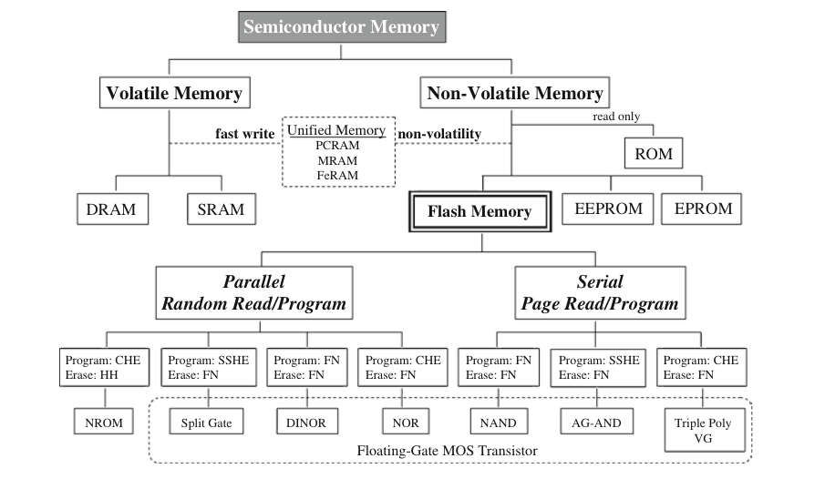
1. Ogura, T. Flash Memory. CMOS Processors and Memories 2010, 197–232.

Slide 37
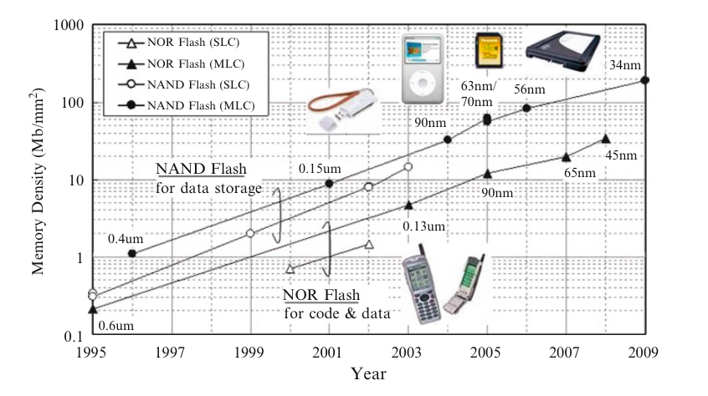
Flash Memory
1. Ogura, T. Flash Memory. CMOS Processors and Memories 2010, 197–232.

Slide 38
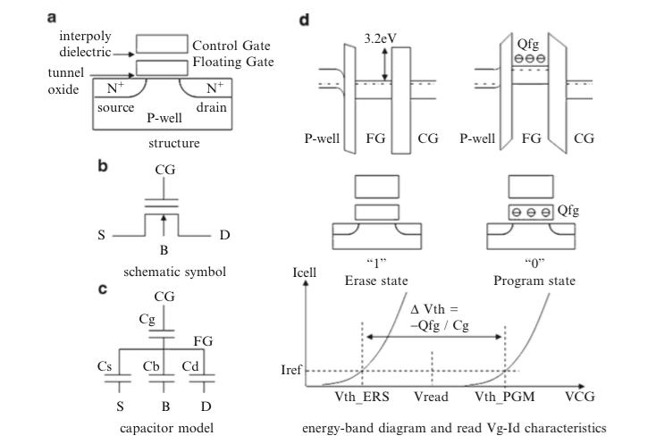
Flash memory
1. Ogura, T. Flash Memory. CMOS Processors and Memories 2010, 197–232.

Slide 39
SRAM

Slide 40
DRAM

