Slide 1
EECS 70A: Network Analysis
Announcements:
Announcements
Lecture 5

Slide 2
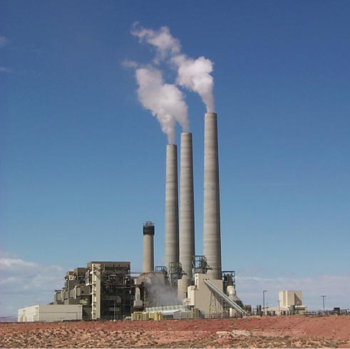
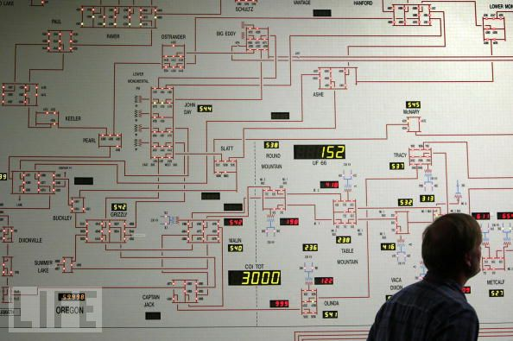
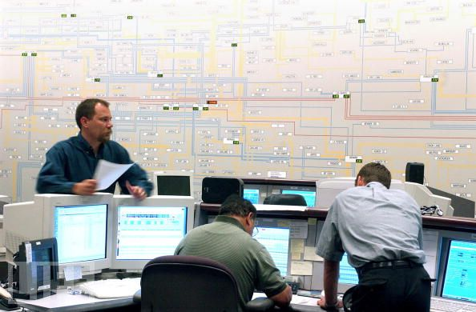
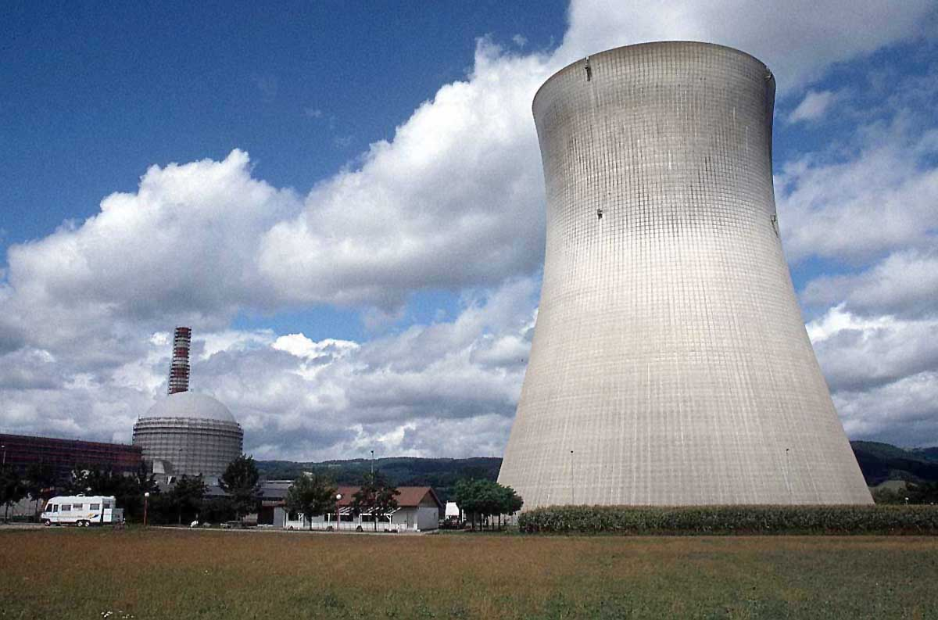
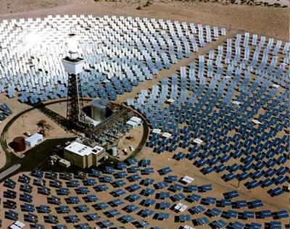

Slide 3
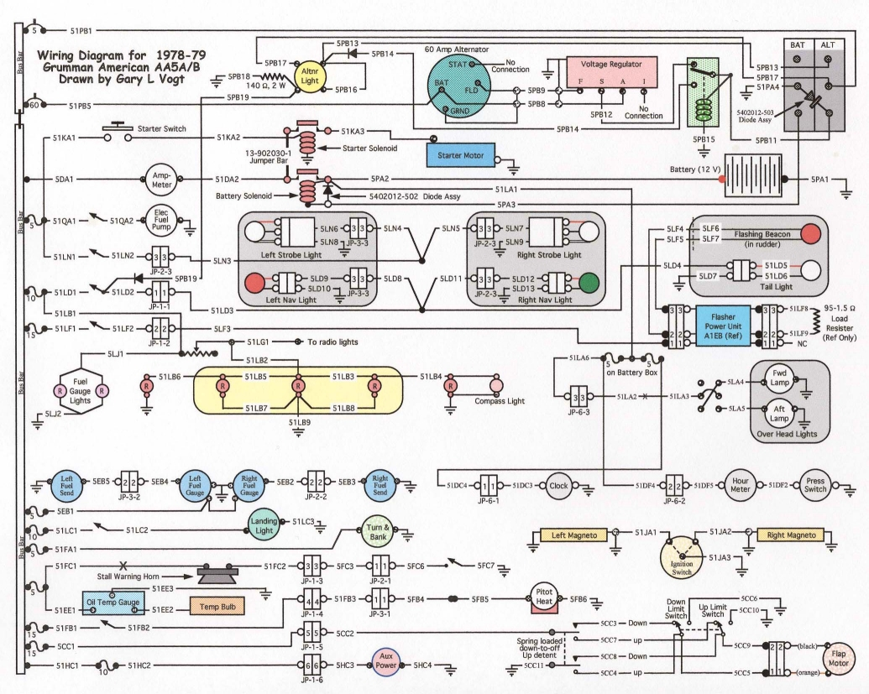


Slide 4

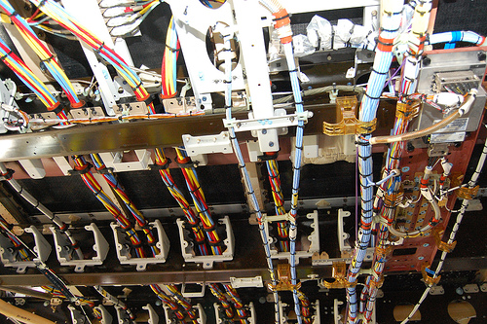


Slide 5
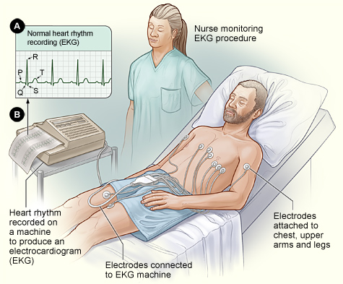
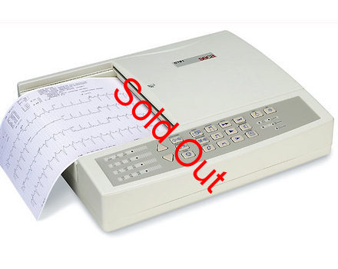

Slide 6
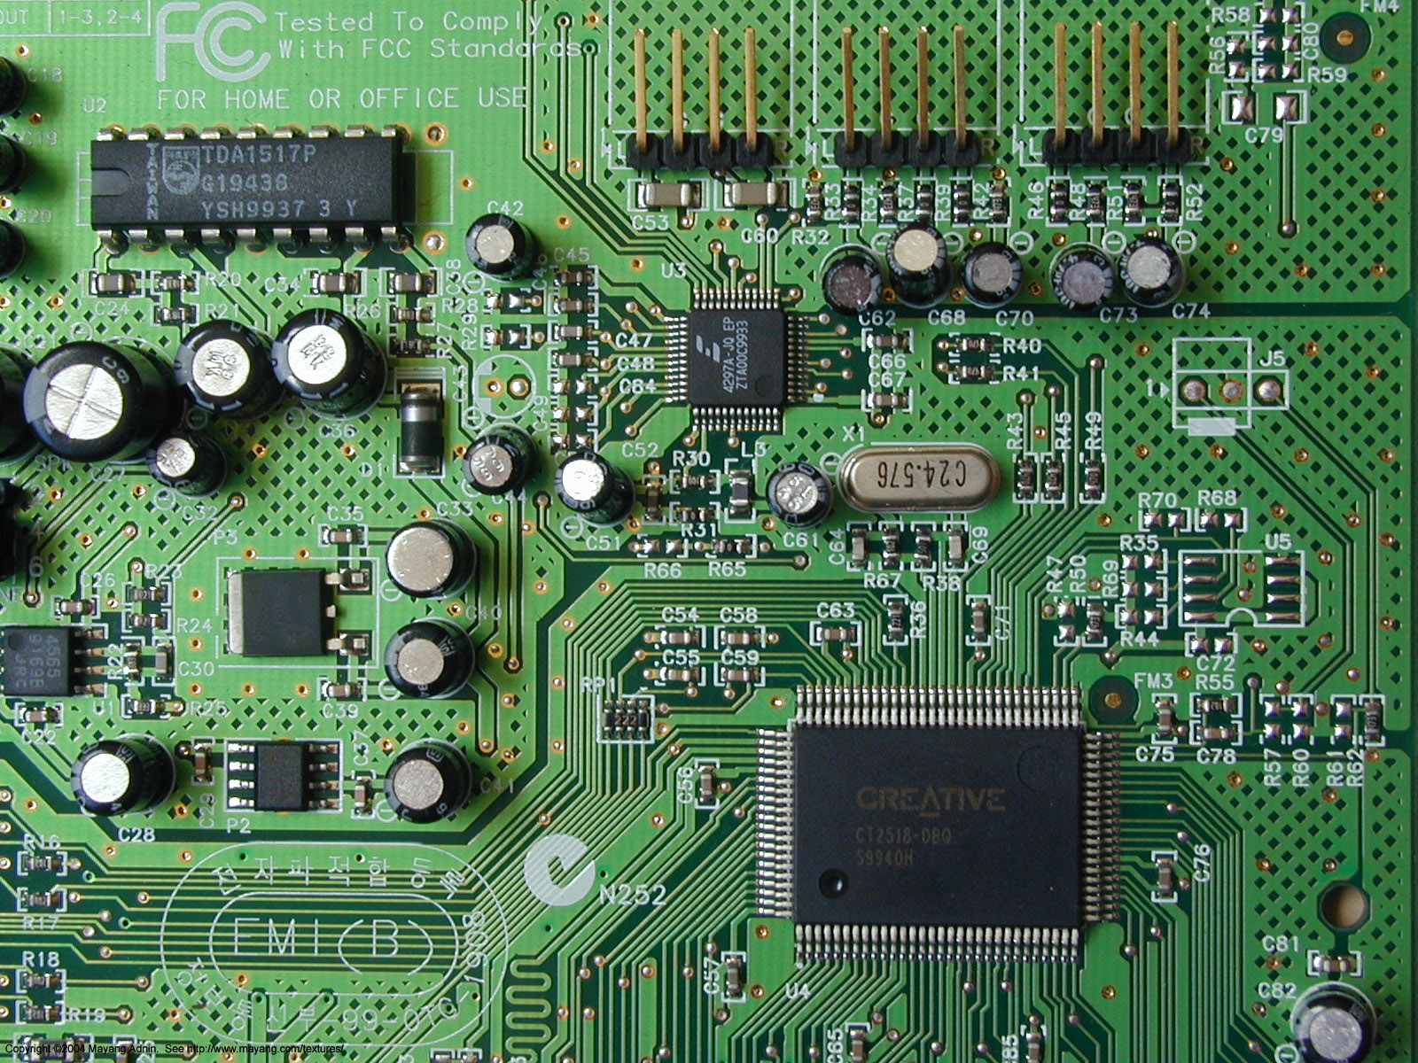

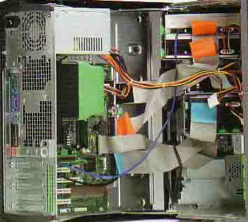

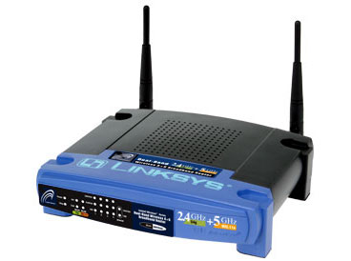



Slide 7
3 V
(Monster HW problem)
+
3 A
7 Ω
7 Ω
7 Ω
-
i₁
2 Ω
3 i₁
3 A
2 i₁
7 Ω
7 Ω
+
-
3 V
3 V
3 V
3 Ω
5 Ω
+
+
+
-
-
-
2 Ω
5 Ω
7 Ω
7 Ω
3 A
3 A
3 Ω
3 A
3 V
7 Ω
7 Ω
+
-
2 Ω
5 Ω
7 Ω
7 Ω
7 Ω
7 Ω
3 i₁
3 A
7 Ω
7 Ω
7 Ω
+
-
2 Ω
5 Ω
7 Ω
7 Ω
7 Ω
7 Ω
7 Ω
3 A
3 A
7 Ω
7 Ω

Slide 8
+
+
Nodal analysis
(simplified)
Nodal analysis
(complete)
+
+
-
-
Later in course:
All our methods can also be used with these elements.

Slide 9
+
+
+
+
Mesh analysis
(simplified)
-
-
Mesh analysis
(complete)

Slide 10
Diode
Nodal/mesh analysis won’t work on this but…
Solar cell is a diode.
Behaves like:
Radio wave detector is a diode.
Behaves like:
Detector
V_{dc} = 0.1 x V_{ac}
V_{ac}
+
-
b
Nodal/mesh analysis works on these equivalent circuits!

Slide 11
Transistors
drain
gate
Nodal/mesh analysis won’t work on this but…
source
In some cases behaves like switch:
In some cases behaves like potentiometer:
In some cases behaves like VCCS:
drain
drain
drain
R
αR
5 x V_{gate}
source
V_{gate} | Switch
+ 5 V | Open
0 V | Closed
source
source
R_{sd} = (constant) x V_{gate}
Nodal/mesh analysis works on these equivalent circuits!

Slide 12
Nodal vs. mesh analysis
Consider 2 examples, each with 2 resistors.
For both problems, find i₁, i₂, V₁, V₂.
Is it easier to solve for the currents or the voltages first?
i₁
i₂
R₁
+
R₂
+
V₁
V₂
i₀
i₁
i₂
-
-
+
R₂
+
3 V
R₁
V₁
V₂
+
-
-
-
i₁
R₁
+
V₁
3 A
-
i₂
R₂
+
V₂
-

Slide 13
Notation: two elements in series
Textbook chapter 2 notation:
i
a
i
+
R₁
R₁
V₁
-
i
b
i
R₂
R₂
+
V₂
i
i
-
c
c
V_{ab} is the voltage drop across resistor 1
V₁ is the voltage drop across resistor 1

Slide 14
Nodal analysis
Define a reference node.
Label remaining nodes
i
a
R₁
i
b
R₂
i
c
V_{ab} is the voltage drop across resistor 1

Slide 15
Example (Ch. 2 notation)
V₁
V₂
i₁
i₂
+
-
+
-
R₁
R₂
i₃
i₄
i₅
R₃
V₃
R₄
V₄
R₅
V₅
+
-
+
-
+
-
V₆
V₇
i₆
i₇
3 A
+
-
+
-
R₆
R₇
i₈
i₉
i₁₀
R₈
V₈
R₉
V₉
R₁₀
V₁₀
+
-
+
-
+
-
V₁₁
V₁₂
+
-
+
-
R₁₁
R₁₂
i₁₁
i₁₂
Typical notation:
V₁ is voltage drop across R₁.
i₁ is current through R₁.
Label voltages as drops across resistors.

Slide 16
Same circuit: Nodal analysis
Define a reference node.
Label remaining nodes.
Apply KCL + ohm.
i₁
i₂
R₁
R₂
i₃
i₄
i₅
R₃
R₄
R₅
i₆
i₇
3 A
R₆
R₇
i₈
i₉
i₁₀
R₈
R₉
R₁₀
R₁₁
R₁₂
i₁₁
i₁₂
Typical notation:
i₁ is current through R₁. (Same as before)
V₁ is voltage of node 1 relative to
reference node. (Different from before)

Slide 17
Kramer’s rule
Solve for x,y,z in terms of known constants a₁₋₃, b₁₋₃, c₁₋₃, d₁₋₃:

Slide 18
Determinants:
Solve for x,y,z in terms of known constants a₁₋₃, b₁₋₃, c₁₋₃, d₁₋₃:

Slide 19
Nodal analysis example
i₁
i₂
i₅
3 Ω
7 Ω
i₃
i₄
i₅
2 A
2 Ω
4 Ω

Slide 20
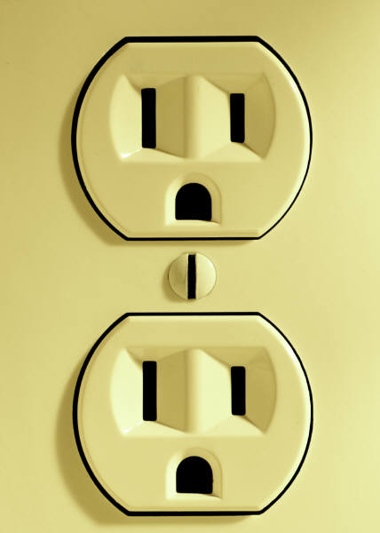

Ground?
?

Slide 21
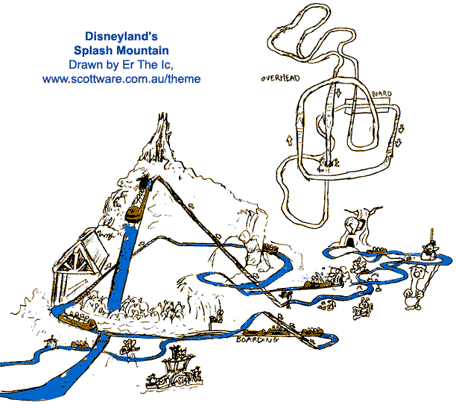

Slide 22
Nodal analysis example
i₁
i₂
i₃
i₄
2 A
7 Ω
2 Ω
5 Ω
5 A
3 Ω

Slide 23
Questions?

Slide 24
KCL examples
From Lecture 3, Week 2: Find a relationship among i₁,i₂, i₃,i_{4…}
i₁
i₃
i₂
i₈
i₄
i₇
i₆
i₅

Slide 25
“Supernode”
A node with a voltage source in it…
i₂
KCL:
i₃
+
-
i₁
i₄
Must define a supernode if a voltage source appears when doing nodal analysis…
(unless one end of voltage source connected to reference node)
Define a reference node.
Label remaining nodes.
Apply KCL + ohm to all nodes and supernodes
Apply KVL to loop with voltage source

Slide 26
Example nodal w/voltage source
5 A
10 V
2 Ω
+
-
2 Ω
3 Ω
3 A

Slide 27
Questions?

Slide 28
Example nodal w/voltage source
5 Ω
5 A
2 Ω
3 Ω
7 Ω
3 A

Slide 29
Example nodal w/voltage source
2 Ω
4 Ω
3 Ω
2 Ω
10 V
2 i₁
+
-

Slide 30
Symbol library
I_{ab}
I=5 A
a
+
+
a
+
a
-
b
b
-
-
b

Slide 31
Symbol library
+
+
2
-
-
+
-
i₇
i₇
i₇
2 Ω
3 V
3 A
3 i₁
2 i₁
+
+
-
-

Slide 32
Symbol & circuit library

