Slide 1
Resonance

Slide 2
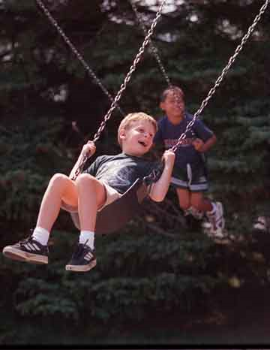

Slide 3
Band pass filter (RLC)
+
C
V₁
-
INPUT:
V(t)=V₀ cos(ωt)
a
+
+
OUTPUT:
V_{ab}(t)
V₂
R
-
-
b

Slide 5
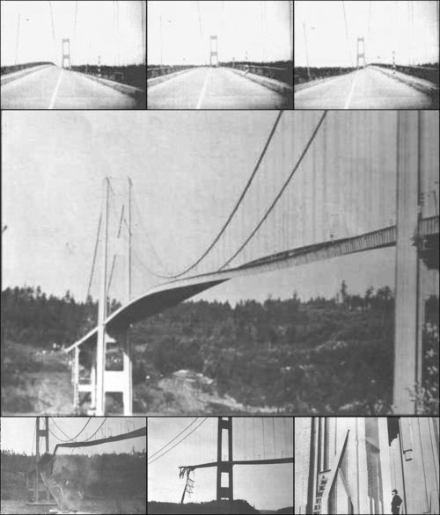
Tacoma Narrows Bridge (1940)
Nov 7, 1940
http://www.youtube.com/watch?v=3mclp9QmCGs

Slide 6
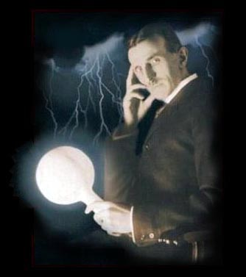
Tesla

Slide 7
Goals rest of quarter: Understand these knobs!
http://www.peachparts.com/shopforum/showthread.php?t=256624

