Slide 1
EECS 70A: Network Analysis
Announcements:
Announcements
Lecture 7 & 8

Slide 2
Nodal analysis summary
Define reference node
Label remaining nodes (e.g. V₁, V₂, V₃, …)
Apply KCL + Ohm’s law
Solve for nodal voltages (e.g. using Kramer’s rule)
Solve for currents

Slide 3
Nodal analysis example
Define a reference node.
Label remaining nodes.
Apply KCL + ohm.
i₁
i₂
R₁
R₂
i₃
i₄
i₅
R₃
R₄
R₅
i₆
i₇
3 A
R₆
R₇
i₈
i₉
i₁₀
R₈
R₉
R₁₀
R₁₁
R₁₂
i₁₁
i₁₂
Typical notation:
i₁ is current through R₁. (Same as before)
V₁ is voltage of node 1 relative to
reference node. (Different from before)
We will do this entire problem in class…
Using these techniques, you can attempt the “monster problem” as extra credit on HW3…

Slide 4
Mesh analysis summary
Assign mesh currents i₁, i₂, … i_{n}
Apply KVL to each mesh
Solve for mesh currents (e.g. using Kramer’s rule)
Then solve for voltages

Slide 5
Assigning mesh currents
R₁
R₂
V₁
+
R₃
+
V₂
-
-

Slide 6
Nodal vs. mesh analysis?
i₁
i₂
i₃
i₄
2 A
7 Ω
2 Ω
5 Ω
5 A
3 Ω

Slide 7
Nodal analysis example
i₁
i₂
i₃
i₄
2 A
7 Ω
2 Ω
5 Ω
5 A
3 Ω

Slide 8
Nodal vs. Mesh Analysis
2 Ω
5 Ω
6 V
3 Ω
4 V
+
+
-
-
4 Ω
1 Ω
1 Ω
1 Ω
+
+
-
-
2 V
3 V

Slide 9
Nodal vs. Mesh Analysis
2 Ω
5 Ω
6 V
3 Ω
4 V
+
+
-
-
4 Ω
1 Ω
1 Ω
1 Ω
+
+
-
-
2 V
3 V

Slide 10
3 V
(Monster HW problem)
+
3 A
7 Ω
7 Ω
7 Ω
-
i₁
2 Ω
3 i₁
3 A
2 i₁
7 Ω
7 Ω
+
-
3 V
3 V
3 V
3 Ω
5 Ω
+
+
+
-
-
-
2 Ω
5 Ω
7 Ω
7 Ω
3 A
3 A
3 Ω
3 A
3 V
7 Ω
7 Ω
+
-
2 Ω
5 Ω
7 Ω
7 Ω
7 Ω
7 Ω
3 i₁
3 A
7 Ω
7 Ω
7 Ω
+
-
2 Ω
5 Ω
7 Ω
7 Ω
7 Ω
7 Ω
7 Ω
3 A
3 A
7 Ω
7 Ω

Slide 11
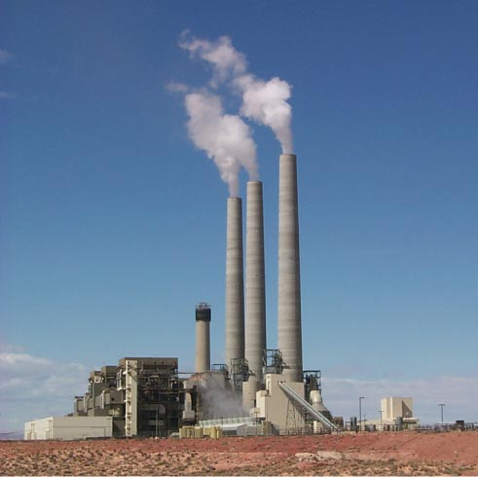
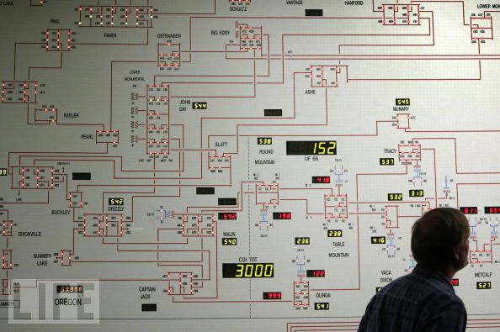
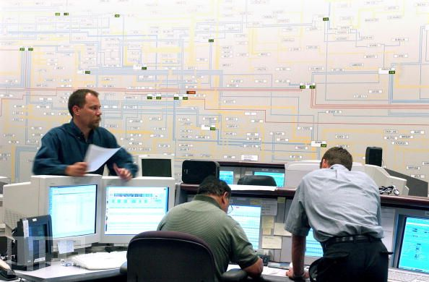
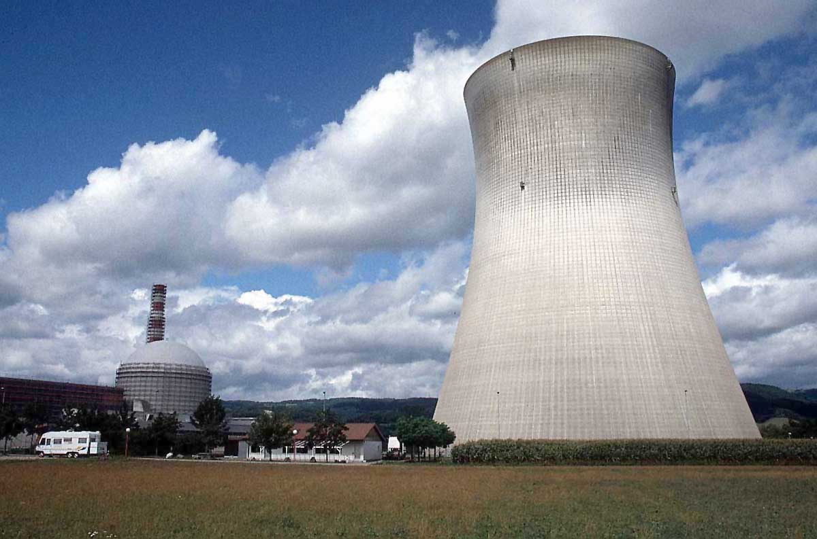
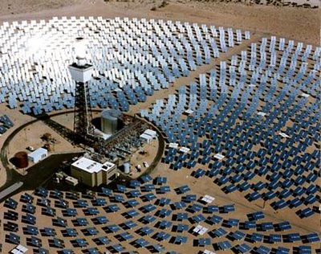

Slide 12
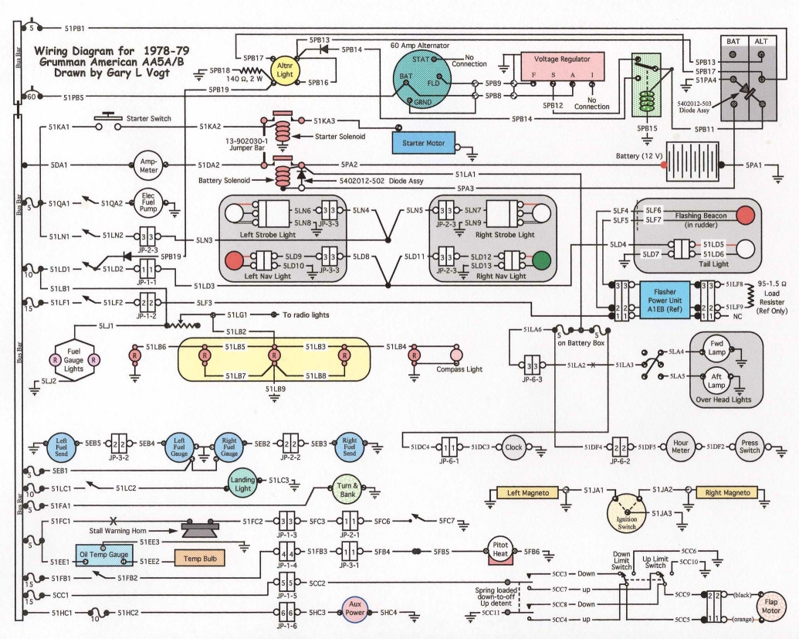

Slide 13
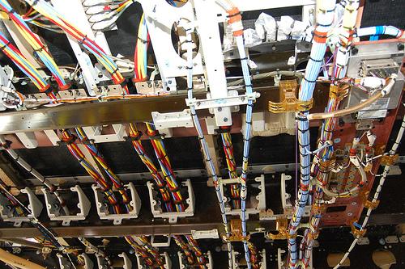

Slide 14
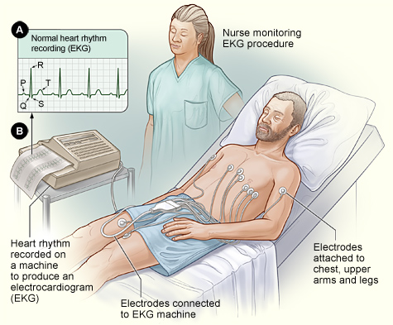
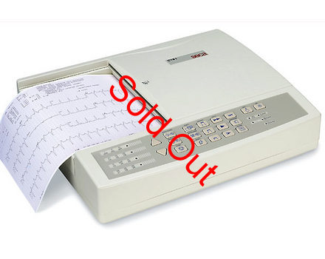

Slide 15
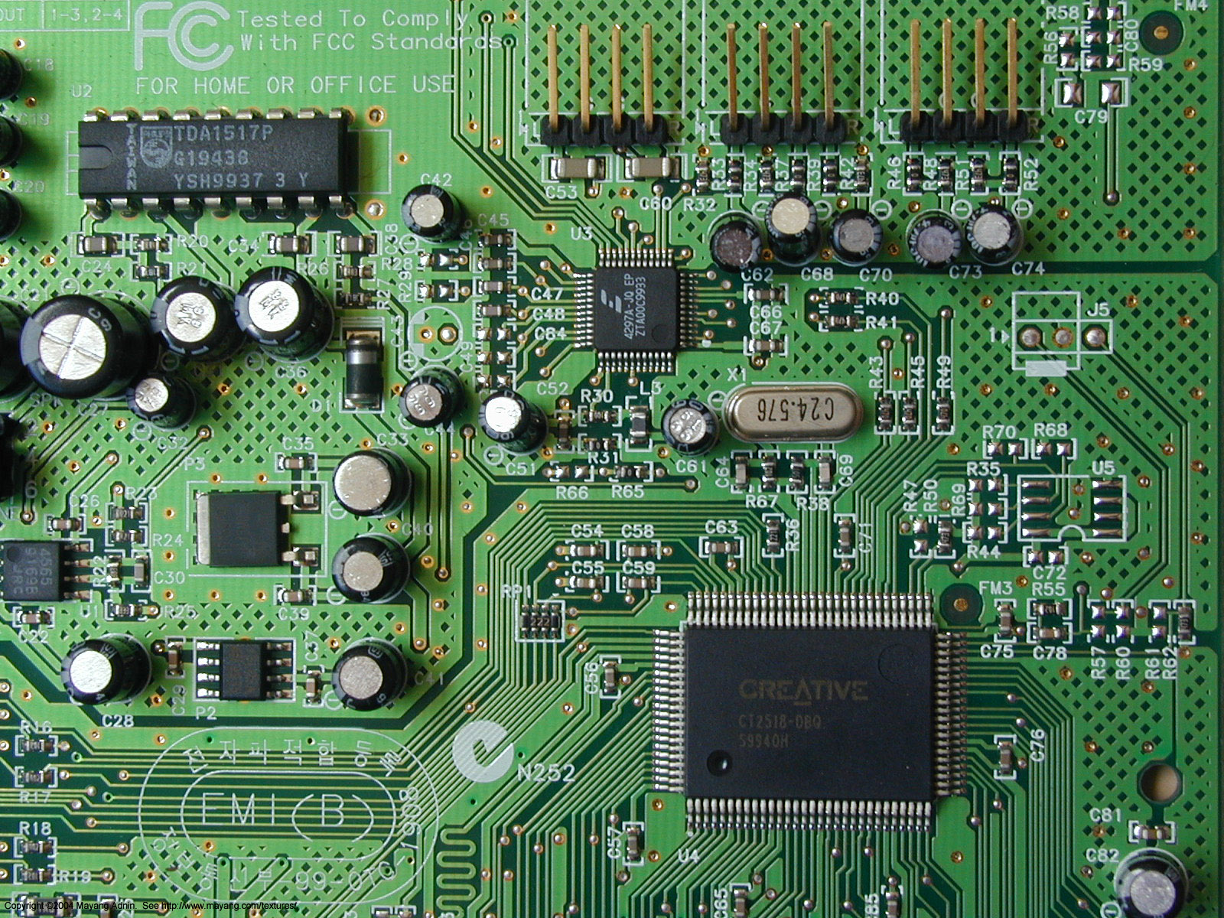
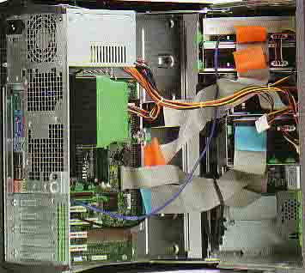

Slide 16
Compartmentalization: Need for simplicity
Power brick image.
And ask class to show their own…
Demo: Computer?

Slide 17
Thevenin’s Theorem
I
Linear two-terminal circuit
Load
a
+
-
b
Equivalent to:
R_{th}
Load
a
V_{th}
+
+
-
-
b

Slide 18
Finding V_{th}, R_{th}
Linear two-terminal circuit
a
+
-
b
Equivalent to:
R_{th}
a
V_{th}
+
+
-
-
b

Slide 19
Source/load
R_{source}
V_{source}
+
R_{load}
-
Derivation:
Case 1:
Thevenin Thm:
Any circuit can be
represented by this
equivalent circuit.
Case 2:
We say R_{load} “loads down” the source.

Slide 20
Source/load
R_{source}
V_{source}
+
R_{load}
-
Derivation:
Case 1:
Thevenin Thm:
Any circuit can be
represented by this
equivalent circuit.
Case 2:
We say R_{load} “loads down” the source.

Slide 21
Example
Find Thevenin equivalent circuit:
R₁
V₁
+
-
R₂

Slide 22
Norton’s Theorem
I
Linear two-terminal circuit
Load
a
+
-
b
Equivalent to:
Load
a
I_{N}
R_{N}
+
-
b

Slide 23
Finding V_{th}, R_{th}
Linear two-terminal circuit
a
+
-
b
Equivalent to:
Equivalent to:
R_{th}
a
a
V_{th}
+
+
+
I_{N}
R_{N}
-
-
-
b
b

Slide 24
Example
Find the Thevenin & Norton equivalent circuit of the circuit below with respect to terminals a and b:
12 Ω
a
+
+
30 V
60 Ω
2 V_{x}
+
V_{x}
-
-
-
b

Slide 29
3 V
(Monster HW problem: Part 2):Find the Thevenin & Norton equivalent circuit of the circuit below with respect to terminals a and b:
+
3 A
7 Ω
7 Ω
7 Ω
-
a
i₁
+
2 Ω
3 i₁
3 A
2 i₁
7 Ω
7 Ω
+
-
3 V
3 V
3 V
3 Ω
5 Ω
+
+
+
-
-
-
-
b
2 Ω
5 Ω
7 Ω
7 Ω
3 A
3 A
3 Ω
3 A
3 V
7 Ω
7 Ω
+
-
2 Ω
5 Ω
7 Ω
7 Ω
7 Ω
7 Ω
3 i₁
3 A
7 Ω
7 Ω
7 Ω
+
-
2 Ω
5 Ω
7 Ω
7 Ω
7 Ω
7 Ω
7 Ω
3 A
3 A
7 Ω
7 Ω

Slide 32
Power
R_{th}
a
Arrow means R_{L} variable (e.g. by a knob)
V_{th}
+
+
R_{L}
-
-
Power delivered to load = ?

Slide 40
Questions?

Slide 41
Ground?
?
Ground
Reference
Earth

Slide 42
Symbol library
I_{ab}
I=5 A
a
+
+
a
+
a
-
b
b
-
-
b

Slide 43
Symbol library
+
+
2
-
-
+
-
i₇
i₇
i₇
2 Ω
3 V
3 A
3 i₁
2 i₁
+
+
-
-

Slide 44
Symbol & circuit library

