Slide 1
EECS 70A: Network Analysis
Announcements:
Announcements
Lecture 9

Slide 2
Today’s Agenda
Thevinin/Norton theorem
Power transfer
Capacitors
Inductors

Slide 3
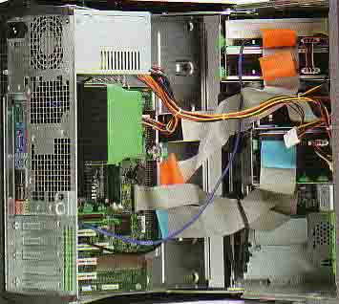
Compartmentalization: Need for simplicity
Power brick image.
And ask class to show their own…
Demo: Computer?

Slide 4
Thevenin’s Theorem
I
Linear two-terminal circuit
Load
a
+
-
b
Equivalent to:
R_{th}
Load
a
V_{th}
+
+
-
-
b

Slide 5
Finding V_{th}, R_{th}
Linear two-terminal circuit
a
+
-
b
Equivalent to:
R_{th}
a
V_{th}
+
+
-
-
b

Slide 6
Example
Find the Thevenin & Norton equivalent circuit of the circuit below with respect to terminals a and b:
12 Ω
a
+
+
30 V
60 Ω
2 V_{x}
+
V_{x}
-
-
-
b

Slide 7
Alternate method to find R_{th}:
12 Ω
a
+
+
30 V
60 Ω
2 V_{x}
+
V_{x}
-
-
-
b
Find R_{ab} when all independent sources turned off. (Voltage sources become shorts, current sources become opens).

Slide 8
Norton’s Theorem
I
Linear two-terminal circuit
Load
a
+
-
b
Equivalent to:
Load
a
I_{N}
R_{N}
+
-
b

Slide 9
Finding V_{th}, R_{th}
Linear two-terminal circuit
a
+
-
b
Equivalent to:
Equivalent to:
R_{th}
a
a
V_{th}
+
+
+
I_{N}
R_{N}
-
-
-
b
b

Slide 10
Example
Find the Thevenin & Norton equivalent circuit of the circuit below with respect to terminals a and b:
12 Ω
a
+
+
30 V
60 Ω
2 V_{x}
+
V_{x}
-
-
-
b

Slide 11
Example
(Students): Find Thevenin & Norton equivalent circuit:
R₁
V₁
+
-
R₂

Slide 12
3 V
(Monster HW problem: Part 2):Find the Thevenin & Norton equivalent circuit of the circuit below with respect to terminals a and b:
+
3 A
7 Ω
7 Ω
7 Ω
-
a
i₁
+
2 Ω
3 i₁
3 A
2 i₁
7 Ω
7 Ω
+
-
3 V
3 V
3 V
3 Ω
5 Ω
+
+
+
-
-
-
-
b
2 Ω
5 Ω
7 Ω
7 Ω
3 A
3 A
3 Ω
3 A
3 V
7 Ω
7 Ω
+
-
2 Ω
5 Ω
7 Ω
7 Ω
7 Ω
7 Ω
3 i₁
3 A
7 Ω
7 Ω
7 Ω
+
-
2 Ω
5 Ω
7 Ω
7 Ω
7 Ω
7 Ω
7 Ω
3 A
3 A
7 Ω
7 Ω

Slide 13
“Baby” monster problem
Find the Thevenin & Norton equivalent circuit of the circuit below with respect to terminals a and b:
3 V
3 A
7 Ω
7 Ω
7 Ω
+
-
a
i₁
+
2 Ω
3 i₁
3 A
2 i₁
7 Ω
7 Ω
+
-
3 V
3 V
3 V
3 Ω
5 Ω
+
+
+
-
-
-
-

Slide 14
Source/load
R_{source}
V_{source}
+
R_{load}
-
Derivation:
Case 1:
Thevenin Thm:
Any circuit can be
represented by this
equivalent circuit.
Case 2:
We say R_{load} “loads down” the source.

Slide 15
Source/load
R_{source}
V_{source}
+
R_{load}
-
Derivation:
Case 1:
Thevenin Thm:
Any circuit can be
represented by this
equivalent circuit.
Case 2:
We say R_{load} “loads down” the source.

Slide 16
Power
R_{th}
a
Arrow means R_{L} variable (e.g. by a knob)
V_{th}
+
+
R_{L}
-
-
Power delivered to load = ?

Slide 17
Questions?

Slide 18
Capacitors
+q
-q
A=area
d=plate separation
Farads[F] = Coulombs/Volt [C]/[V]
+
-
V
C
Dielectric constant:
i
SiO₂
+
-
HfO₂
V

Slide 19
“High-K Dielectric”
http://www.intel.com/technology/45nm/hafnium.htm?iid=tech_45nm+body_animation_hafnium

Slide 20
Time dependence
q, V, i can depend on time !
Implicit:
Will not always write (t), but it is assumed from now on.

Slide 21
Example Capacitor Problem
Find V(t), q(t)
+
C
V
-

Slide 22
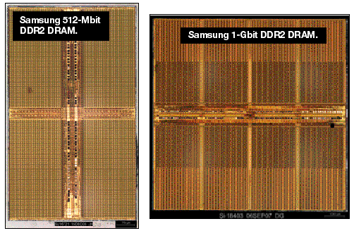
One-bit memory
Typical dimensions:
0.1 micron x 0.1 micron area
10 nm thickness.
What is C?
http://i.cmpnet.com/eet/news/07/11/DC1502_UTH_samsung.gif

Slide 23
1 Bit Read/Write
+
C
V
-

Slide 24
Example Problem #2
V
(Students): Find i(t), q(t)
t
+
C
V
-

Slide 25
RC circuit
Find V(t), q(t), i(t)
R
+
C
V
-

Slide 26
DRAM vs. SRAM

Slide 27
Example Capacitor Problem #2
Find V(t), q(t)
I(t)=I₀cos(ωt)
+
C
V
-

Slide 28
Parallel Capacitors
?
i₁
i₂
i₃
i_{N}
=
i
C₁
C₂
C₃
C_{N}
i
C_{equivalent}

Slide 29
Series Capacitors
C₁
C₂
C₃
C_{N}
?
+
-
+
-
+
-
+
-
=
V₁
V₂
V₃
V_{N}
+
V
+
V
C_{equivalent}
-
-

Slide 30
Example problem #4
(Students) Find V(t), given that V(t=0) = 5 Volts
1 kΩ
+
1 μF
2 μF
V
4 kΩ
3 μF
-

Slide 31
Inductors
L
i
A=area
l=wire length
N = # of turns
μ = 4 π 10⁻⁶ H/m
+
-
V
Henry[H]
V

Slide 32
Series Inductors
L₁
L₂
L₃
?
+
-
+
-
+
-
=
V₁
V₂
V₃
+
V
+
V
L_{equivalent}
-
-

Slide 33
Parallel Inductors
?
i₁
i₂
i₃
i_{N}
=
+
L₁
L₂
L₃
L_{N}
+
V
V
L_{equivalent}
-
-

Slide 34
Example Inductor Problem
(Students): Find V(t).
L₁
+
V
-

Slide 35
Example Inductor Problem #2
V
(Students): Find i(t)
t
L₁
+
V
-

Slide 36
Example Inductor Problem #3
Find V(t)
L
+
I(t)=I₀cos(ωt)
V
-

Slide 37
LR circuit
Find V(t), i(t)
R
L₁
+
V
-

Slide 38
Example LR problem
(Students) Find V(t), given that V(t=0) = 5 Volts
+
1 kΩ
4 kΩ
1 μH
2 μH
V
3 μH
-

Slide 39
Power
I
I x V_{ab} = power
a
Watts [W] = Volt Amp [V-A]
Note: MKSA unit system: Meters Kilogram Second Amp
b
Resistor:
Energy lost to heat…
Inductor or capacitor:
Energy STORED and can be recovered…

Slide 40
Energy stored
I
I x V_{ab} = power
a
Energy:
b
Capacitor stored energy:
Inductor stored energy:

Slide 41
Symbol library
I_{ab}
I=5 A
a
+
+
a
+
a
-
b
b
-
-
b

Slide 42
Symbol library
+
+
2
-
-
+
C
-
i
+
-
V
i₇
i₇
i₇
2 Ω
3 V
3 A
3 i₁
2 i₁
+
+
-
-

