Slide 1
EECS 70A: Network Analysis
Announcements:
Etc etc etc
Lecture 10

Slide 2
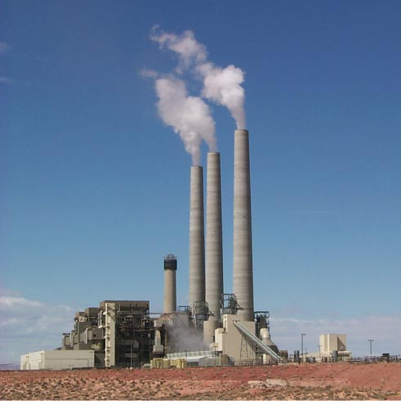
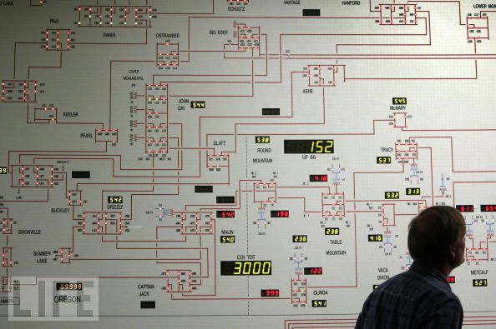
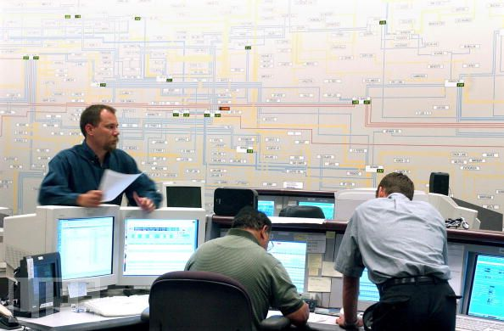
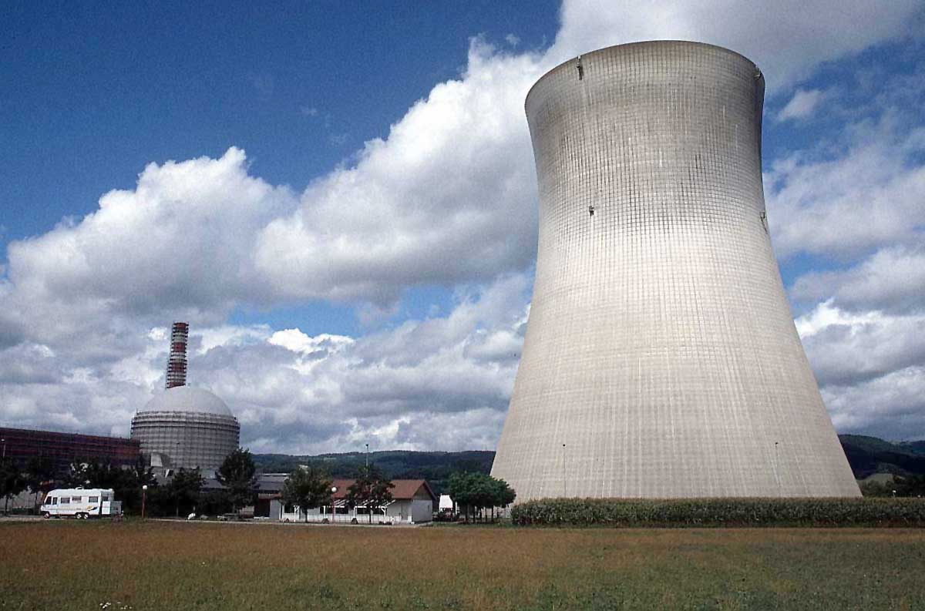
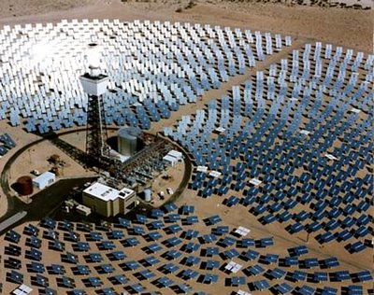

Slide 3
Capacitors
+q
-q
A=area
d=plate separation
Farads[F] = Coulombs/Volt [C]/[V]
+
-
V
C
Dielectric constant:
i
SiO₂
+
-
HfO₂
V

Slide 4
“High-K Dielectric”
http://www.intel.com/technology/45nm/hafnium.htm?iid=tech_45nm+body_animation_hafnium

Slide 5
Time dependence
q, V, i can depend on time !
Implicit:
Will not always write (t), but it is assumed from now on.

Slide 6
Example Capacitor Problem
Find V(t), q(t)
+
C
V
-

Slide 7
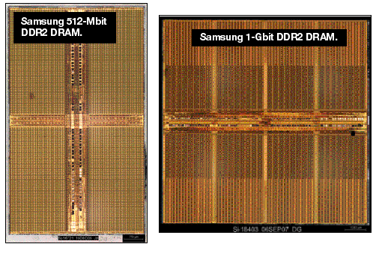
One-bit memory
Typical dimensions:
0.1 micron x 0.1 micron area
10 nm thickness.
What is C?
http://i.cmpnet.com/eet/news/07/11/DC1502_UTH_samsung.gif

Slide 8
1 Bit Read/Write
+
C
V
-

Slide 9
1 Bit Read/Write
+
C
V
-

Slide 10
1 Bit Read/Write
+
C
V
-

Slide 11
1 Bit Read/Write
+
C
V
-

Slide 12
Example Problem #2
V
(Students): Find i(t), q(t)
t
+
C
V
-

Slide 13
RC circuit
Find V(t), q(t), i(t)
R
+
C
V
-

Slide 19
DRAM vs. SRAM

Slide 21
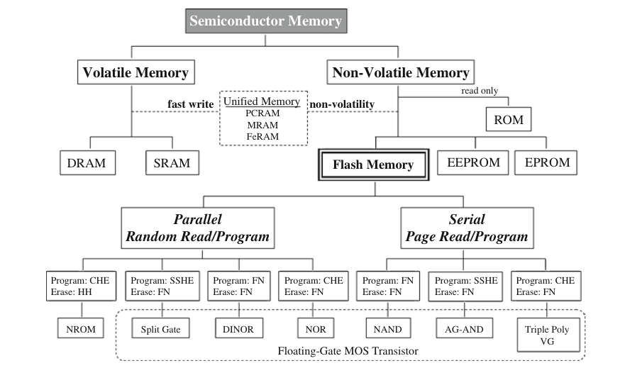
Semiconductor memory
1. Ogura, T. Flash Memory. CMOS Processors and Memories 2010, 197–232.

Slide 22
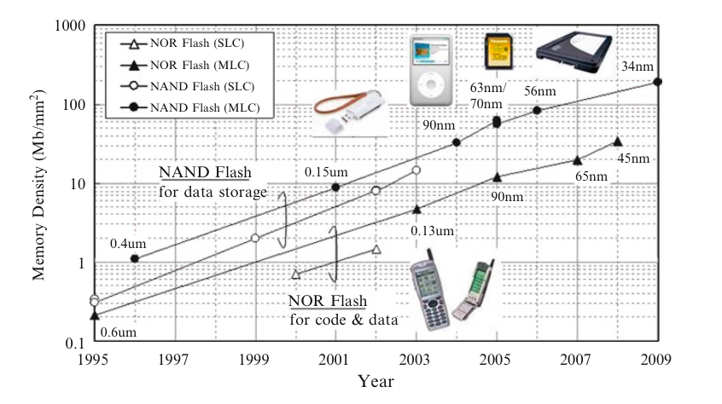
Flash Memory
1. Ogura, T. Flash Memory. CMOS Processors and Memories 2010, 197–232.

Slide 23
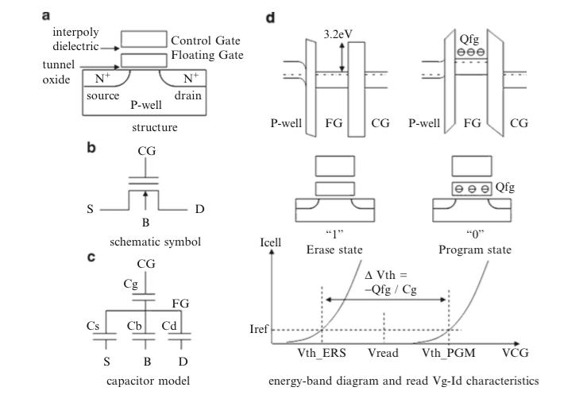
Flash memory
1. Ogura, T. Flash Memory. CMOS Processors and Memories 2010, 197–232.

Slide 24
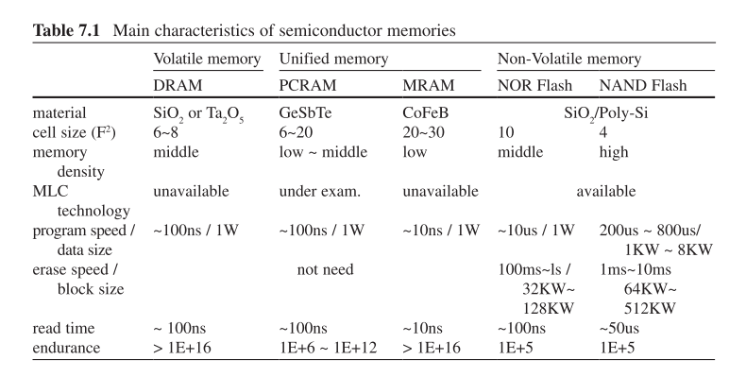
Flash memory
1. Ogura, T. Flash Memory. CMOS Processors and Memories 2010, 197–232.

Slide 25
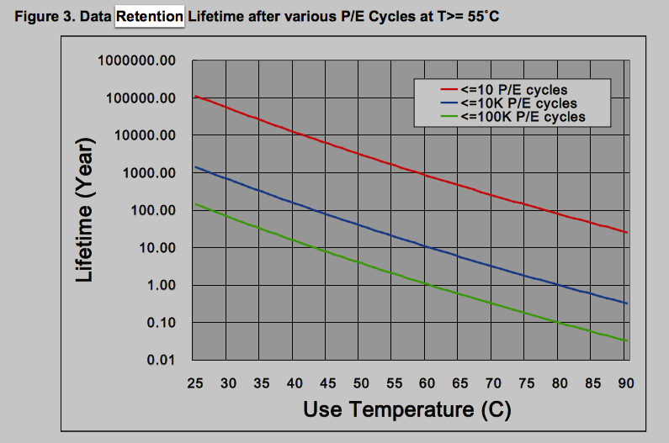
Data retention
http://www.macronix.com/Lists/ApplicationNote/Attachments/750/AN0291V2-ProgramErase%20Cycling%20Endurance%20and%20Data%20Retention%20in%20NOR%20Flash%20Memories.pdf

Slide 26
Example Capacitor Problem #2
Find V(t), q(t)
I(t)=I₀cos(ωt)
+
C
V
-

Slide 28
Phasors

Slide 31
Parallel Capacitors
?
i₁
i₂
i₃
i_{N}
=
i
C₁
C₂
C₃
C_{N}
i
C_{equivalent}

Slide 32
Series Capacitors
C₁
C₂
C₃
C_{N}
?
+
-
+
-
+
-
+
-
=
V₁
V₂
V₃
V_{N}
+
V
+
V
C_{equivalent}
-
-

Slide 33
Example problem #4
(Students) Find V(t), given that V(t=0) = 5 Volts
1 kΩ
+
1 μF
2 μF
V
4 kΩ
3 μF
-

Slide 34
Inductors
L
i
A=area
l=wire length
N = # of turns
μ = 4 π 10⁻⁶ H/m
+
-
V
Henry[H]
V

Slide 35
Series Inductors
L₁
L₂
L₃
?
+
-
+
-
+
-
=
V₁
V₂
V₃
+
V
+
V
L_{equivalent}
-
-

Slide 36
Parallel Inductors
?
i₁
i₂
i₃
i_{N}
=
+
L₁
L₂
L₃
L_{N}
+
V
V
L_{equivalent}
-
-

Slide 37
Example Inductor Problem
(Students): Find V(t).
L₁
+
V
-

Slide 38
Impedance

Slide 40
Example Inductor Problem #2
V
(Students): Find i(t)
t
L₁
+
V
-

Slide 41
Example Inductor Problem #3
Find V(t)
L
+
I(t)=I₀cos(ωt)
V
-

Slide 42
LR circuit
Find V(t), i(t)
R
L₁
+
V
-

Slide 43
Example LR problem
(Students) Find V(t), given that V(t=0) = 5 Volts
+
1 kΩ
4 kΩ
1 μH
2 μH
V
3 μH
-

Slide 44
Power
I
I x V_{ab} = power
a
Watts [W] = Volt Amp [V-A]
Note: MKSA unit system: Meters Kilogram Second Amp
b
Resistor:
Energy lost to heat…
Inductor or capacitor:
Energy STORED and can be recovered…

Slide 45
Energy stored
I
I x V_{ab} = power
a
Energy:
b
Capacitor stored energy:
Inductor stored energy:

Slide 46
Symbol library
I_{ab}
I=5 A
a
+
+
a
+
a
-
b
b
-
-
b

Slide 47
Symbol library
+
+
2
-
-
+
C
-
i
+
-
V
i₇
i₇
i₇
2 Ω
3 V
3 A
3 i₁
2 i₁
+
+
-
-

