Slide 1
EECS 70A: Network Analysis
Announcements:
HW
Quiz
Lecture 14

Slide 2
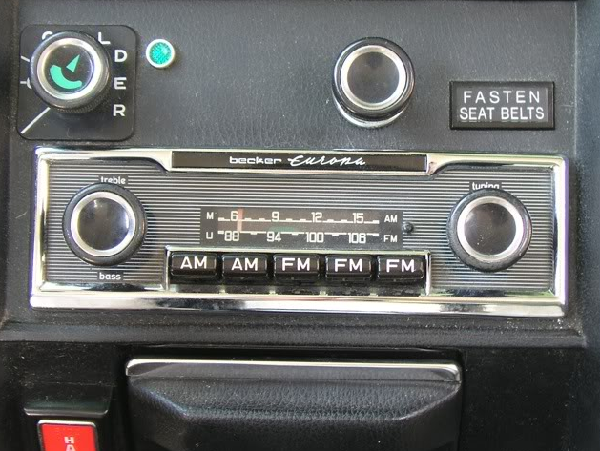
Goals rest of quarter:
Understand these knobs!
http://www.peachparts.com/shopforum/showthread.php?t=256624

Slide 3
Phasors
V
I
V = I Z

Slide 4
Example problem #3
Find i(t), V₁(t), V₂(t) for this circuit: (instructor)
+
C
V₁
-
V(t)=V₀ cos(ωt)
+
V₂
R
-

Slide 5
Find i(t), V₁(t), V₂(t) for this circuit: (instructor)

Slide 6
Example problem #4
Find i(t), V₁(t), V₂(t) for this circuit: (students)
+
V₁
R
V(t)=V₀ cos(ωt + 90)
-
L
+
V₂
-

Slide 7
High pass filter
+
C
V₁
-
INPUT:
V(t)=V₀ cos(ωt)
a
+
+
OUTPUT:
V_{ab}(t)
V₂
R
-
-
b

Slide 8
Low pass filter
R
INPUT:
V(t)=V₀ cos(ωt)
a
+
OUTPUT:
V_{ab}(t)
C
-
b

Slide 9
“Transfer function”
Linear network
H(ω)
X(ω)
Y(ω)
Input
Output
demo

Slide 10
RC transfer function
R
INPUT:
V(t)=V₀ cos(ωt)
a
+
OUTPUT:
V_{ab}(t)
C
-
b

Slide 11
Band pass filter (RLC)
+
C
V₁
-
INPUT:
V(t)=V₀ cos(ωt)
a
+
+
OUTPUT:
V_{ab}(t)
V₂
R
-
-
b

