Slide 1
EECS 70A: Network Analysis
Announcements:
Announcement
Lecture 13

Slide 2
Goals rest of quarter: Understand these knobs!
http://www.peachparts.com/shopforum/showthread.php?t=256624

Slide 3
Goals rest of quarter: Understand these knobs!
http://www.peachparts.com/shopforum/showthread.php?t=256624

Slide 4
Band pass filter (RLC)
+
C
V₁
-
INPUT:
V(t)=V₀ cos(ωt)
a
+
+
OUTPUT:
V_{ab}(t)
V₂
R
-
-
b

Slide 5
Bandwidth

Slide 6
Bode of RLC

Slide 8
Superposition

Slide 9
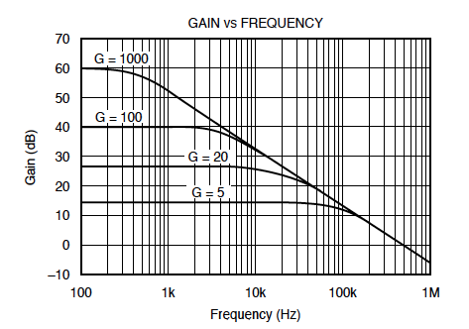
Bode example w/superposition
Find Vout(t) given:
Vin(t)= 1 mV cos ( 2*pi*1kHz*t) + 1 mV cos ( 2*pi*10kHz*t)

Slide 12
Modulation scheme

Slide 14
Topics covered
KCL, KVL
Nodal analysis
Mesh analysis
Thevenin/Norton theorem
RL, RC circuits (time dependence)
R,L,C circuits
Phasors
Impedances
Transfer function

Slide 15
Thevenin, Norton Theorems:
Linear two-terminal circuit
Thevenin:
Calculating V_{th}: Connect nothing to a-b. Calculate voltage. This is V_{th}.
Calculating R_{th}:
Method 1: Connect terminal a to b (short). Calculate the current from a to b. This is call I_{short circuit}.
R_{th}=V_{th}/I_{short circuit}.
Method 2: Find the input resistance looking into terminals a-b after all the independent sources have been turned off. (Voltage sources become shorts, current sources become opens.) Trick (if dependent sources present): Apply a 1 A current source to terminals a-b, find V_{ab}
R_{th} = V_{ab}/1A.
a
+
-
b
Equivalent to:
R_{th}
a
V_{th}
+
+
-
-
b
Equivalent to:
a
+
Norton:
Calculating R_{N}: R_{N}=R_{th}
Calculating I_{N}:
I_{N}=V_{th}/R_{th}
I_{N}
R_{N}
-
b

Slide 16
RC circuit
Find V(t), q(t), i(t)
+
R
C
V
-

Slide 17
LR circuit
Find V(t), i(t)
R
L₁
+
V
-

Slide 18
Conversion procedures
i(t)
I
I =
v(t)
V
V =
I
i(t)
I
V
v(t)
V
For the exam, you should know how to carry out these procedures.

Slide 19
Circuits
V = I R
+
V=I/jωC
L
+
V=jωL I
R
C
V
V
-
-
“Impedance”
Z = R
Z=1/jωC
Z = jωL
KCL, KVL hold for relationship between V, I.

Slide 20
Series/Parallel Impedances
=
Z₁
Z₂
Z₃
Z_{eq}
Z _{eq}= Z ₁ +Z ₂ +Z ₃
Z₃
=
Z₁
Z_{eq}
Z₂
Z _{eq}⁻¹ = Z ₁⁻¹ +Z ₂⁻¹ +Z ₃⁻¹

Slide 21
Conversion procedures
Given i(t) find v(t):
i(t)
i(t)
I
V = I Z_{eq}
v(t)
+
Z_{eq}
v(t)
Given v(t) find i(t):
-
v(t)
V
I = V/ Z_{eq}
i(t)
For the exam, you should know how to carry out these procedures.

Slide 22
“Transfer Function”
Linear network
Input
Output
H(ω) = V_{out}/V_{in}

Slide 23
Example Transfer function
+
R₁
L₁
V_{in}
+
L₂
V_{out}
-
-
Calculate H(ω) for this circuit. Sketch the magnitude of H(ω) vs. ω.

Slide 24
Comprehensive Example
1 kΩ
3 kΩ
Solve for all the currents, voltages in this circuit using nodal analysis.
3cos(ω t+30 deg)
2 mF
25 μH

Slide 25
Symbol library
+
+
2
-
-
+
C
-
i
+
-
V
i₇
i₇
i₇
2 Ω
3 V
3 A
3 i₁
2 i₁
+
+
-
-

Slide 26
Exam cheat sheet
This will be provided with the exam.

