Slide 1
EECS 70A: Network Analysis
Announcements:
HW
etc
Lecture 16
Comprehensive review

Slide 2
Topics covered
Midterm #1 focused on:
  KCL, KVL
  Nodal analysis
  Mesh analysis
  Thevenin/Norton theorem
Midterm #2 will focus on:
  Op amps (ideal)
  RL, RC circuits (time dependence)
  R,L,C circuits
    Phasors
    Impedances

Slide 3
RC circuit
Find V(t), q(t), i(t)
+
R
C
V
-

Slide 4
LR circuit
Find V(t), i(t)
R
L₁
+
V
-

Slide 5
Comprehensive Example
1 kΩ
3 kΩ
a
+
3 V
2 kΩ
4kΩ
+
-
-
b
This circuit is connected to a capacitor of value 1 μF. The switch is in the closed position.
After a long time, what are all the voltages and currents in this circuit?
Next, the switch is opened.
What are all the voltages and currents in this circuit as a function of time
after the switch is opened?
This circuit is now connected to a resistor R₀. What is the power dissipated in R₀?
If you were to pick a value of R₀ to absorb as much power as possible, what would it be?
Exercise: Do the same as A,B with an inductor instead.

Slide 6
Comprehensive Example
1 kΩ
3 kΩ
a
+
3 V
2 kΩ
4kΩ
+
-
-
b

Slide 7
Comprehensive Example
1 kΩ
3 kΩ
a
+
3 V
2 kΩ
4kΩ
+
-
-
b

Slide 8
Conversion procedures
i(t)
I
I =
v(t)
V
V =
I
i(t)
I
V
v(t)
V
For the exam, you should know how to carry out these procedures.

Slide 9
Circuits
V = I R
+
V=I/jωC
L
+
V=jωL I
R
C
V
V
-
-
“Impedance”
Z = R
Z=1/jωC
Z = jωL
KCL, KVL hold for relationship between V, I.

Slide 10
Series/Parallel Impedances
=
Z₁
Z₂
Z₃
Z_{eq}
Z _{eq}= Z ₁ +Z ₂ +Z ₃
Z₃
=
Z₁
Z_{eq}
Z₂
Z _{eq}⁻¹ = Z ₁⁻¹ +Z ₂⁻¹ +Z ₃⁻¹

Slide 11
Conversion procedures
Given i(t) find v(t):
i(t)
i(t)
I
V = I Z_{eq}
v(t)
+
Z_{eq}
v(t)
Given v(t) find i(t):
-
v(t)
V
I = V/ Z_{eq}
i(t)
For the exam, you should know how to carry out these procedures.

Slide 12
Phasor Example 1
Find v(t).
1 kΩ
3 cos(ω t+30deg)
10 kΩ
25 μH
2 mF
+
V
-

Slide 13
Phasor Example 2
3 kΩ
1 μH
Find v(t).
4cos(ω t+45deg)
+
5kΩ
V
1 kΩ
-

Slide 14
Example Impedance problem
+
R₁
L₁
V_{in}
L₂
R₂
-
Find the impedance of this circuit.

Slide 15
Symbol library
+
+
2
-
-
+
C
-
i
+
-
V
i₇
i₇
i₇
2 Ω
3 V
3 A
3 i₁
2 i₁
+
+
-
-

Slide 16
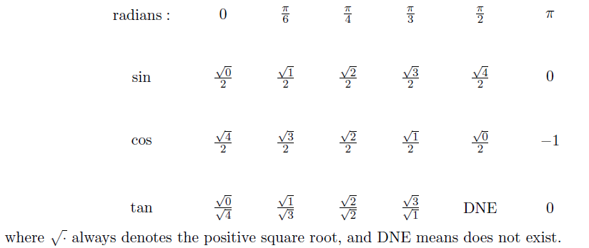
Exam cheat sheet
This will be provided with the exam.

