Slide 1
EECS 70A: Network Analysis
Announcements:
Announcement
Lecture 13

Slide 2
Goals rest of quarter: Understand these knobs!
http://www.peachparts.com/shopforum/showthread.php?t=256624

Slide 3
Example problem #3
Find i(t), V₁(t), V₂(t) for this circuit: (instructor)
+
C
V₁
-
V(t)=V₀ cos(ωt)
+
V₂
R
-

Slide 5
High pass filter
+
C
V₁
-
INPUT:
V(t)=V₀ cos(ωt)
a
+
+
OUTPUT:
V_{ab}(t)
V₂
R
-
-
b

Slide 6
“Transfer function”
Linear network
H(ω)
X(ω)
Y(ω)
Input
Output

Slide 7
RC transfer function
R
INPUT:
V(t)=V₀ cos(ωt)
a
+
OUTPUT:
V_{ab}(t)
C
-
b

Slide 8
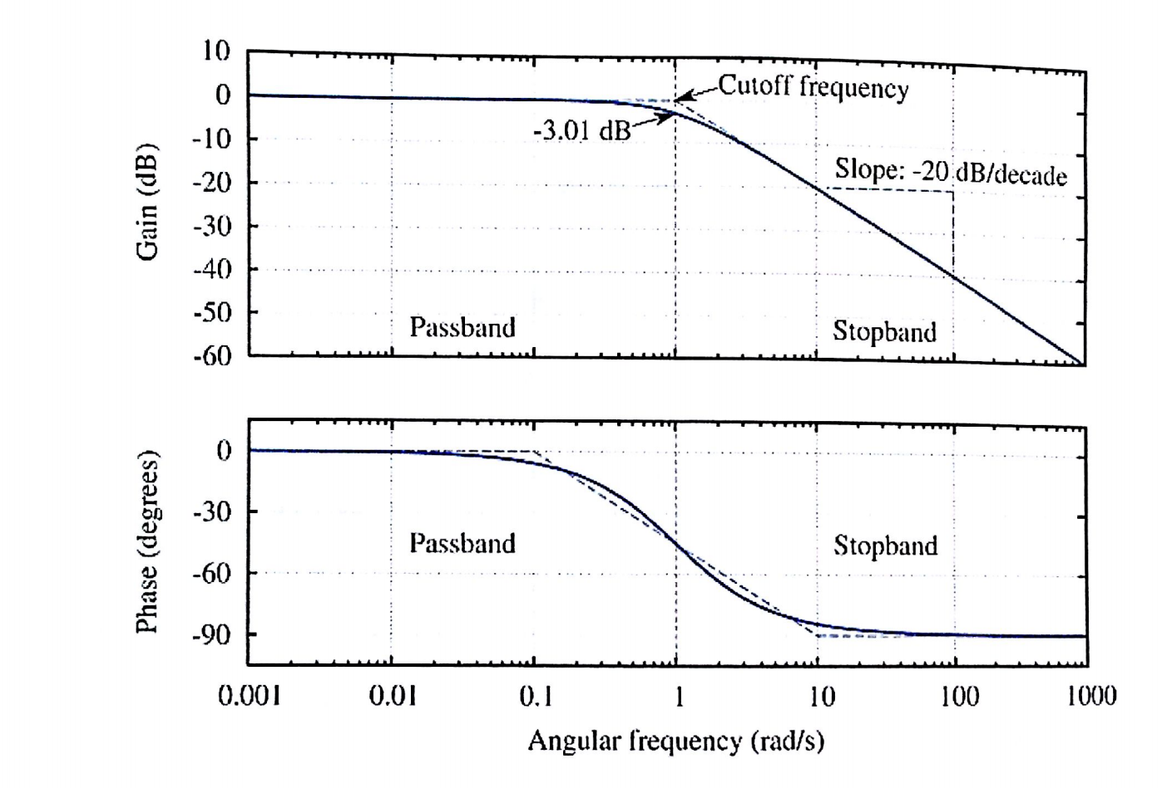
Bode example
Find Vout(t) given:
Vin(t)= 1 mV cos ( 100 rad/s*t)

Slide 9
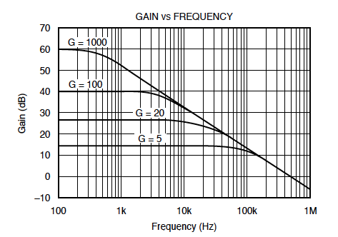
Bode example
Find Vout(t) given:
Vin(t)= 1 mV cos ( 2*pi*1kHz*t)

Slide 10
RC transfer function (High pass filter) Find H(ω)
+
C
V₁
-
INPUT:
V(t)=V₀ cos(ωt)
a
+
+
OUTPUT:
V_{ab}(t)
V₂
R
-
-
b

Slide 11
Goals rest of quarter: Understand these knobs!
http://www.peachparts.com/shopforum/showthread.php?t=256624

Slide 12
Band pass filter (RLC)
+
C
V₁
-
INPUT:
V(t)=V₀ cos(ωt)
a
+
+
OUTPUT:
V_{ab}(t)
V₂
R
-
-
b

Slide 13
Resonance

Slide 15
Tesla

Slide 16
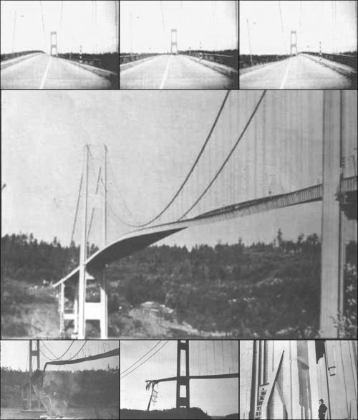
Tacoma Narrows Bridge (1940)
Nov 7, 1940
http://www.youtube.com/watch?v=3mclp9QmCGs

Slide 17
Superposition

Slide 18
Bode example w/superposition
Find Vout(t) given:
Vin(t)= 1 mV cos ( 2*pi*1kHz*t) + 1 mV cos ( 2*pi*10kHz*t)

Slide 20
EXAMPLE PROBLEMS

Slide 21
Example problem #4
Find i(t), V₁(t), V₂(t) for this circuit
Find the transfer function.
+
V₁
R
-
I(t)=I₀ cos(ωt)
L
+
V₂
-

Slide 22
Example Transfer function
+
R₁
L₁
V_{in}
+
L₂
R₂
V_{out}
-
-
Calculate H(ω) for this circuit. Sketch the magnitude of H(ω) vs. ω.

Slide 23
Example problem
Find H(ω) for this circuit, then sketch the magnitude of H(ω) vs ω: (students)
+
R
V_{in}
+
L
V_{out}
-
-

