Slide 1
EECS 70A: Network Analysis
Announcements:
Etc etc etc
Lecture 10

Slide 2
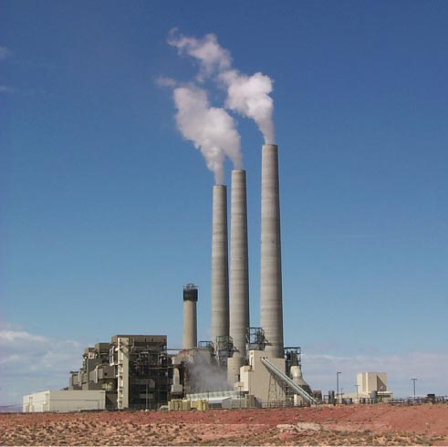
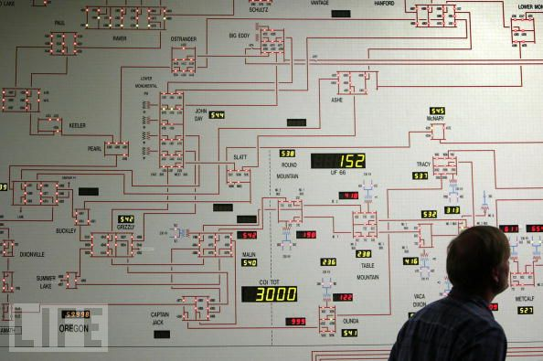
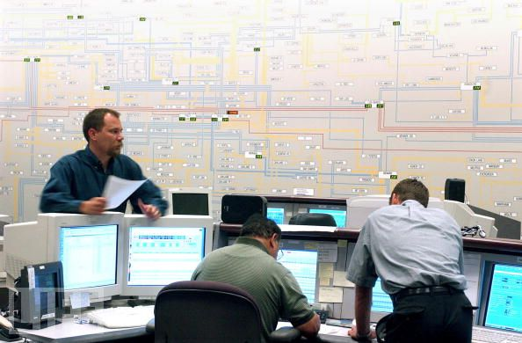
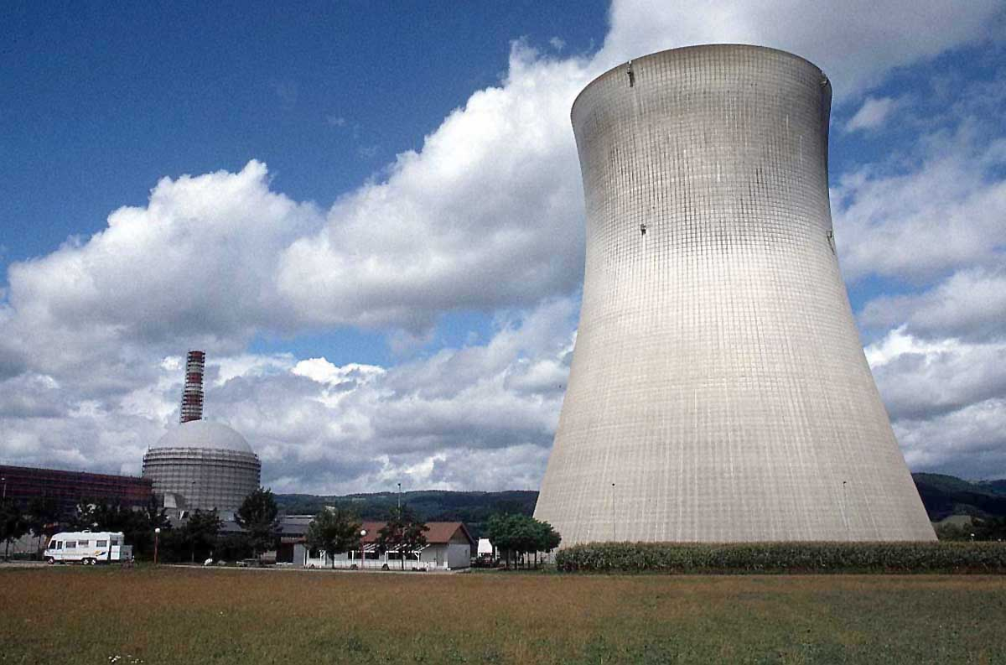
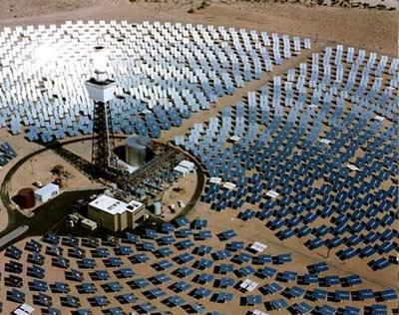

Slide 4
Capacitors
+q
-q
A=area
d=plate separation
Farads[F] = Coulombs/Volt [C]/[V]
+
-
V
C
Dielectric constant:
i
SiO₂
+
-
HfO₂
V

Slide 5
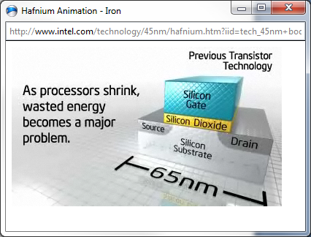
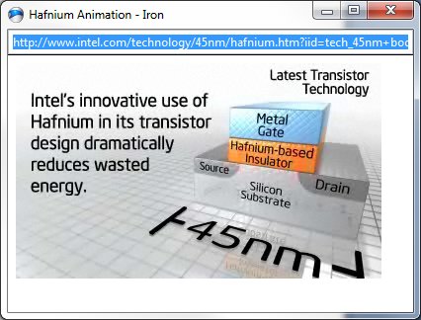
“High-K Dielectric”
http://www.intel.com/technology/45nm/hafnium.htm?iid=tech_45nm+body_animation_hafnium

Slide 6
Time dependence
q, V, i can depend on time !
Implicit:
Will not always write (t), but it is assumed from now on.

Slide 7
Example Capacitor Problem
Find V(t), q(t)
+
C
V
-

Slide 8
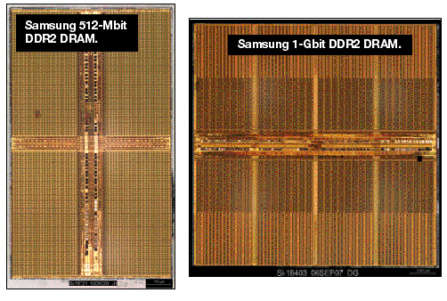
One-bit memory
Typical dimensions:
0.1 micron x 0.1 micron area
10 nm thickness.
What is C?
http://i.cmpnet.com/eet/news/07/11/DC1502_UTH_samsung.gif

Slide 10
1 Bit Read/Write
+
C
V
-

Slide 11
1 Bit Read/Write
+
C
V
-

Slide 12
1 Bit Read/Write
+
C
V
-

Slide 13
Example Problem #2
V
(Students): Find i(t), q(t)
t
+
C
V
-

Slide 14
RC circuit
Find V(t), q(t), i(t)
R
+
C
V
-

Slide 20
DRAM vs. SRAM

Slide 22
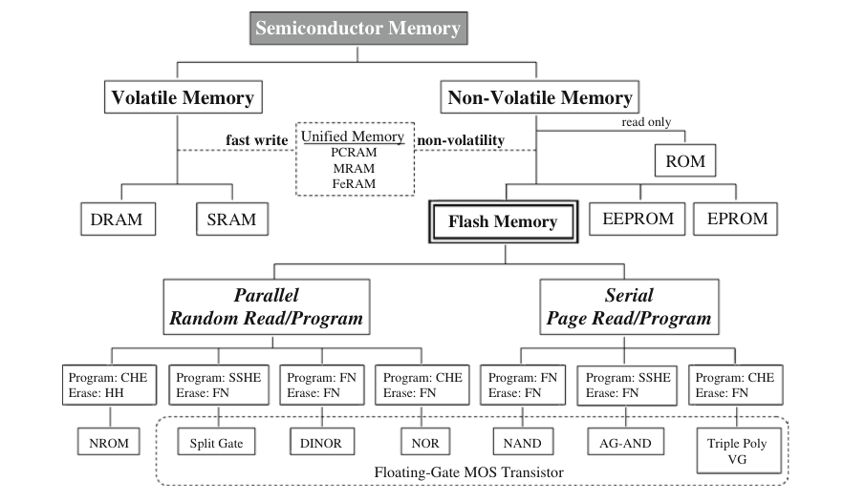
Semiconductor memory
1. Ogura, T. Flash Memory. CMOS Processors and Memories 2010, 197–232.

Slide 23
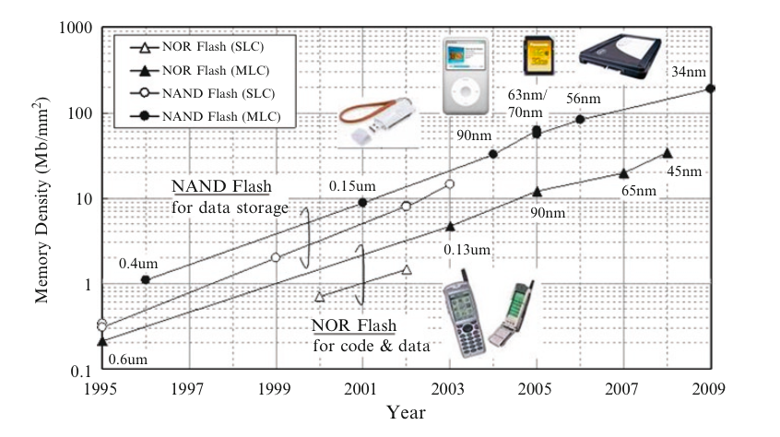
Flash Memory
1. Ogura, T. Flash Memory. CMOS Processors and Memories 2010, 197–232.

Slide 24
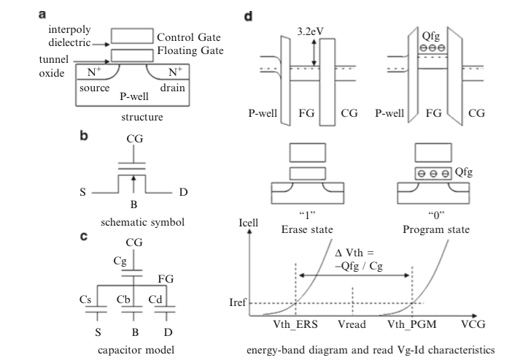
Flash memory
1. Ogura, T. Flash Memory. CMOS Processors and Memories 2010, 197–232.

Slide 25
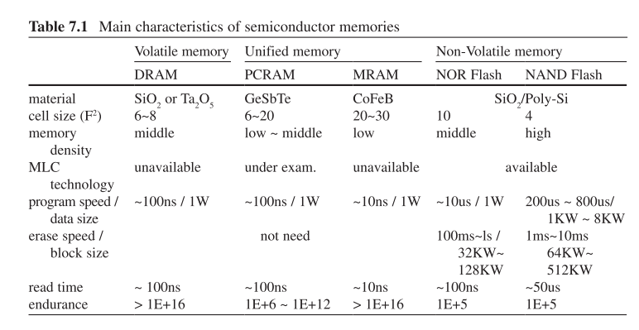
Flash memory
1. Ogura, T. Flash Memory. CMOS Processors and Memories 2010, 197–232.

Slide 26
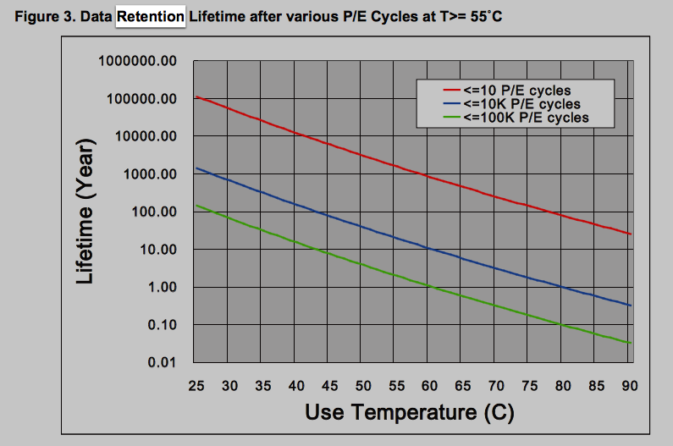
Data retention
http://www.macronix.com/Lists/ApplicationNote/Attachments/750/AN0291V2-ProgramErase%20Cycling%20Endurance%20and%20Data%20Retention%20in%20NOR%20Flash%20Memories.pdf

Slide 27
Example Capacitor Problem #2
Find V(t), q(t)
I(t)=I₀cos(ωt)
+
C
V
-

Slide 32
Parallel Capacitors
?
i₁
i₂
i₃
i_{N}
=
i
C₁
C₂
C₃
C_{N}
i
C_{equivalent}

Slide 33
Series Capacitors
C₁
C₂
C₃
C_{N}
?
+
-
+
-
+
-
+
-
=
V₁
V₂
V₃
V_{N}
+
V
+
V
C_{equivalent}
-
-

Slide 34
Example problem #4
(Students) Find V(t), given that V(t=0) = 5 Volts
1 kΩ
+
1 μF
2 μF
V
4 kΩ
3 μF
-

Slide 35
Inductors
L
i
A=area
l=wire length
N = # of turns
μ = 4 π 10⁻⁶ H/m
+
-
V
Henry[H]
V

Slide 36
Series Inductors
L₁
L₂
L₃
?
+
-
+
-
+
-
=
V₁
V₂
V₃
+
V
+
V
L_{equivalent}
-
-

Slide 37
Parallel Inductors
?
i₁
i₂
i₃
i_{N}
=
+
L₁
L₂
L₃
L_{N}
+
V
V
L_{equivalent}
-
-

Slide 38
Example Inductor Problem
(Students): Find V(t).
L₁
+
V
-

Slide 39
Example Inductor Problem #2
V
(Students): Find i(t)
t
L₁
+
V
-

Slide 40
Example Inductor Problem #3
Find V(t)
L
+
I(t)=I₀cos(ωt)
V
-

Slide 41
LR circuit
Find V(t), i(t)
R
L₁
+
V
-

Slide 42
Example LR problem
(Students) Find V(t), given that V(t=0) = 5 Volts
+
1 kΩ
4 kΩ
1 μH
2 μH
V
3 μH
-

Slide 43
Power
I
I x V_{ab} = power
a
Watts [W] = Volt Amp [V-A]
Note: MKSA unit system:
Meters Kilogram Second Amp
b
Resistor:
Energy lost to heat…
Inductor or capacitor:
Energy STORED and can be recovered…

Slide 44
Energy stored
I
I x V_{ab} = power
a
Energy:
b
Capacitor stored energy:
Inductor stored energy:

Slide 45
Symbol library
I_{ab}
I=5 A
a
+
+
a
+
a
-
b
b
-
-
b

Slide 46
Symbol library
+
+
2
-
-
+
C
-
i
+
-
V
i₇
i₇
i₇
2 Ω
3 V
3 A
3 i₁
2 i₁
+
+
-
-

