Slide 1
EECS 70A: Network Analysis
Announcements:
Announcement #1
Lecture 11

Slide 2
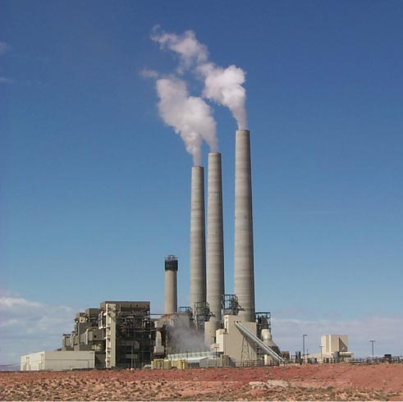
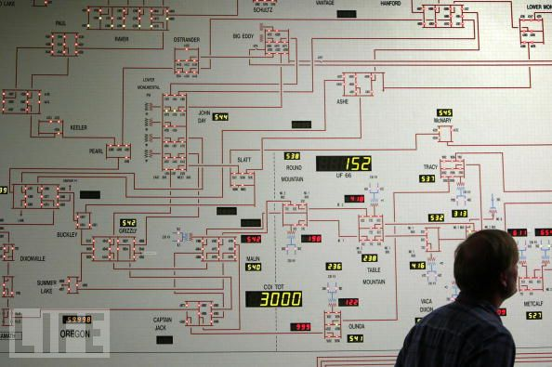
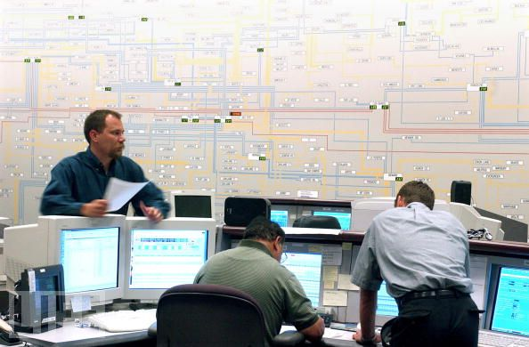
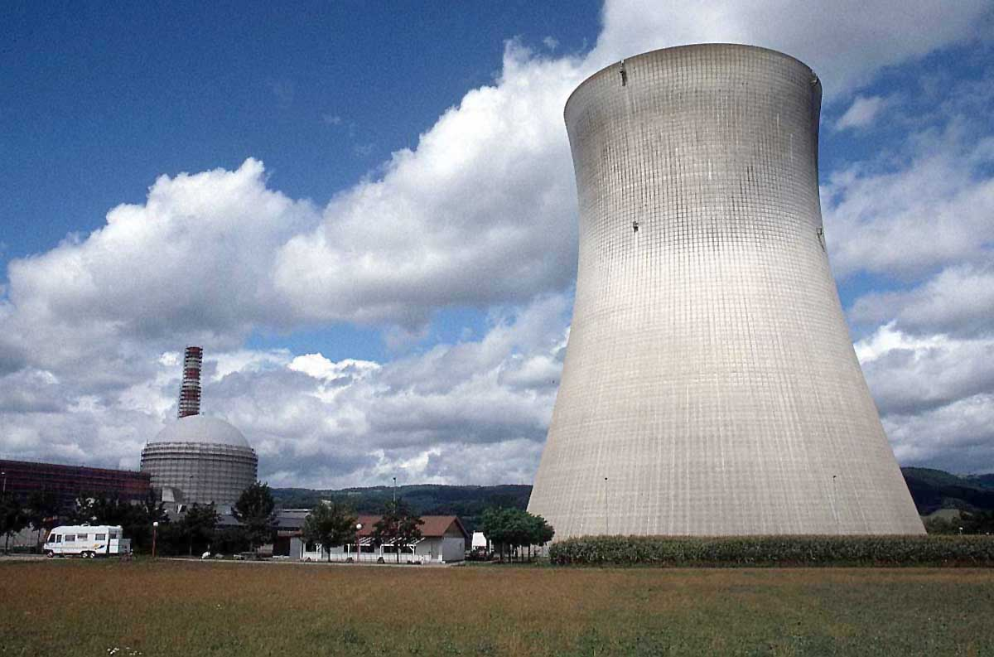
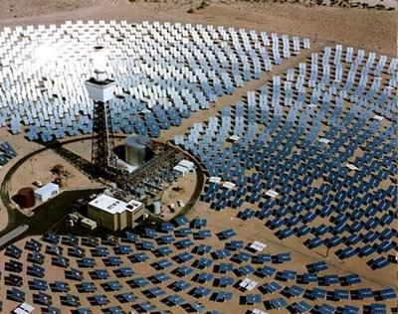

Slide 3
Sine waves

Slide 4
Phase

Slide 5
Complex numbers
Imag
y
x
Real

Slide 6
Complex algebra
Addition:
Subtraction:
Multiplication:
Division:
Inversion:
Square root:
Complex conjugate:

Slide 7
Euler relationship
Phasors:
“Phasor”
V
(Complex #)

Slide 8
Complex numbers
Euler’s relationship:
Memorize
Need to be able to manipulate complex numbers, e.g. given:
(A,B,C,D all real)
Find Re(u), Im(u)
Express u as x+jy, re^{iφ}
Find Re(u re^{jωt})
Did some of this in office hours..

Slide 9
Conversion procedures
i(t)
I
I =
v(t)
V
V =
I
i(t)
I
V
v(t)
V
For the exam, you should know how to carry out these procedures.

Slide 10
Conversion procedures
Given i(t) find v(t):
i(t)
i(t)
I
V = I Z_{eq}
v(t)
+
Z_{eq}
v(t)
Given v(t) find i(t):
-
v(t)
V
I = V/ Z_{eq}
i(t)
For the exam, you should know how to carry out these procedures.

Slide 11
Circuits
V = I R
+
V=I/jωC
L
+
V=jωL I
R
C
V
V
-
-
“Impedance”
Z = R
Z=1/jωC
Z = jωL
KCL, KVL hold for relationship between V, I.

Slide 12
Series/Parallel Impedances
=
Z₁
Z₂
Z₃
Z_{eq}
Z _{eq}= Z ₁ +Z ₂ +Z ₃
Z₃
=
Z₁
Z_{eq}
Z₂
Z _{eq}⁻¹ = Z ₁⁻¹ +Z ₂⁻¹ +Z ₃⁻¹

Slide 14
Example problem #1
Find Z_{eq} for this circuit: (instructor)
R₂
R₁
L

Slide 15
Example problem #2
Find Z_{eq} for this circuit: (students)
C
R₁
R₂

Slide 16
Phasor to voltage conversion
Find V(t), q(t)
Problem gives us:
I(t)=I₀cos(ωt)
I(t)=I₀cos(ωt)
+
C
V
-

Slide 18
Phasor to voltage conversion
Find V(t), q(t)
Problem gives us:
I(t)=I₀cos(ωt)
Compare to definition of current phasor:
I(t)=I₀cos(ωt)
+
C
V
-
Find voltage phasor using generalized Ohm’s law:
V=I/jωC
Find v(t) from voltage phasor:

Slide 19
Phase vs. impedance (Z)
In general:
Z real i.e. Z = x + jy
=> i(t), v(t) “in phase”
In general:
Z imag i.e. Z = x + jy
=> i(t), v(t) “out of phase by 90 degrees”
i(t)
v(t)
HW problem: Find relationship between phase shift and impedance (Z).

Slide 20
Example phasor problem
Find i(t) (students)
Problem gives us:
v(t)=3 cos(10 t + 30º) Volts
Compare to definition of voltage phasor:
+
C
V
v(t)=3 cos(10 t + 30º) Volts
-
Find current phasor using generalized Ohm’s law:
I=jωC V = …
Find i(t) from current phasor:

Slide 23
Example problem #3
Find i(t), V₁(t), V₂(t) for this circuit: (instructor)
+
C
V₁
-
V(t)=V₀ cos(ωt)
+
V₂
R
-

Slide 24
Example problem #4
Find i(t), V₁(t), V₂(t) for this circuit: (students)
+
V₁
R
-
I(t)=I₀ cos(ωt)
L
+
V₂
-

Slide 25
Low pass filter
R
INPUT:
V(t)=V₀ cos(ωt)
a
+
OUTPUT:
V_{ab}(t)
C
-
b

Slide 26
High pass filter
+
C
V₁
-
INPUT:
V(t)=V₀ cos(ωt)
a
+
+
OUTPUT:
V_{ab}(t)
V₂
R
-
-
b

Slide 27
Band pass filter (RLC)
+
C
V₁
-
INPUT:
V(t)=V₀ cos(ωt)
a
+
+
OUTPUT:
V_{ab}(t)
V₂
R
-
-
b

Slide 28
Symbol library
I_{ab}
I=5 A
a
+
+
a
+
a
-
b
b
-
-
b

Slide 29
Symbol library
+
+
2
-
-
+
C
-
i
+
-
V
i₇
i₇
i₇
2 Ω
3 V
3 A
3 i₁
2 i₁
+
+
-
-

