Slide 1
EECS 70A: Network Analysis
Announcements:
Last HW due Thursday
Lecture June 6, 2017

Slide 2
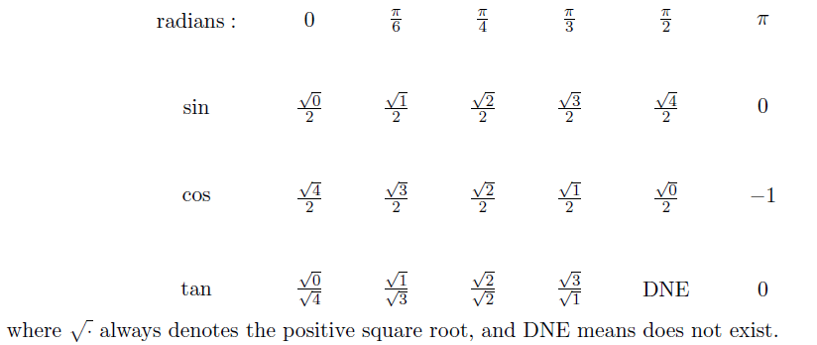
Exam cheat sheet
This will be provided with the exam.

Slide 3
Band pass filter (RLC)
+
C
V₁
-
INPUT:
V(t)=V₀ cos(ωt)
a
+
+
OUTPUT:
V_{ab}(t)
V₂
R
-
-
b

Slide 4
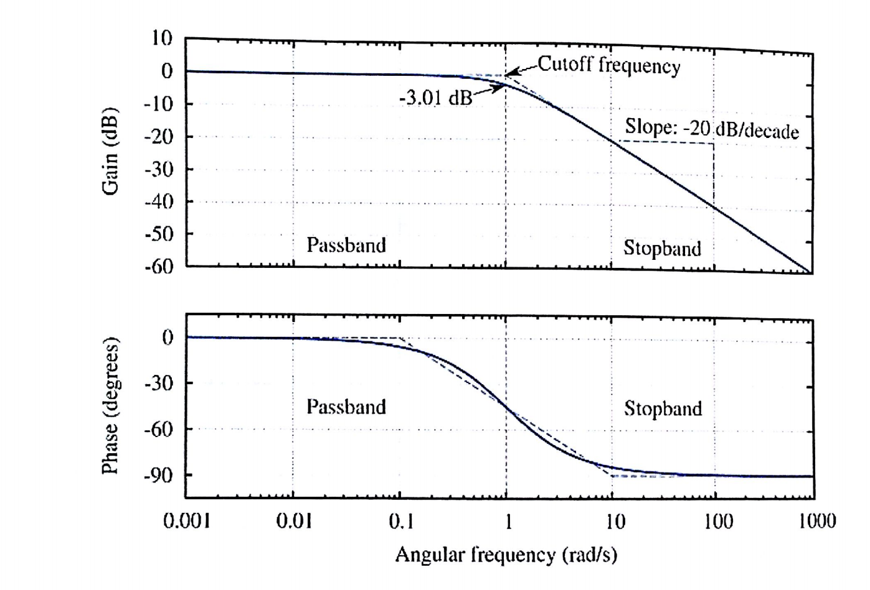
Bode example
Find Vout(t) given:
Vin(t)= 1 mV cos ( 2*pi*1kHz*t)

Slide 5
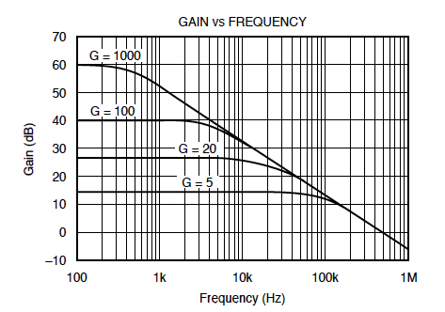
Bode example #2 (amplifier)
Find Vout(t) given:
Vin(t)= 1 mV 1 mV cos ( 2*pi*10kHz*t)

Slide 6
Bode example w/superposition
Find Vout(t) given:
Vin(t)= 1 mV cos ( 2*pi*1kHz*t) + 1 mV cos ( 2*pi*10kHz*t)

Slide 7




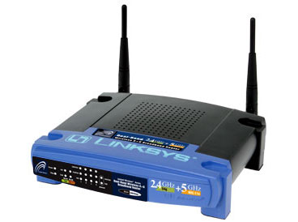
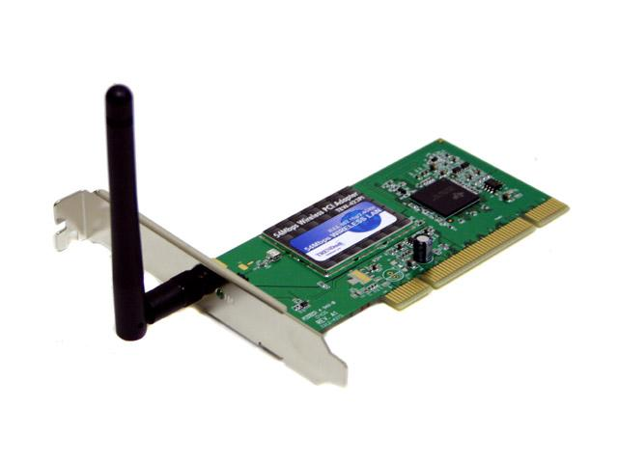

Wireless Communications
Broadcast Radio:
Telecom:
All use sine waves (phasors) as way to describe signals and circuits.
Internet:
3G data:

Slide 8
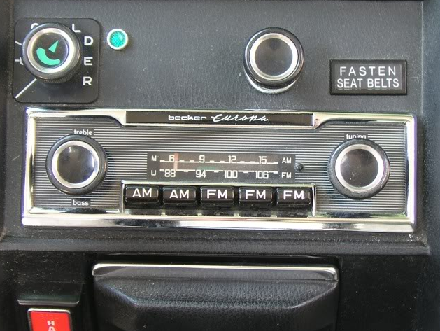
Goals rest of quarter:
Understand these knobs!
http://www.peachparts.com/shopforum/showthread.php?t=256624

