Slide 1
EECS 70A: Network Analysis
Announcements:
Last HW due Thursday
Lecture June 8, 2017

Slide 2
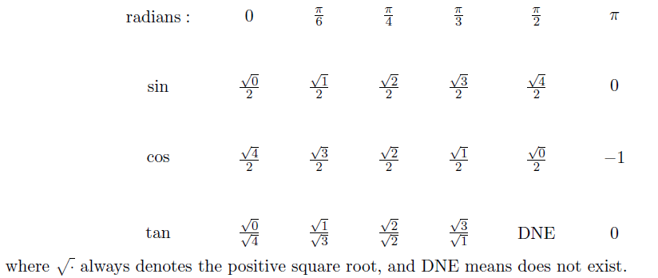
Exam cheat sheet
This will be provided with the exam.

Slide 3
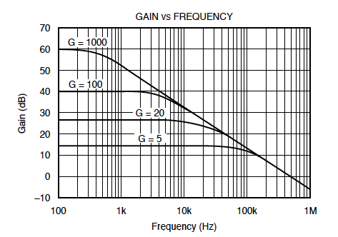
Bode example w/superposition
Find Vout(t) given:
Vin(t)= 1 mV cos ( 2*pi*1kHz*t) + 1 mV cos ( 2*pi*10kHz*t)

Slide 4
Bode example w/superposition
Find Vout(t) given:
Vin(t)= 1 mV cos ( 2*pi*1kHz*t) + 1 mV cos ( 2*pi*10kHz*t)

Slide 7
Superposition

Slide 8
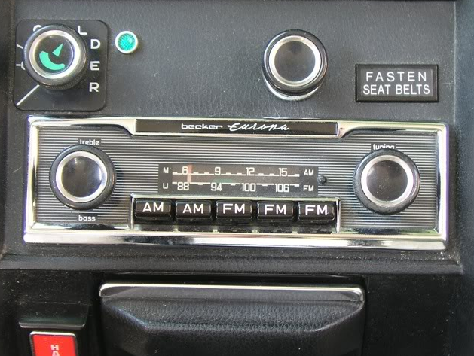
Goals rest of quarter:
Understand these knobs!
http://www.peachparts.com/shopforum/showthread.php?t=256624

Slide 10
Modulation

Slide 13





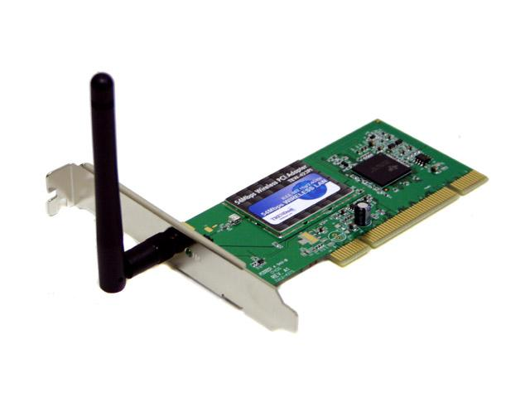

Wireless Communications
Broadcast Radio:
Telecom:
All use sine waves (phasors) as way to describe signals and circuits.
Internet:
3G data:

Slide 14
Frequency Allocations
http://www.ntia.doc.gov/osmhome/allochrt.PDF

