Slide 1
EECS 70A: Network Analysis
Announcements:
Announcement #1
Lecture 11

Slide 2
Conversion procedures
i(t)
I
I =
v(t)
V
V =
I
i(t)
I
V
v(t)
V
For the exam, you should know how to carry out these procedures.

Slide 3
Conversion procedures
Given i(t) find v(t):
i(t)
i(t)
I
V = I Z_{eq}
v(t)
+
Z_{eq}
v(t)
Given v(t) find i(t):
-
v(t)
V
I = V/ Z_{eq}
i(t)
For the exam, you should know how to carry out these procedures.

Slide 4
Circuits
V = I R
+
V=I/jωC
L
+
V=jωL I
R
C
V
V
-
-
“Impedance”
Z = R
Z=1/jωC
Z = jωL
KCL, KVL hold for relationship between V, I.

Slide 5
Series/Parallel Impedances
=
Z₁
Z₂
Z₃
Z_{eq}
Z _{eq}= Z ₁ +Z ₂ +Z ₃
Z₃
=
Z₁
Z_{eq}
Z₂
Z _{eq}⁻¹ = Z ₁⁻¹ +Z ₂⁻¹ +Z ₃⁻¹

Slide 6
Example problem #3
Find i(t), V₁(t), V₂(t) for this circuit: (instructor)
+
C
V₁
-
V(t)=V₀ cos(ωt)
+
V₂
R
-

Slide 8
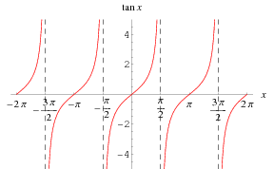
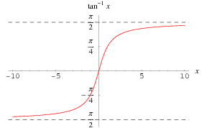

Slide 9
High pass filter
+
C
V₁
-
INPUT:
V(t)=V₀ cos(ωt)
a
+
+
OUTPUT:
V_{ab}(t)
V₂
R
-
-
b

Slide 10
“Transfer Function”
Linear network
Input
Output
H(ω) = V_{out}/V_{in}

Slide 11
Significance of H(ω)

Slide 12
RC transfer function
R
INPUT:
V(t)=V₀ cos(ωt)
a
+
OUTPUT:
V_{ab}(t)
C
-
b

Slide 14
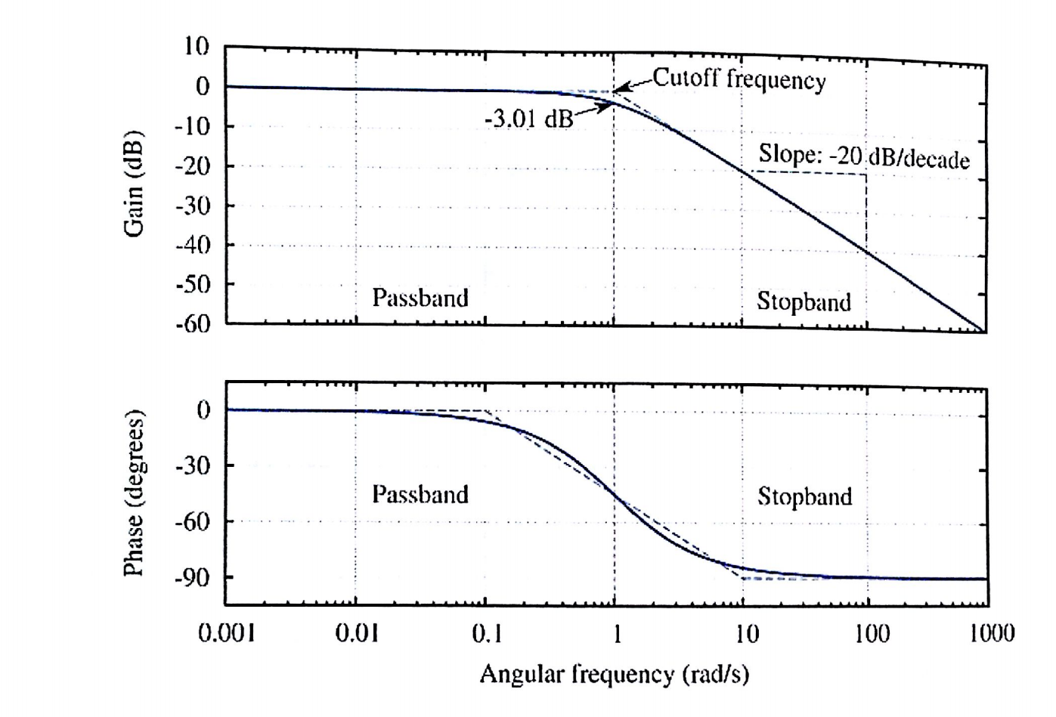
Bode plot

Slide 15
Bode example
Find Vout(t) given:
Vin(t)= 1 mV cos ( 2*pi*1kHz*t)

Slide 16
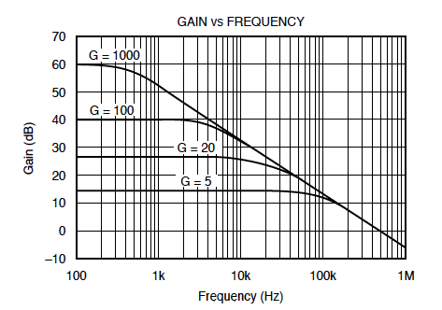
Bode example #2 (amplifier)
Find Vout(t) given:
Vin(t)= 1 mV 1 mV cos ( 2*pi*10kHz*t)

Slide 17
High pass filter
+
C
V₁
-
INPUT:
V(t)=V₀ cos(ωt)
a
+
+
OUTPUT:
V_{ab}(t)
V₂
R
-
-
b

Slide 19
Example problem #4
Find i(t), V₁(t), V₂(t) for this circuit: (students)
+
V₁
R
-
I(t)=I₀ cos(ωt)
L
+
V₂
-

Slide 20
Example problem
Find H(ω) for this circuit, then sketch the magnitude of H(ω) vs ω: (students)
+
R
V_{in}
+
L
V_{out}
-
-

Slide 21
Band pass filter (RLC)
+
C
V₁
-
INPUT:
V(t)=V₀ cos(ωt)
a
+
+
OUTPUT:
V_{ab}(t)
V₂
R
-
-
b

Slide 23
Resonance

Slide 24


Slide 25

Tesla

Slide 26
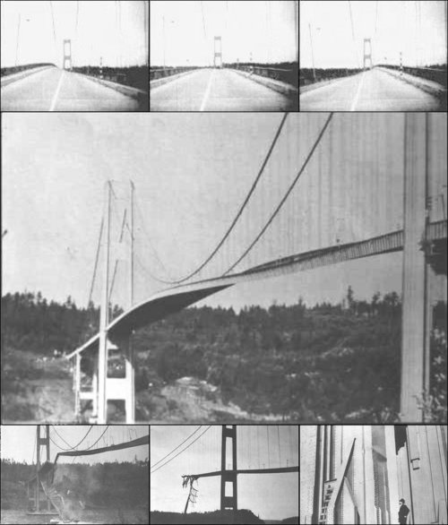
Tacoma Narrows Bridge (1940)
Nov 7, 1940
http://www.youtube.com/watch?v=3mclp9QmCGs

Slide 27




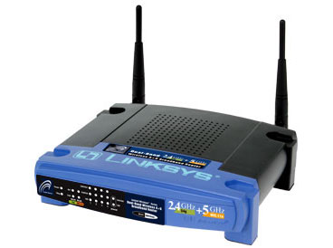
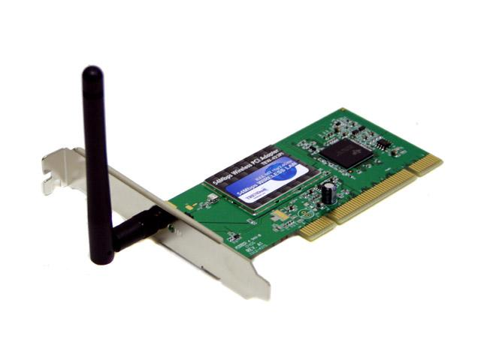

Wireless Communications
Broadcast Radio:
Telecom:
All use sine waves (phasors) as way to describe signals and circuits.
Internet:
3G data:

Slide 28
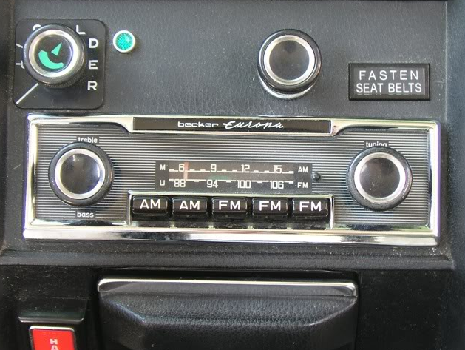
Goals rest of quarter:
Understand these knobs!
http://www.peachparts.com/shopforum/showthread.php?t=256624

Slide 29
Superposition

Slide 31
Bode example w/superposition
Find Vout(t) given:
Vin(t)= 1 mV cos ( 2*pi*1kHz*t) + 1 mV cos ( 2*pi*10kHz*t)

Slide 32
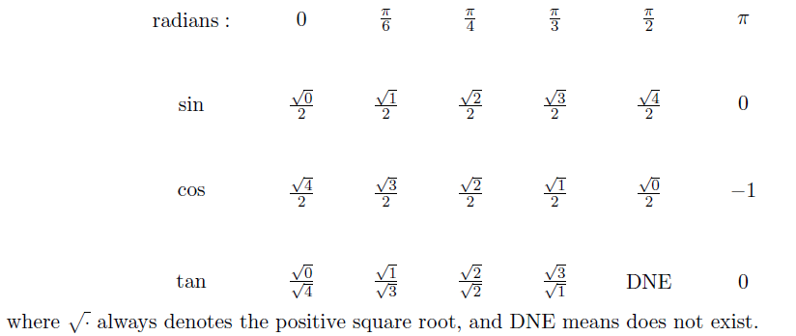
Exam cheat sheet
This will be provided with the exam.

