Slide 1
EECS 70A: Network Analysis
Announcements:
HW #6 will be posted today, due Thurs of 10th week
Lecture 11

Slide 2
Conversion procedures
i(t)
I
I =
v(t)
V
V =
I
i(t)
I
V
v(t)
V
For the exam, you should know how to carry out these procedures.

Slide 3
Conversion procedures
Given i(t) find v(t):
i(t)
i(t)
I
V = I Z_{eq}
v(t)
+
Z_{eq}
v(t)
Given v(t) find i(t):
-
v(t)
V
I = V/ Z_{eq}
i(t)
For the exam, you should know how to carry out these procedures.

Slide 4
Circuits
V = I R
+
V=I/jωC
L
+
V=jωL I
R
C
V
V
-
-
“Impedance”
Z = R
Z=1/jωC
Z = jωL
KCL, KVL hold for relationship between V, I.

Slide 5
Series/Parallel Impedances
=
Z₁
Z₂
Z₃
Z_{eq}
Z _{eq}= Z ₁ +Z ₂ +Z ₃
Z₃
=
Z₁
Z_{eq}
Z₂
Z _{eq}⁻¹ = Z ₁⁻¹ +Z ₂⁻¹ +Z ₃⁻¹

Slide 6
Example problem #3
Find i(t), V₁(t), V₂(t) for this circuit: (instructor)
+
C
V₁
-
V(t)=V₀ cos(ωt)
+
V₂
R
-

Slide 15
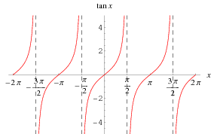
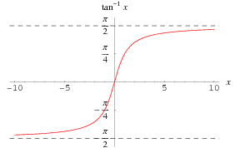

Slide 16
High pass filter
+
C
V₁
-
INPUT:
V(t)=V₀ cos(ωt)
a
+
+
OUTPUT:
V_{ab}(t)
V₂
R
-
-
b

Slide 23
“Transfer Function”
Linear network
Input
Output
H(ω) = V_{out}/V_{in}

Slide 25
RC transfer function
R
INPUT:
V(t)=V₀ cos(ωt)
a
+
OUTPUT:
V_{ab}(t)
C
-
b

Slide 32
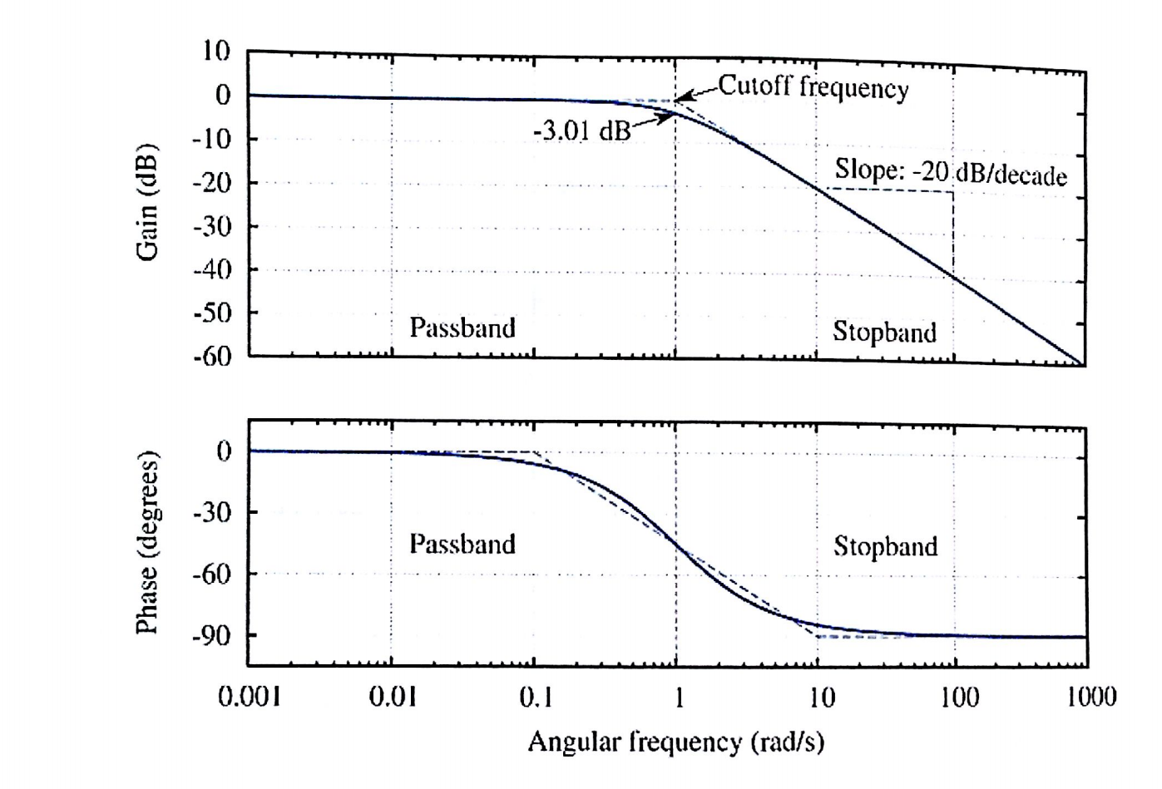
Bode plot

Slide 33
Bode example
Find Vout(t) given:
Vin(t)= 1 mV cos ( 2*pi*1kHz*t)

Slide 34
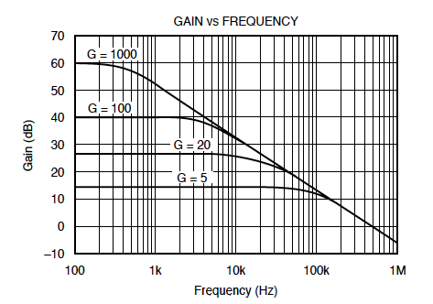
Bode example #2 (amplifier)
Find Vout(t) given:
Vin(t)= 1 mV 1 mV cos ( 2*pi*10kHz*t)

Slide 35
High pass filter
+
C
V₁
-
INPUT:
V(t)=V₀ cos(ωt)
a
+
+
OUTPUT:
V_{ab}(t)
V₂
R
-
-
b

Slide 37
Example problem #4
Find i(t), V₁(t), V₂(t) for this circuit: (students)
+
V₁
R
-
I(t)=I₀ cos(ωt)
L
+
V₂
-

Slide 38
Example problem
Find H(ω) for this circuit, then sketch the magnitude of H(ω) vs ω: (students)
+
R
V_{in}
+
L
V_{out}
-
-

Slide 39
Band pass filter (RLC)
+
C
V₁
-
INPUT:
V(t)=V₀ cos(ωt)
a
+
+
OUTPUT:
V_{ab}(t)
V₂
R
-
-
b

Slide 41
Resonance

Slide 42


Slide 43

Tesla

Slide 44
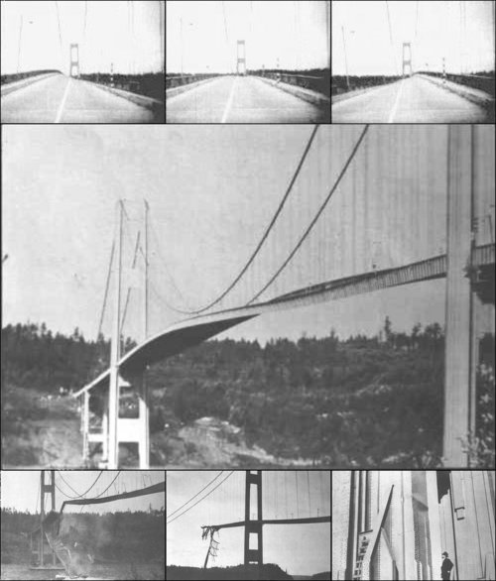
Tacoma Narrows Bridge (1940)
Nov 7, 1940
http://www.youtube.com/watch?v=3mclp9QmCGs

Slide 45




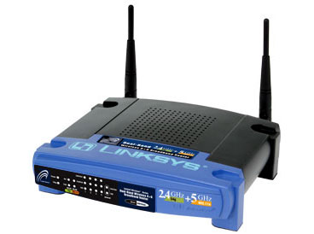
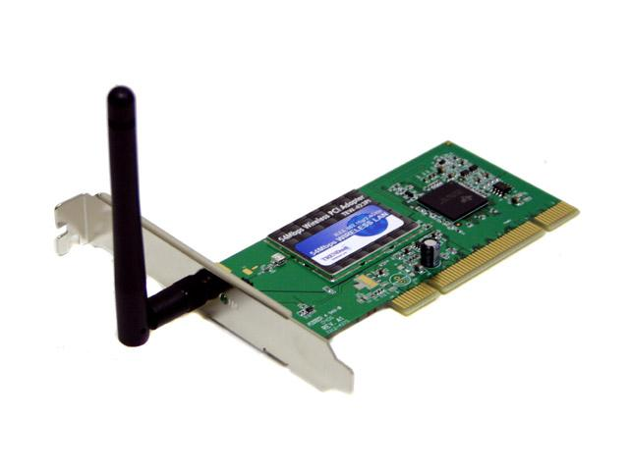

Wireless Communications
Broadcast Radio:
Telecom:
All use sine waves (phasors) as way to describe signals and circuits.
Internet:
3G data:

Slide 46
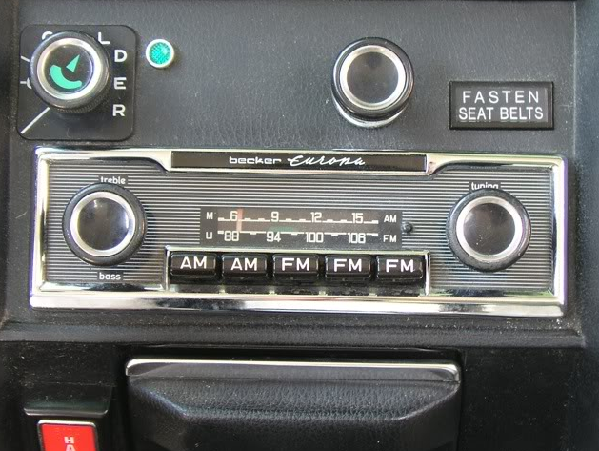
Goals rest of quarter:
Understand these knobs!
http://www.peachparts.com/shopforum/showthread.php?t=256624

Slide 47
Superposition

Slide 49
Bode example w/superposition
Find Vout(t) given:
Vin(t)= 1 mV cos ( 2*pi*1kHz*t) + 1 mV cos ( 2*pi*10kHz*t)

Slide 50
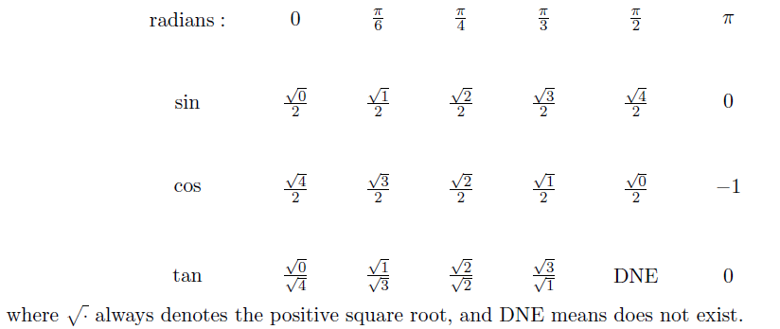
Exam cheat sheet
This will be provided with the exam.

