Slide 1
EECS 70A: Network Analysis
Announcements:
Final exam Wed 4-6 pm
Wed class to be examples by TA Murad (Professor out of town)
Last HW due Friday (changed from Thurs)
Extra credit (5% on final) for students who fill out course survey
Lecture June 4, 2018

Slide 2
Low pass filter
R
INPUT:
V(t)=V₀ cos(ωt)
a
+
OUTPUT:
V_{ab}(t)
C
-
b

Slide 4
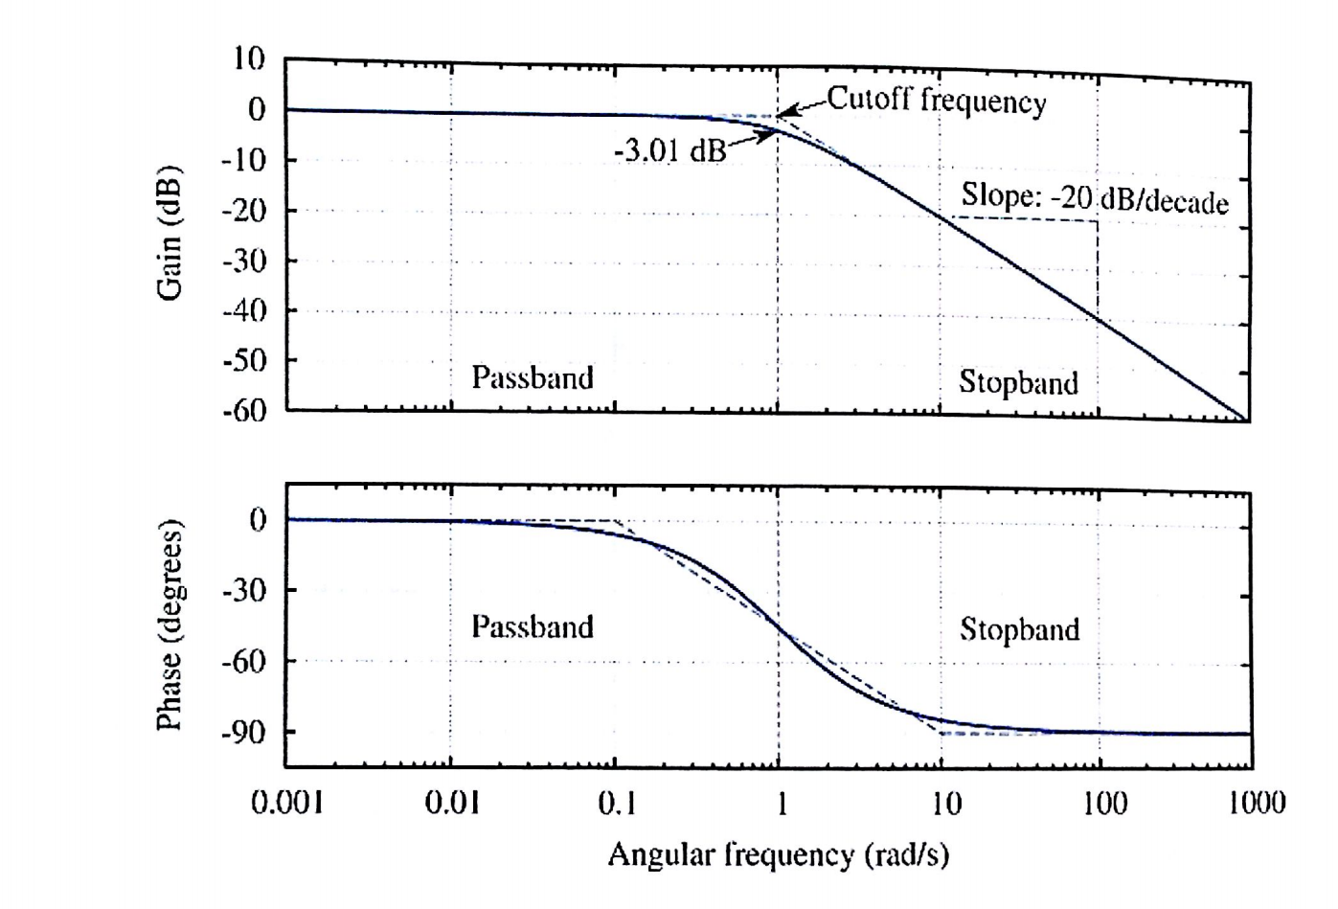
Bode example
Find Vout(t) given:
Vin(t)= 1 mV cos ( 100 (radians/s) *t)

Slide 5
Bode example w/superposition
Find Vout(t) given:
Vin(t)= 10 mV cos ( 0.01 (radians/s) *t) + 10 mV cos ( 1000(radians/s) *t)

Slide 6
Fourier theorem
Any function of time f(t) can be written as a sum of cosine waves.
For example, if v(t) is the voltage as a function of time, Fourier’s theorem says it can be written as:

Slide 7
Superposition

Slide 8
Band pass filter (RLC)
+
C
V₁
-
INPUT:
V(t)=V₀ cos(ωt)
a
+
+
OUTPUT:
V_{ab}(t)
V₂
R
-
-
b

Slide 10
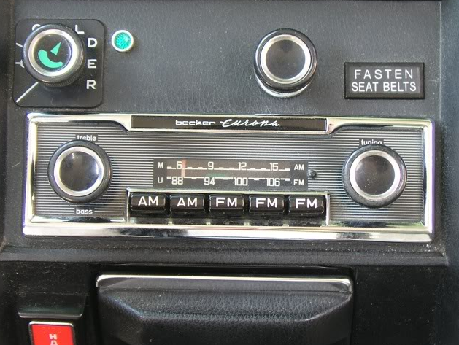
Goals rest of quarter:
Understand these knobs!
http://www.peachparts.com/shopforum/showthread.php?t=256624

Slide 17




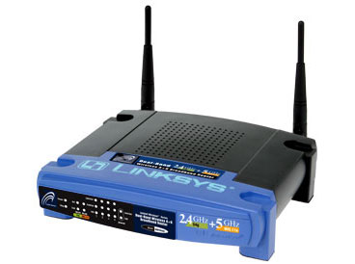
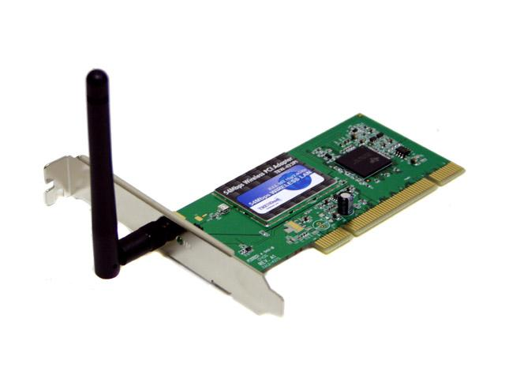

Wireless Communications
Broadcast Radio:
Telecom:
All use sine waves (phasors) as way to describe signals and circuits.
Internet:
3G data:

Slide 18
Frequency Allocations
http://www.ntia.doc.gov/osmhome/allochrt.PDF

Slide 19
Resonance

Slide 20


Slide 21
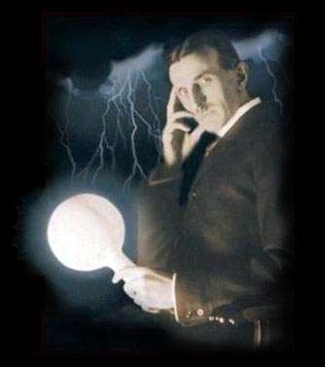
Tesla

Slide 22
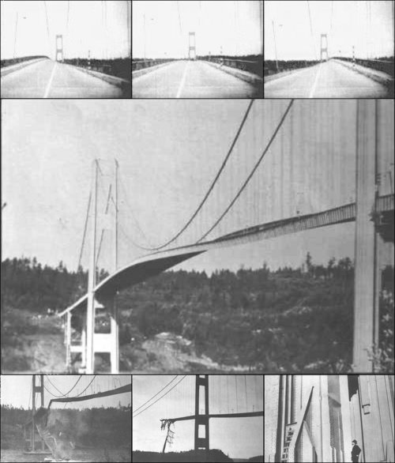
Tacoma Narrows Bridge (1940)
Nov 7, 1940
http://www.youtube.com/watch?v=3mclp9QmCGs

