Slide 1
EECS 70A: Network Analysis
Announcements:
Etc etc etc
Lecture 10

Slide 4
Capacitors
+q
-q
V

Slide 5
Capacitors
+q
-q
A=area
d=plate separation
Farads[F] = Coulombs/Volt [C]/[V]
+
-
V
C
Dielectric constant:
i
SiO₂
+
-
HfO₂
V

Slide 6
RC circuit
Find V(t), q(t), i(t)
R
+
C
V
-

Slide 7
RC circuit
Find V(t), q(t), i(t)
R
+
C
V
-

Slide 10
Example Capacitor Problem
Find V_{c}(t)
t₁ switch open
+
+
1 kΩ
10 V
3 μF
V_{c}
-
-

Slide 12
Example Capacitor Problem
Find V(t), i(t)
t₁ switch open
t₂ switch closed
i₀
+
C
V
-

Slide 13
Example Capacitor Problem
Find V(t), i(t)
t₁ switch open
t₂ switch closed
+
i₀
C
R
V
-

Slide 14
Example Capacitor Problem
Find V(t), i(t)
t₁ switch open
t₂ switch closed
+
i₀
C
R
V
-

Slide 16
Example Capacitor Problem
Find V(t), i(t)
t₁ switch open
t₂ switch closed
+
i₀
C
R
V
-

Slide 18
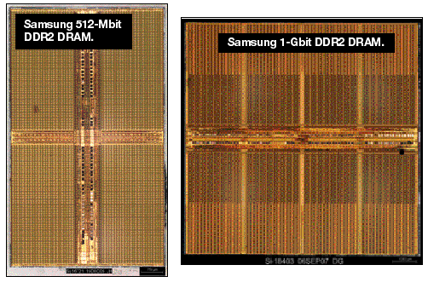
One-bit memory
Typical dimensions:
0.1 micron x 0.1 micron area
10 nm thickness.
What is C?
http://i.cmpnet.com/eet/news/07/11/DC1502_UTH_samsung.gif

Slide 19
1 Bit Read/Write
+
C
V
-

Slide 20
Example Capacitor Problem
Find V(t), i(t)
t₁ switch open
t₂ switch closed
+
i₀
C
R
V
-

Slide 25
DRAM vs. SRAM

Slide 26
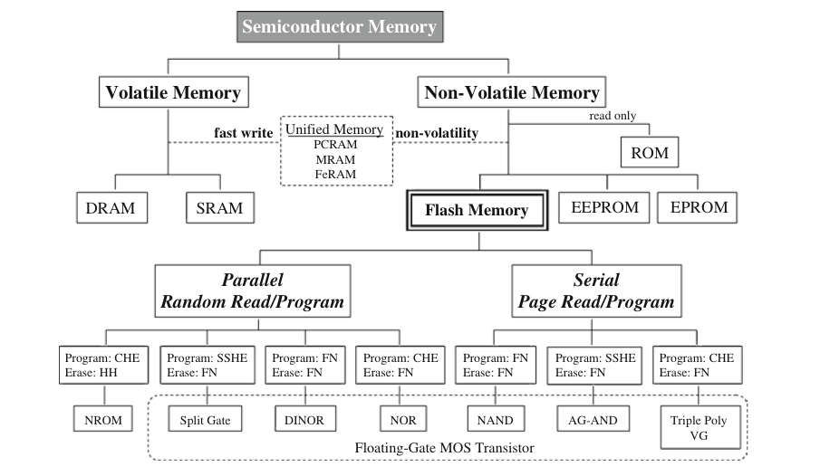
Semiconductor memory
1. Ogura, T. Flash Memory. CMOS Processors and Memories 2010, 197–232.

Slide 27
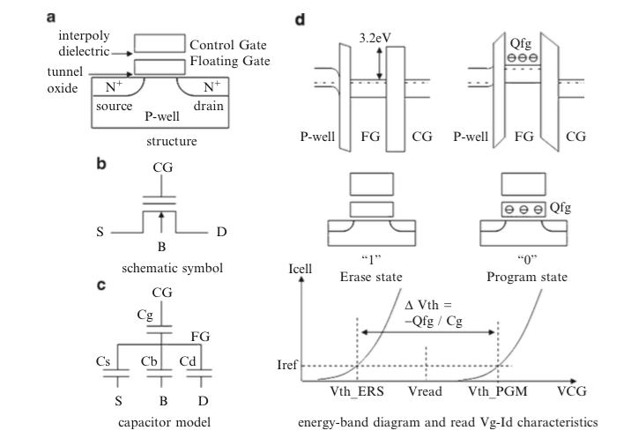
Flash memory
1. Ogura, T. Flash Memory. CMOS Processors and Memories 2010, 197–232.

Slide 28
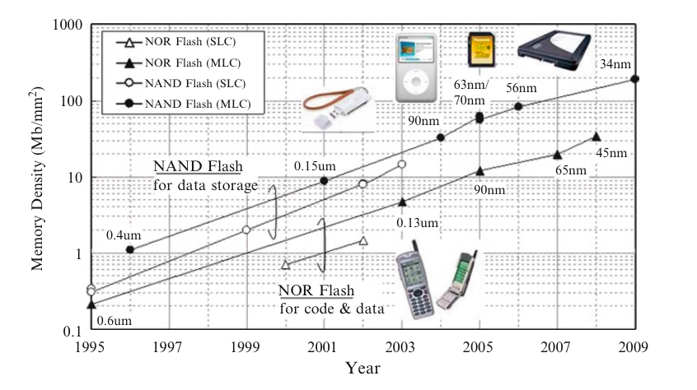
Flash Memory
1. Ogura, T. Flash Memory. CMOS Processors and Memories 2010, 197–232.

Slide 29
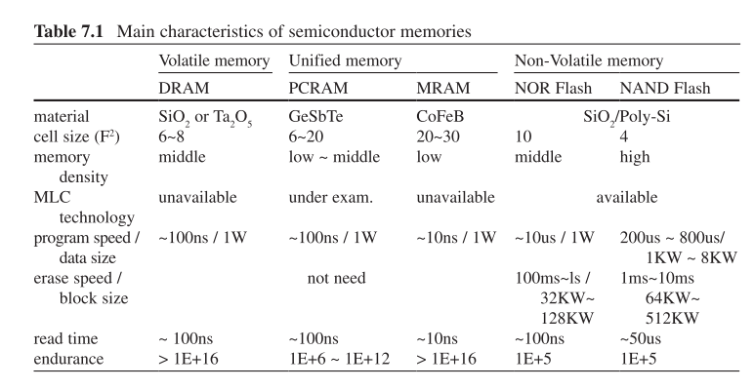
Flash memory
1. Ogura, T. Flash Memory. CMOS Processors and Memories 2010, 197–232.

Slide 30
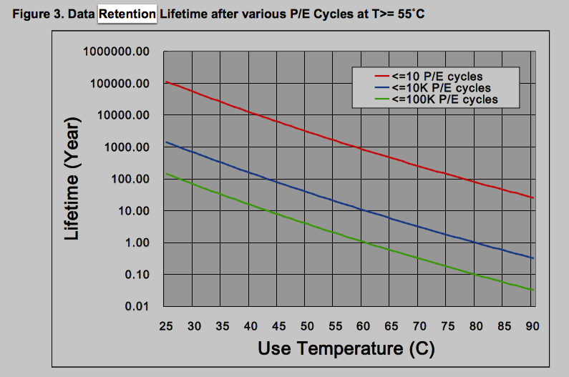
Data retention
http://www.macronix.com/Lists/ApplicationNote/Attachments/750/AN0291V2-ProgramErase%20Cycling%20Endurance%20and%20Data%20Retention%20in%20NOR%20Flash%20Memories.pdf

Slide 31
Example Capacitor Problem #2
Find V(t), q(t)
I(t)=I₀cos(ωt)
+
C
V
-

Slide 32
Parallel Capacitors
?
i₁
i₂
i₃
i_{N}
=
i
C₁
C₂
C₃
C_{N}
i
C_{equivalent}

Slide 33
Series Capacitors
C₁
C₂
C₃
C_{N}
?
+
-
+
-
+
-
+
-
=
V₁
V₂
V₃
V_{N}
+
V
+
V
C_{equivalent}
-
-

Slide 34
Example problem #4
(Students) Find V(t), given that V(t=0) = 5 Volts
1 kΩ
+
1 μF
2 μF
V
4 kΩ
3 μF
-

Slide 35
Inductors
L
i
A=area
l=wire length
N = # of turns
μ = 4 π 10⁻⁶ H/m
+
-
V
Henry[H]
V

Slide 36
Series Inductors
L₁
L₂
L₃
?
+
-
+
-
+
-
=
V₁
V₂
V₃
+
V
+
V
L_{equivalent}
-
-

Slide 37
Parallel Inductors
?
i₁
i₂
i₃
i_{N}
=
+
L₁
L₂
L₃
L_{N}
+
V
V
L_{equivalent}
-
-

Slide 38
Example Inductor Problem
(Students): Find V(t).
L₁
+
V
-

Slide 39
Example Inductor Problem #2
V
(Students): Find i(t)
t
L₁
+
V
-

Slide 40
Example Inductor Problem #3
Find V(t)
L
+
I(t)=I₀cos(ωt)
V
-

Slide 41
LR circuit
Find V(t), i(t)
R
L₁
+
V
-

Slide 42
Example LR problem
(Students) Find V(t), given that V(t=0) = 5 Volts
+
1 kΩ
4 kΩ
1 μH
2 μH
V
3 μH
-

Slide 43
Power
I
I x V_{ab} = power
a
Watts [W] = Volt Amp [V-A]
Note: MKSA unit system: Meters Kilogram Second Amp
b
Resistor:
Energy lost to heat…
Inductor or capacitor:
Energy STORED and can be recovered…

Slide 44
Energy stored
I
I x V_{ab} = power
a
Energy:
b
Capacitor stored energy:
Inductor stored energy:

Slide 45
Symbol library
I_{ab}
I=5 A
a
+
+
a
+
a
-
b
b
-
-
b

Slide 46
Symbol library
+
+
2
-
-
+
C
-
i
+
-
V
i₇
i₇
i₇
2 Ω
3 V
3 A
3 i₁
2 i₁
+
+
-
-

