Slide 1
EECS 70A: Network Analysis
Announcements:
Announcement #1
Lecture 11

Slide 2
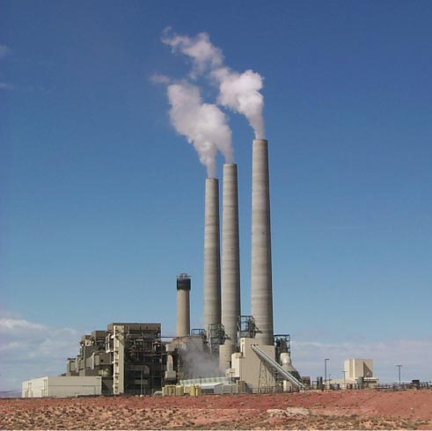
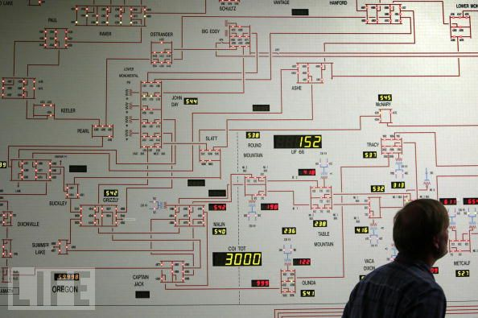
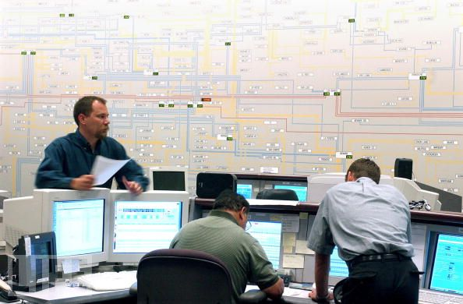
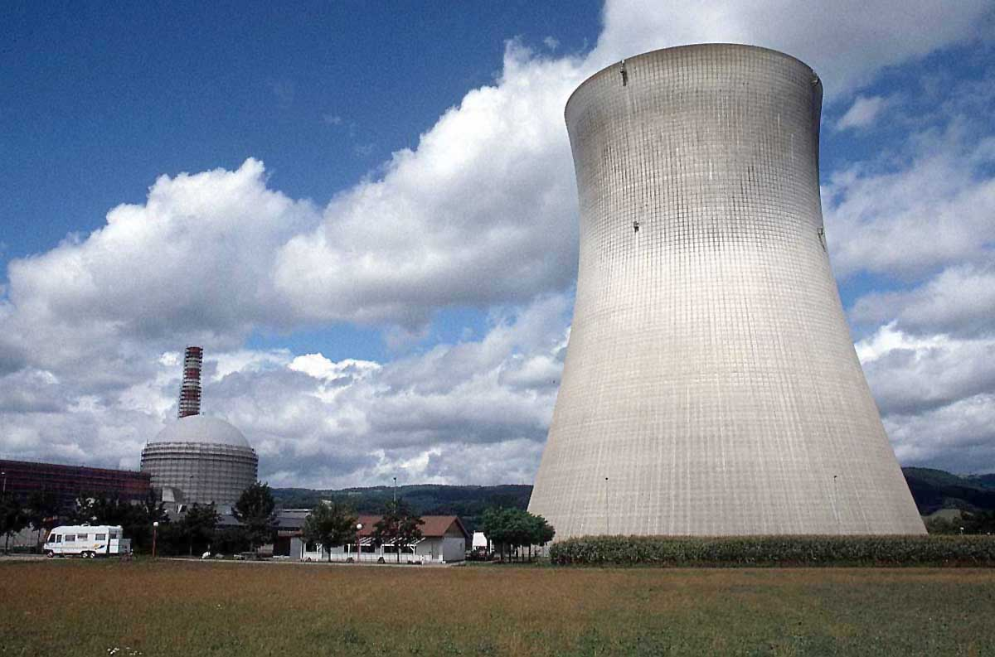
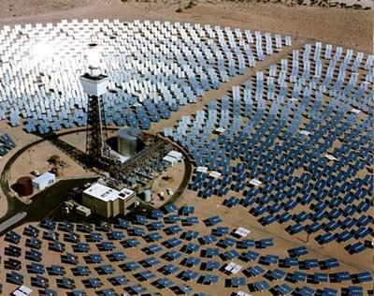

Slide 3




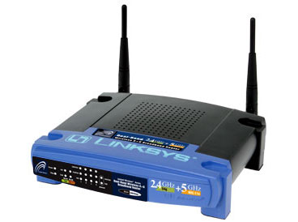
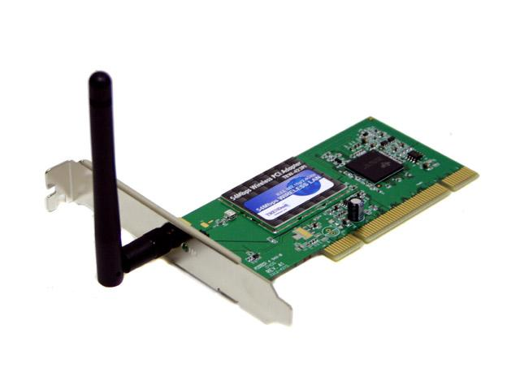
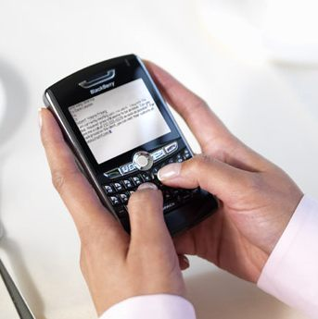
Wireless Communications
Broadcast Radio:
Telecom:
All use sine waves (phasors) as way to describe signals and circuits.
Internet:
3G data:

Slide 4
Frequency Allocations
http://www.ntia.doc.gov/osmhome/allochrt.PDF

Slide 5
Sine waves

Slide 6
Phase

Slide 7
Complex numbers
Imag
y
x
Real

Slide 8
Complex algebra
Addition:
Subtraction:
Multiplication:
Division:
Inversion:
Square root:
Complex conjugate:

Slide 9
Euler relationship
Phasors:
“Phasor”
V
(Complex #)

Slide 10
Phasors
“Voltage Phasor”
V
(Complex #)
“Current Phasor”
I

Slide 11
Circuits
V = I R
+
V=I/jωC
L
+
V=jωL I
R
C
V
V
-
-
“Impedance”
Z = R
Z=1/jωC
Z = jωL
Can think of this as a “generalized Ohm’s law for ac circuits”
KCL, KVL hold for relationship between V, I.

Slide 12
Series/Parallel Impedances
=
Z₁
Z₂
Z₃
Z_{eq}
Z _{eq}= Z ₁ +Z ₂ +Z ₃
Z₃
=
Z₁
Z_{eq}
Z₂
Z _{eq}⁻¹ = Z ₁⁻¹ +Z ₂⁻¹ +Z ₃⁻¹

Slide 13
Example problem #1
Find Z_{eq} for this circuit: (instructor)
R₂
R₁
L

Slide 14
Phasor to voltage conversion
Find V(t), q(t)
I(t)=I₀cos(ωt)
+
C
V
-

Slide 15
Phasor to voltage conversion
Find V(t), q(t)
Problem gives us:
I(t)=I₀cos(ωt)
Compare to definition of current phasor:
I(t)=I₀cos(ωt)
+
C
V
-
Find voltage phasor using generalized Ohm’s law:
V=I/jωC
Find v(t) from voltage phasor:

Slide 16
Example phasor problem
Find i(t0
V(t)=3 cos(ωt+30)
+
C
V
-

Slide 17
Example problem #2
Find Z_{eq} for this circuit: (students)
C
R₁
R₂

Slide 18
Example problem #3
Find i(t), V₁(t), V₂(t) for this circuit: (instructor)
+
C
V₁
-
V(t)=V₀ cos(ωt)
+
V₂
R
-

Slide 19
Example problem #4
Find i(t), V₁(t), V₂(t) for this circuit: (students)
+
V₁
R
-
I(t)=I₀ cos(ωt)
L
+
V₂
-

Slide 20
Low pass filter
R
INPUT:
V(t)=V₀ cos(ωt)
a
+
OUTPUT:
V_{ab}(t)
C
-
b

Slide 21
High pass filter
+
C
V₁
-
INPUT:
V(t)=V₀ cos(ωt)
a
+
+
OUTPUT:
V_{ab}(t)
V₂
R
-
-
b

Slide 22
Band pass filter (RLC)
+
C
V₁
-
INPUT:
V(t)=V₀ cos(ωt)
a
+
+
OUTPUT:
V_{ab}(t)
V₂
R
-
-
b

Slide 23
Symbol library
I_{ab}
I=5 A
a
+
+
a
+
a
-
b
b
-
-
b

Slide 24
Symbol library
+
+
2
-
-
+
C
-
i
+
-
V
i₇
i₇
i₇
2 Ω
3 V
3 A
3 i₁
2 i₁
+
+
-
-

