Slide 1
EECS 70A: Network Analysis
Announcements:
Midterm #2 will be FRIDAY May 25 2018
Lecture 11

Slide 2
Complex numbers
z = 4 + 3 j
Re(z) = ?
Im(z) = ?
Express z in polar form i.e. as

Slide 3
Complex numbers
z = 3 -5 j
Re(z) = ?
Im(z) = ?
Express z in polar form i.e. as

Slide 4
https://commons.wikimedia.org/wiki/File:Sine.svg
https://commons.wikimedia.org/wiki/File:Cosine.svg

Slide 5
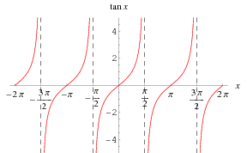
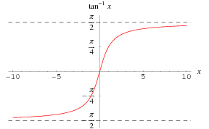

Slide 8
Complex numbers
Imag
y
x
Real

Slide 10
Exam cheat sheet
This will be provided with the exam.

Slide 11
Conversion procedures
i(t)
I
I =
v(t)
V
V =
I
i(t)
I
V
v(t)
V
For the exam, you should know how to carry out these procedures.

Slide 12
Phasors
“Voltage Phasor”
V
(Complex #)
“Current Phasor”
I

Slide 13
Conversion procedures
Given i(t) find v(t):
i(t)
i(t)
I
V = I Z_{eq}
v(t)
+
Z_{eq}
v(t)
Given v(t) find i(t):
-
v(t)
V
I = V/ Z_{eq}
i(t)
For the exam, you should know how to carry out these procedures.

Slide 14
Circuits
V = I R
+
V=I/jωC
L
+
V=jωL I
R
C
V
V
-
-
“Impedance”
Z = R
Z=1/jωC
Z = jωL
Can think of this as a “generalized Ohm’s law for ac circuits”
KCL, KVL hold for relationship between V, I.

Slide 15
Series/Parallel Impedances
=
Z₁
Z₂
Z₃
Z_{eq}
Z _{eq}= Z ₁ +Z ₂ +Z ₃
Z₃
=
Z₁
Z_{eq}
Z₂
Z _{eq}⁻¹ = Z ₁⁻¹ +Z ₂⁻¹ +Z ₃⁻¹

Slide 16
Resistor
Find i(t)
v(t)=v₀cos(ωt+φ)
R

Slide 18
Capacitor
Find i(t)
v(t)=v₀cos(ωt+φ)
C

Slide 20
Inductor
Find i(t)
v(t)=v₀cos(ωt+φ)
L

Slide 22
General
Find i(t)
v(t)=v₀cos(ωt+φ)
Z

Slide 23
Example problem
Find i(t), V₁(t), V₂(t) for this circuit: f = 2 MHz
+
(250/3.14) nF
V₁
-
V(t)=3 cos(ωt+45 degrees) volts
+
2 Ω
V₂
-

