Slide 1
EECS 70A: Network Analysis
Lecture 1

Slide 2
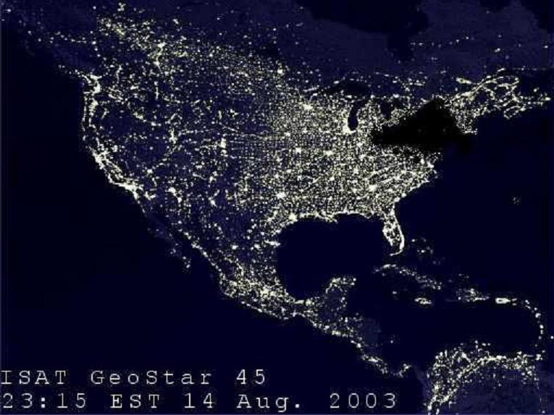
Northeast Blackout 2003
What:
256 power plants down
55 million people affected
How did this happen?

Slide 3
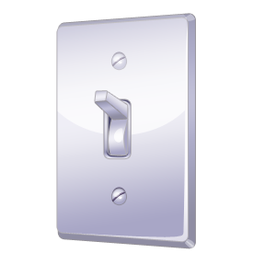
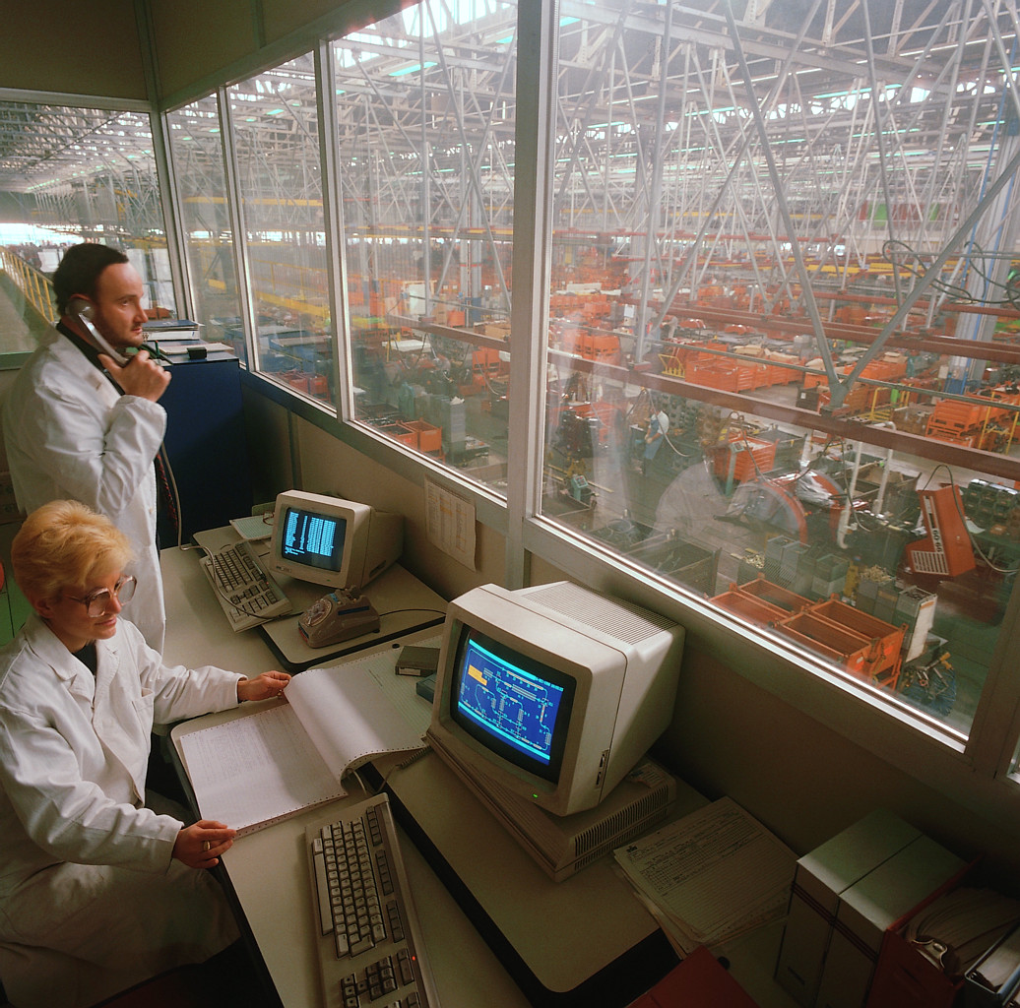
Power Networks
How much power used?
How do we quantify power?
What if someone turns on one light?

Slide 4
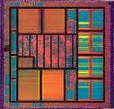
Digital circuits
How do we understand what every transistor is doing?
There are hundreds of millions…

Slide 5
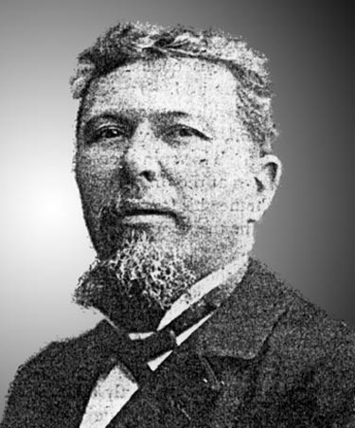
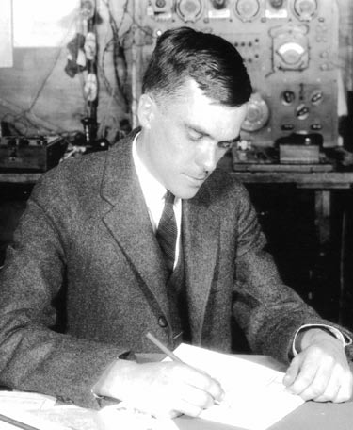
Simplifications
Leon Charles Thevenin
1857–1926
Edward Lawry Norton
1898–1983
Ultimate problem solvers: Take a complex system, break it into its component parts:
Network analysis

Slide 6
Current
Charge of an electron:
e = -1.6 x 10⁻¹⁹ Coulomb [C]
Current is flow of charge.
In a wire, charges are free electrons.
i = dq/dt
i
Amperes [A] = Coulombs/second [C]/[s]

Slide 8
Examples
1 electron per second flows past a plane.
What is the current? (instructor)
10 A of current flows.
How many electrons per second flow past a plane? (students)

Slide 9
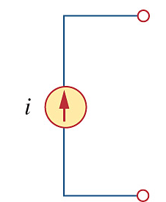
Demo circuit: Current source
i
i
Our first circuit element:
Current source

Slide 10
Voltage
Physically, how do we get electrons to move? Apply a force.
a
b
CIRCUIT
V_{ab} ≠ 0 => electrons pushed a to b, causing current to flow
E electric field: Volts/meter [V/m]
V voltage (aka potential difference): Volts [V]

Slide 11
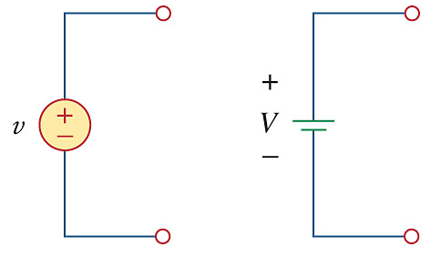
Voltage source
Our next circuit element:
Voltage source
Makes V_{ab} constant, regardless of how much current flows through it.

Slide 12
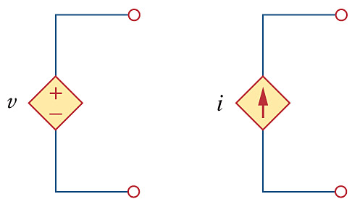
Dependent sources
Value of voltage is determined by something somewhere else in circuit.
Value of current is determined by something somewhere else in circuit.

Slide 13
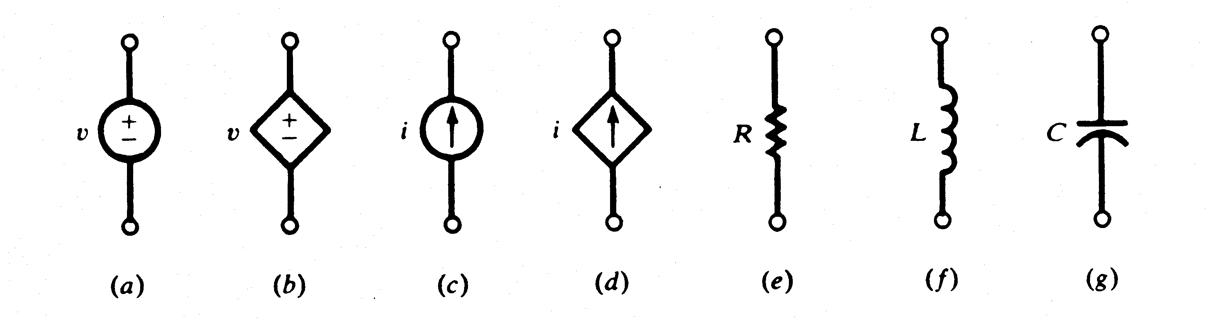
Circuit elements
A dependent source is an active element in which the source quantity is controlled by another voltage or current.
They have four different types: VCVS, CCVS, VCCS, CCCS. Keep in minds the signs of dependent sources.
Independent
sources
Dependent
sources

Slide 14
Power
I
I x V_{ab} = power
a
Watts [W] = Volt Amp [V-A]
Note: MKSA unit system:
Meters Kilogram Second Amp
b

Slide 15
Examples
I=1A
a
V_{ab} = 100 Volts
P = ?
(instructor)
b
I=5A
a
P = 10 W
V_{ab} = ?
b
(students)

Slide 17
Bitcoin

Slide 18
Sign convention
I_{ab}
V_{ab} positive => V_{a} > V_{b}
I_{ab} positive => current flows from a to b
a
+
V_{ab} negative => V_{a} < V_{b}
I_{ab} negative => current flows from b to a
b
-
Define convention first, then solve problem.
P > 0 means power flowing into element (e.g. resistor)
P < 0 means power flowing out of element (e.g. battery)

Slide 19
Example
V = 120 V @ socket (assume DC).
Cost of electricity is 10 cents/kW-h
Day nothing, night 10 light bulbs on (100 W bulbs) for 1 hr.
What is monthly electric bill?
(instructor)

Slide 20
Topology
i₂
i₁=i₂+i₃
i₁
i₃
Like water in a river…
V
V
Voltage same everywhere….
Concept of a node
V

Slide 21
Example
I₃
I₃ = ?
V_{element 1} = ?
V_{element 2} = ?
Power supplied by source =?
10 V
+
I₁=2 A
I₂=3 A
-
1
2
(instructor)

Slide 22
Example
I_{total}
120 V
I₁
I₂
I₃
+
-
1
2
3
(student)
Three light bulbs (100 W each) on 1 hour/night. 120 V @ socket.
What is I per bulb?
What is I_{total} from supply?
What is bill?

Slide 23
Power failure example
I_{total}
120 V
I₁
I₂
I₃
I_{N}
+
-
1
2
3
N
Generator will fail of power required > 1 MW
How many light bulbs need to be turned on to damage the generator?

